Slide 1
Part II

Slide 2
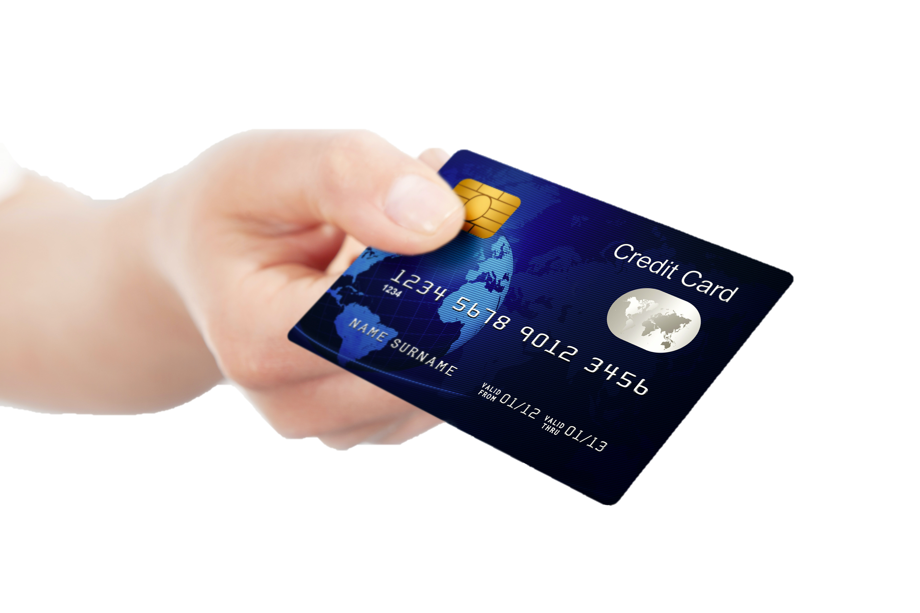
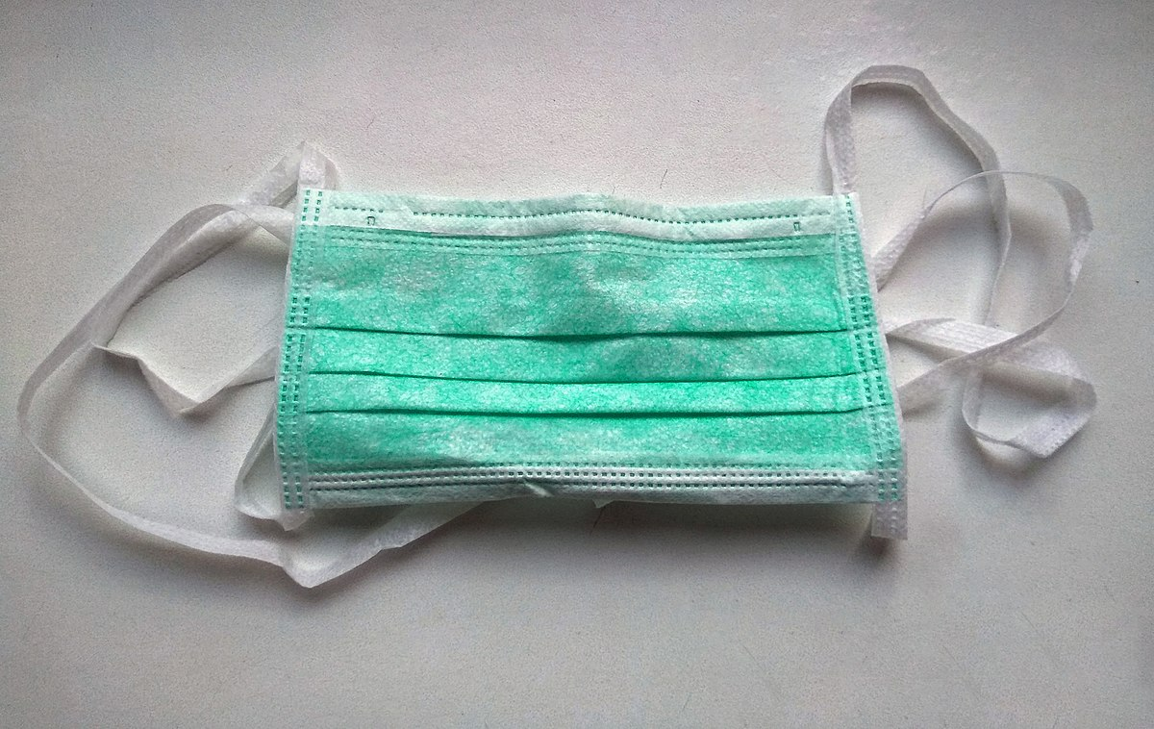
Credit insurance
Other protection products
Product warrantees
Identity theft

Slide 3
Side Bar: Identity Theft
What is it?
How does it happen?
Can it be prevented?
Can it be insured?
Identity theft

Slide 4
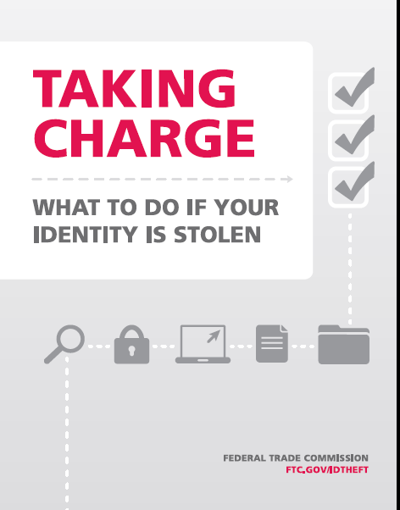
Side Bar: Identity Theft
If you are a victim:
File a police report
Fraud alerts to credit bureaus and ChexSystem
Close any account that were, or you suspect were affected
1-877-ID-THEFT (438-4338) or online at www.ftc.gov/idtheft
Identity theft

Slide 5
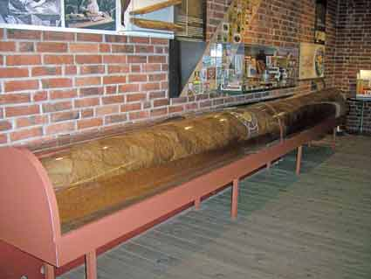
Insure This?

Slide 6
The Cost of Transferring Risk
Premiums – “price of protection”
Deductibles – “you go first”
Co-payments – “pay per view”
Co-insurance – “your ‘fare’ share”
Annual policy fees – “more please”
Premium sales charge – “take a chance”
Surrender charge – “exit fee”
Waiting period – “no so fast”

Slide 7
What is important to know about my insurance policies?

Slide 8
Know Your Policies
What perils (events) causing loss or damage to what property are covered?
What injuries are covered and on whom?
How do I file a claim?
How much is paid and who will receive payment?
How can I control possible losses and policy costs?

Slide 9
Continue to Part III

