Slide 1
Part III

Slide 2
How do I choose which investments are right for me?

Slide 3
How to Choose

Slide 4
Investing Considerations
What do you expect from this asset?
Guaranteed value (safe principal)
Cash payments/income (interest or dividends)
Growth in value (sell for a profit)
Growth and income (a little bit of both)
Speculation (ok if you lose it all)

Slide 5
Investing Considerations
What is your time frame?
Short-term (within one year)
Medium-term (one to four years
Long-term (five years or more)

Slide 6
Investing Considerations
Market – “follow the leader”
Company – “one bad apple”
Liquidity – “get cash now”
Interest Rate –”price of money”
Diversity – “all eggs in one basket”
Longevity – “outliving your money”
Inflation – “worth less”

Slide 7
If You Invested $100 in 1990*
Standard and Poor’s Index (S&P 500)
$2,107
T-Bonds (10-year renewals)
$494
CD’s (six-month renewals)
$245
Inflation
$198
*CD’s, T-bonds, and S&P returns not adjusted for inflation.

Slide 8
Risk vs. Reward
RISK
Small Business
Collectibles
Stocks
Real Property
Bonds
Certificates of Deposit
Insured Savings
REWARD

Slide 9
Who Can Invest?

Slide 10
I’m not rich. How can I invest if I don’t have a lot of money?

Slide 11
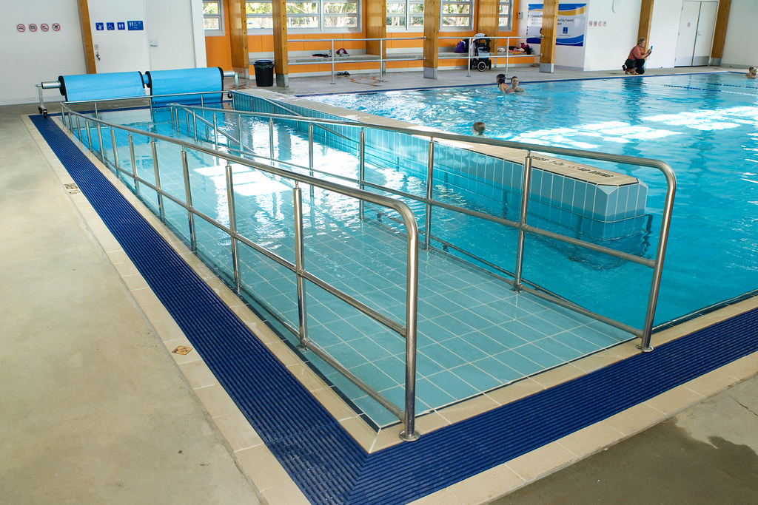
Accessible Investing
Employer retirement plans
PA 529 college savings plan
PA Achieving a Better Life Experience account (ABLE)
Dividend Reinvestment Plans (DRIPS)
Online trading platforms
Mutual fund companies (direct)
Traditional brokerage firms
Accessibility

Slide 12
Monitoring Ownership
What you have less what you owe!
Assets-Debts
JARGON ALERT!
Net Worth

Slide 13
Monitoring Ownership
Assets
Debts
Cash and cash-like
Cash on hand
Checking/savings
MMDA’s/CD’s
Financial assets
Stocks, bonds, mutual funds
Retirement accounts
Real property (house/land)
Small business
Personal property
Automobiles
Home furnishings/clothing
Appliances/electronics
Jewelry, antiques, etc.
Secured debt
Mortgage loan
Automobile loan
Unsecured debt
Past-due bills
Credit card
Personal loan
Garnishments
Child support
Taxes
Student loans

Slide 14
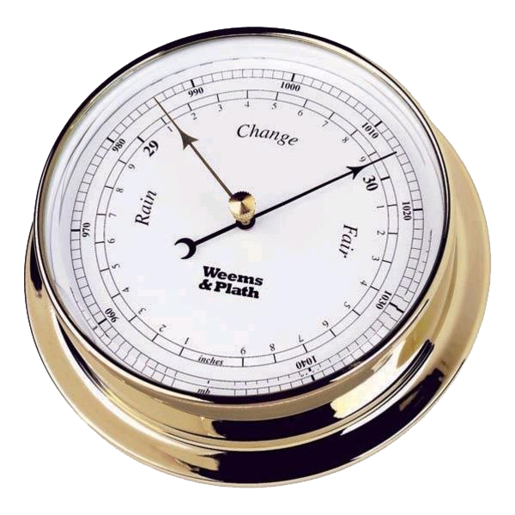
Monitoring Ownership
What’s your number?
Barometer for progress
Measure of “wealth”
Can be positive or negative
Calculate at least once every year
Net Worth

Slide 16
Working vs. Wealth
Saving vs. Investing
Time Value of Money
Types of Assets, Uses, Risk, and Costs
Net Worth
Investing Strategies and Accessibility
Recap
Notes:
Today we’re going to talk about:
Money values and setting financial goals
Creating a Money Map
Making good financial choices
Knowing how your cash flows

Slide 17
Pay yourself first
Save early, save often, and reinvest
Assess and asset’s use, expectations, pros, and cons when making an investing choice
Investigate existing opportunities to invest
Calculate net worth and monitor ownerships

Slide 18
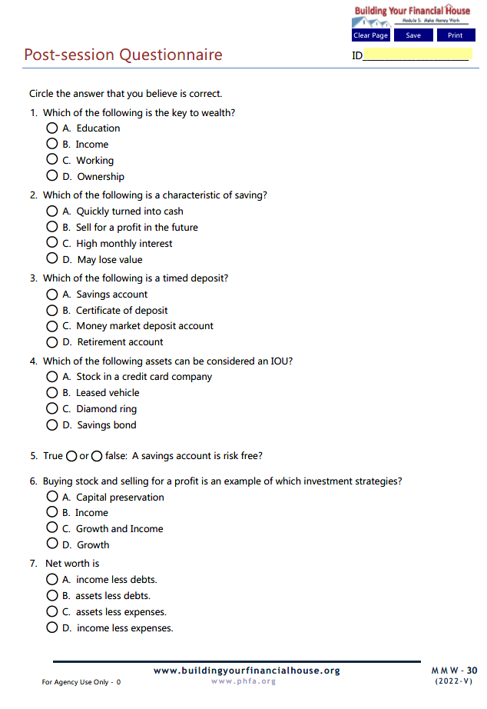
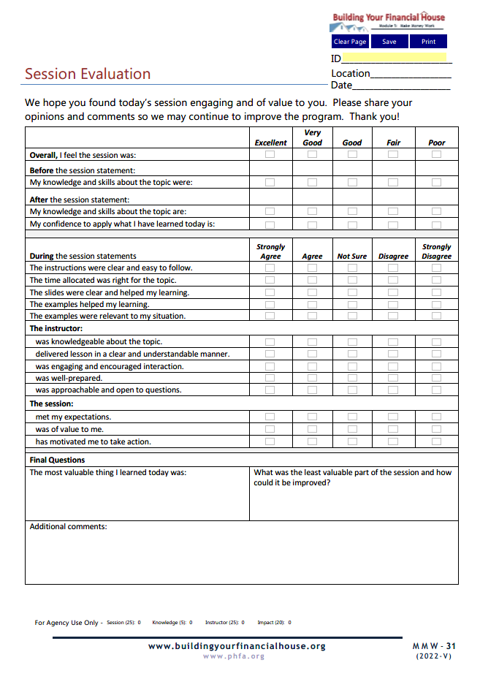
Complete Today

Slide 19
Email the Post-Session Questionnaire and the Session Evaluation to:

Slide 20
Now, it’s your turn!
Note: For best results, view in Adobe Reader DC or Nuance.

Slide 21
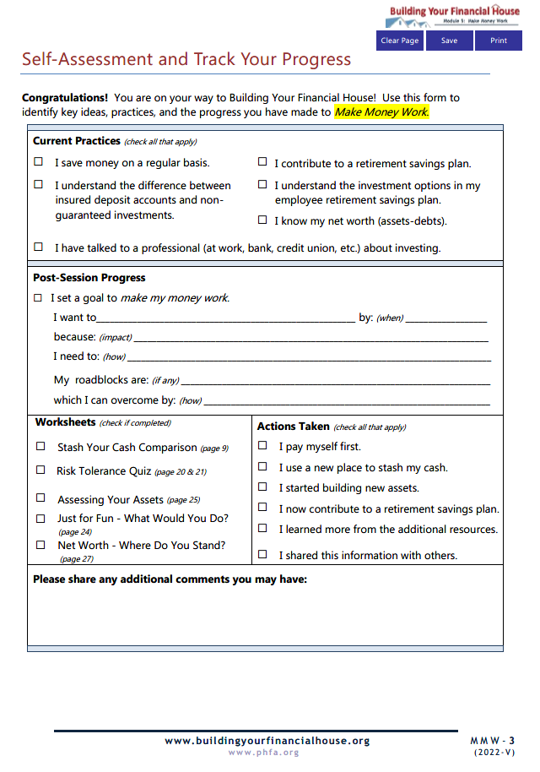
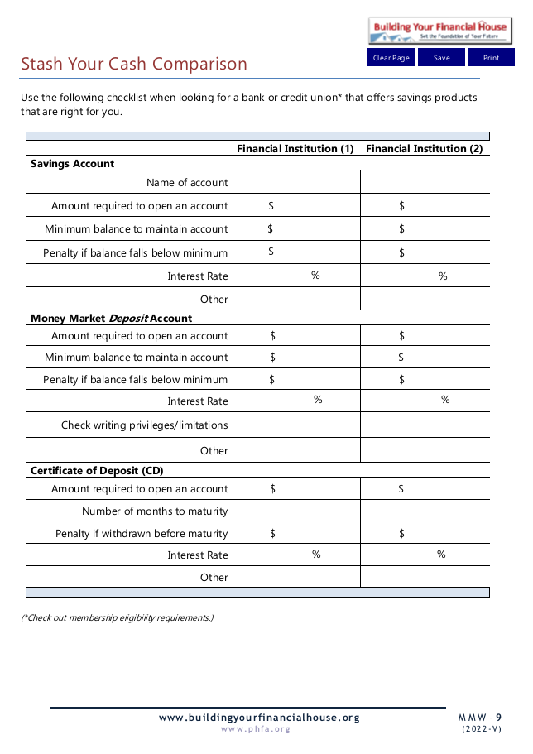
Homework

Slide 22
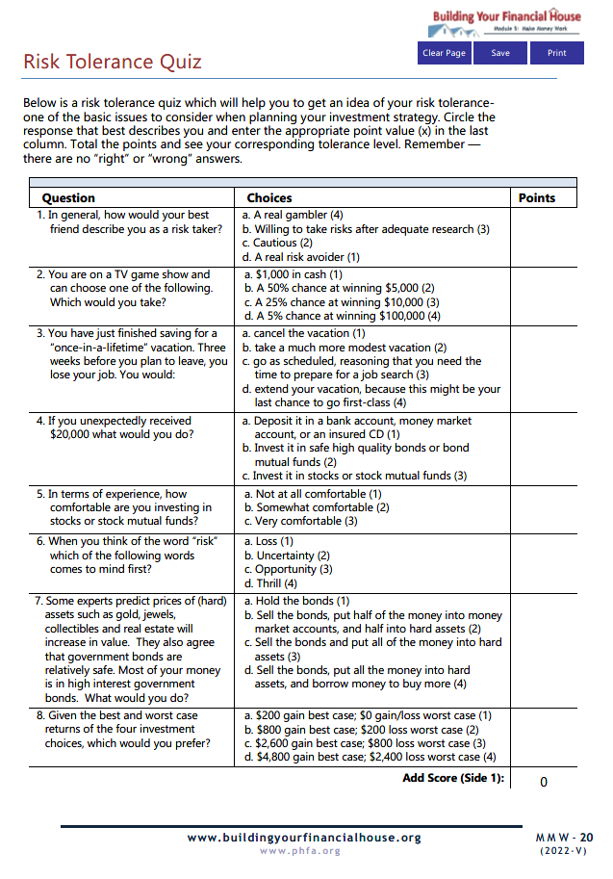
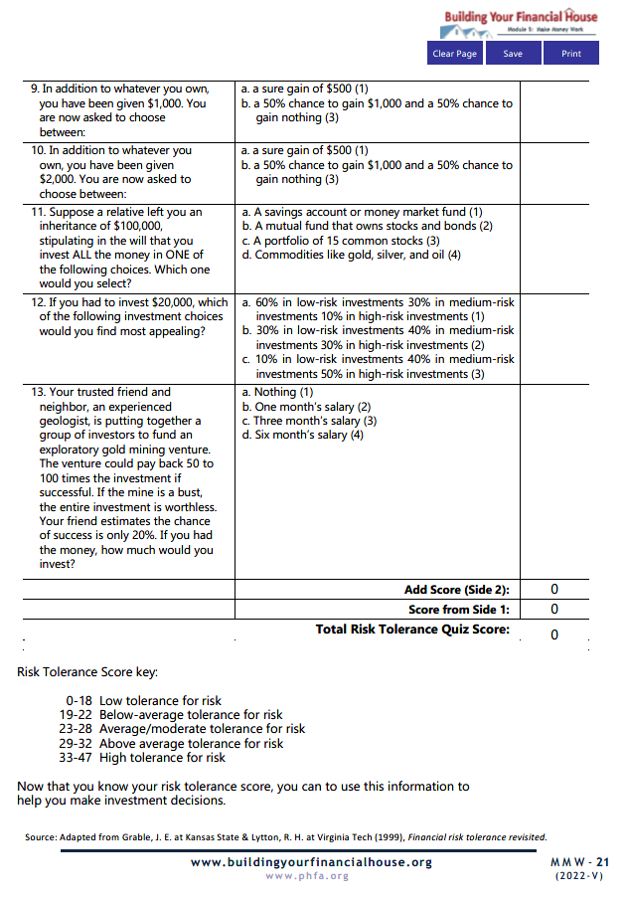

Slide 23
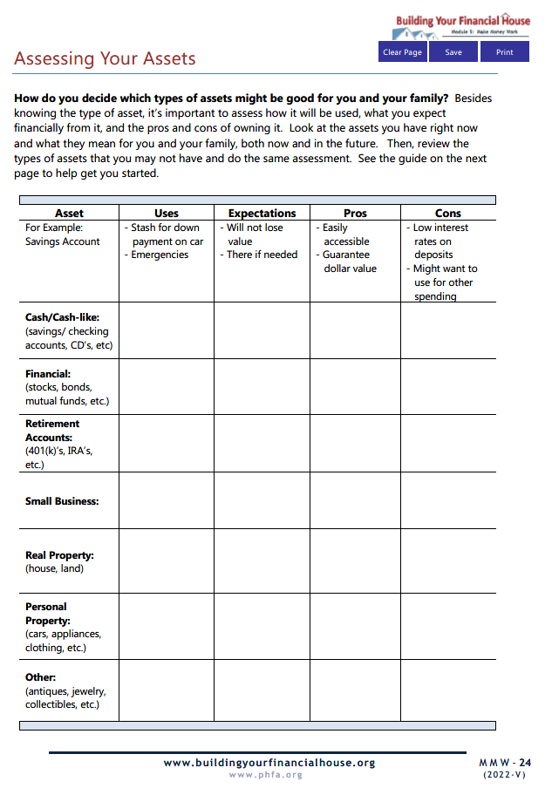
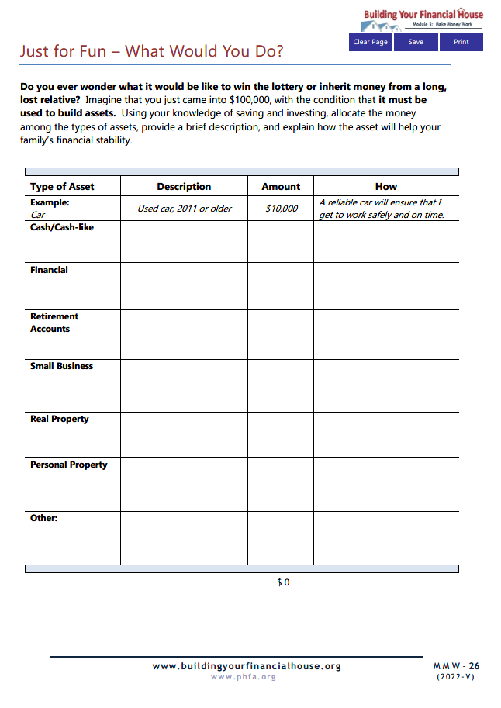

Slide 24
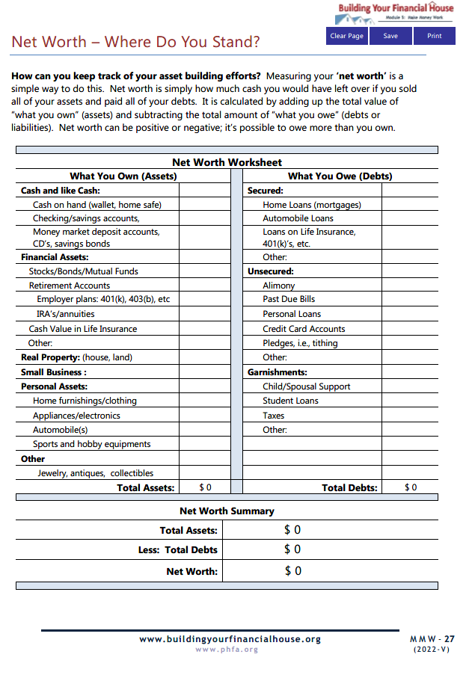

Slide 25
PRIOR TO NEXT SESSION,
email completed homework to:

Slide 26
Next Time:
Protect Your Potential

Slide 27
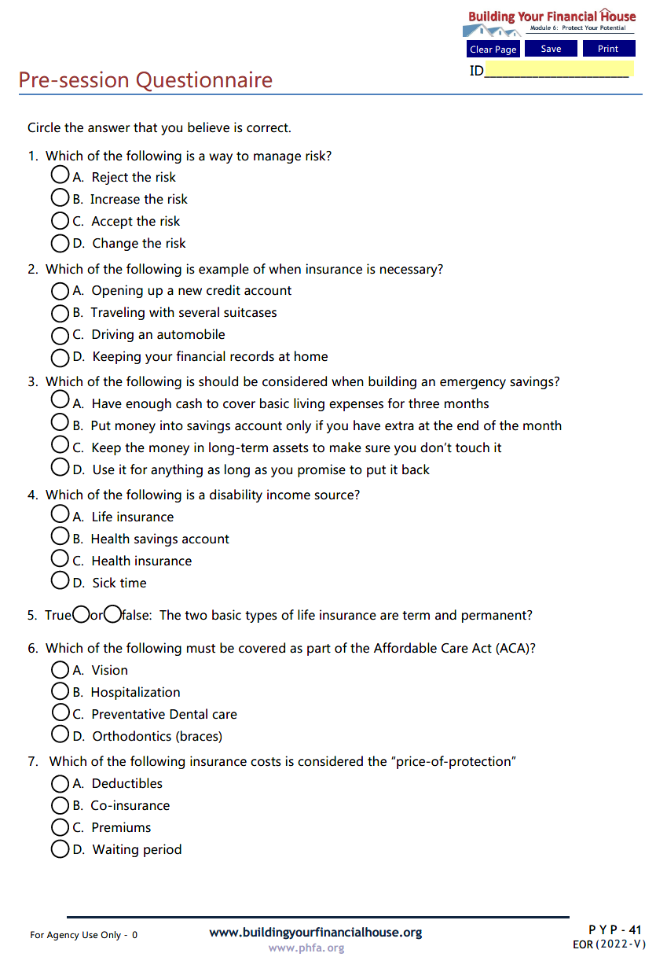
Protect Your Potential Pre-Session Questionnaire
Email Spend Sensibly Pre-Session Questionnaire to:

Slide 28
Questions?

Slide 29
Thank You!

