Slide 2
Building Your Financial House
WELCOME
Notes:
Good afternoon everyone!
Thank you for joining us as we discuss Creating a Financial Resource Center on-site, at you development or agency.
We hope this presentation will help you bring vetted, unbiased financial education resources to your residents or clients that they can use right now.
So let’s get started.

Slide 3
Housekeeping
Please mute your phone or computer to eliminate background noise.
To maximize bandwidth:
(Turn camera off)
Close unused apps or webpages
Please raise hand or use chat feature for questions.
Notes:
Good afternoon everyone!
Thank you for joining us as we discuss Creating a Financial Resource Center on-site, at you development or agency.
We hope this presentation will help you bring vetted, unbiased financial education resources to your residents or clients that they can use right now.
So let’s get started.

Slide 4
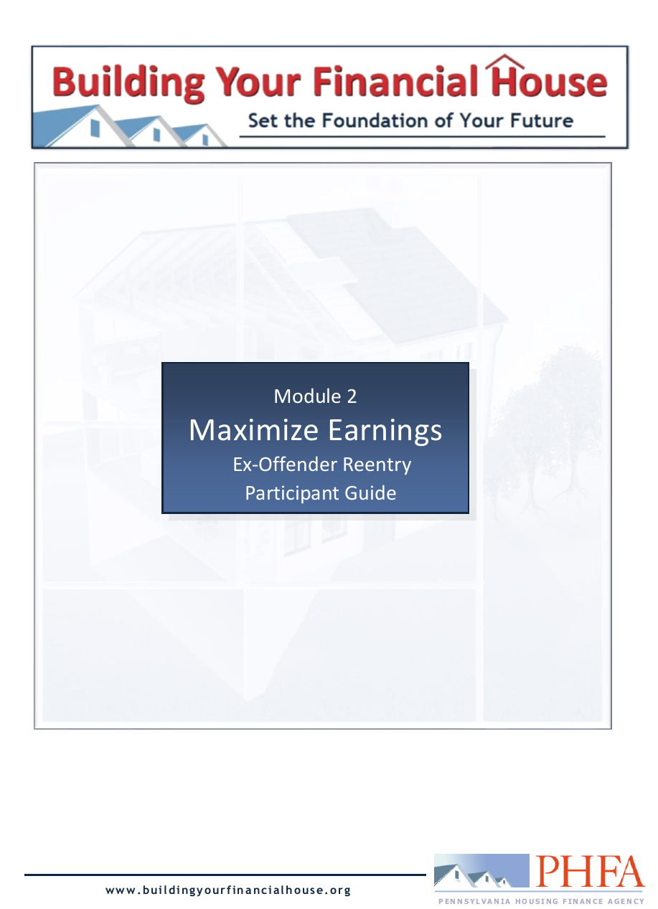
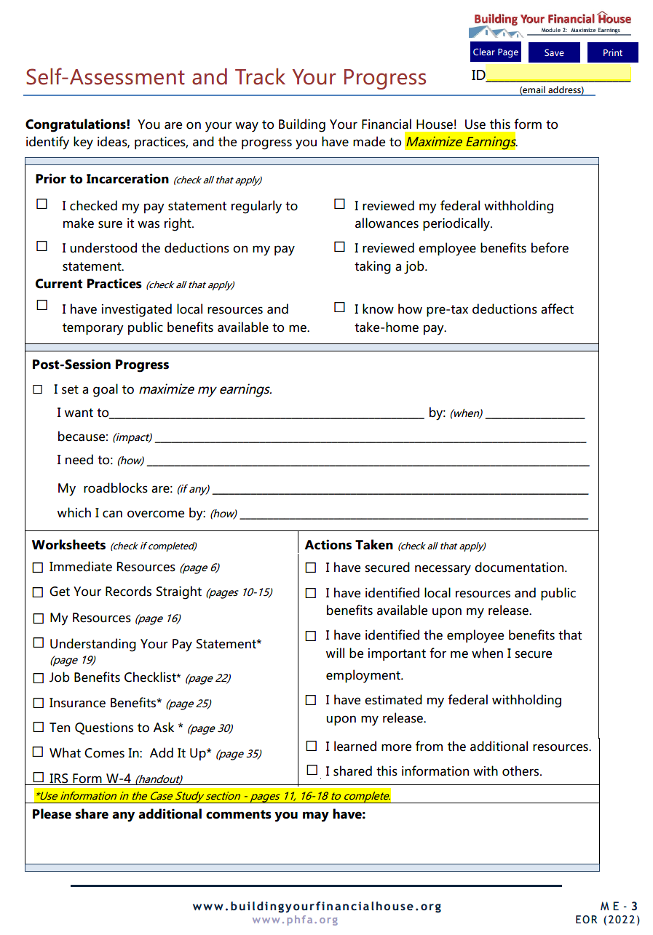
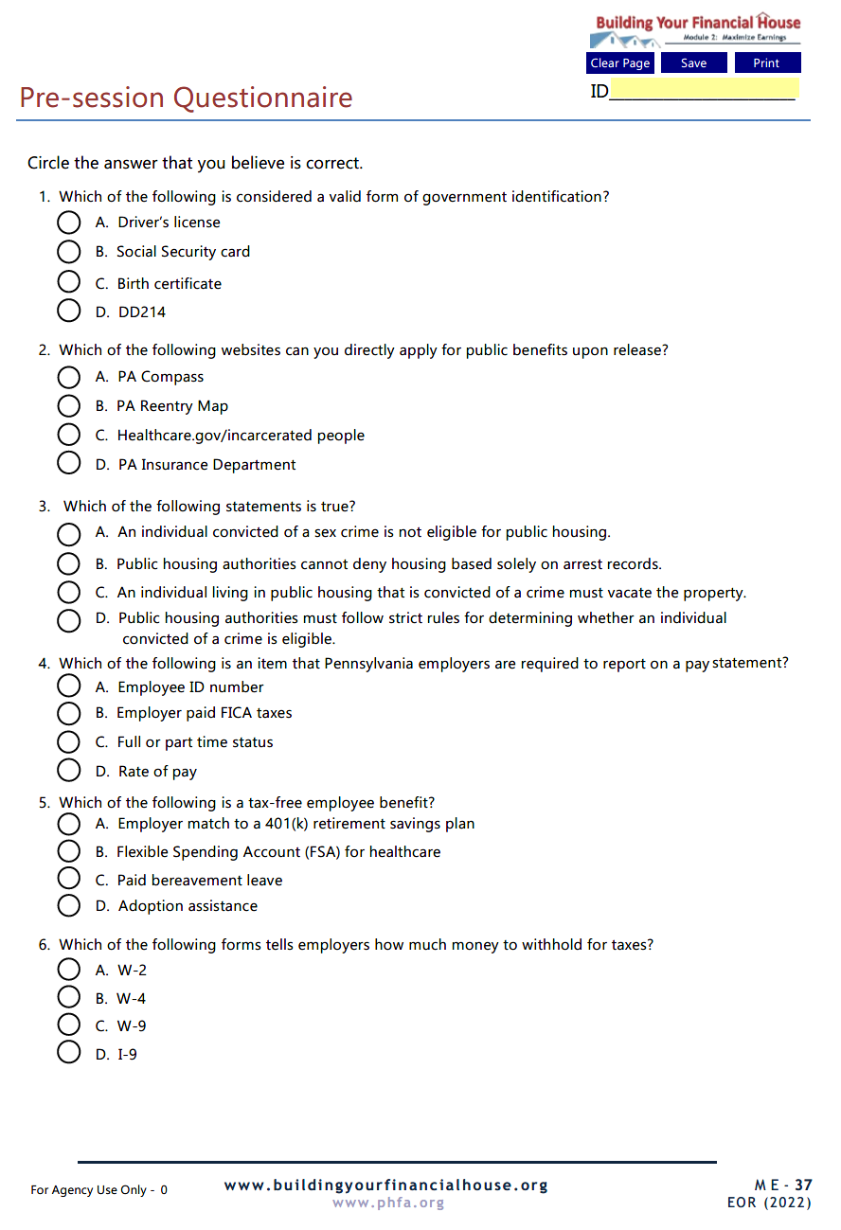
Prior to Today’s Session

Slide 5
Today’s Topics
Immediate Resources Upon Release
Documents and Reports About You
Understanding Pay Statements
Choosing Employee Benefits
Net Economic Benefits of a Job
The Power of Pre-tax

Slide 6
6
Protect Your Potential
5
Make Money Work
4
Check Taxes
3
Spend Sensibly
7
Borrow to Grow
2
Maximize Earnings
1
Invest in Yourself

Slide 7
The walls represent earnings, built up from the foundation, and maximized by utilizing all available resources, directing payroll deductions, and choosing the right employee benefits.
2
Maximize Earnings

Slide 8
Identify documentation that will be necessary upon release
Be familiar with what is being reported about you
Identify your potential cash and non-cash sources of income
Recognize the difference between gross and net pay
Become familiar with employer provided benefits
Recognize the actual dollar value of pre-tax benefits
Identify factors which affect the net economic benefit of a job

Slide 9
Take your reentry seriously; the difference between success and failure is a choice.
Ask for help; there are many resources available to you.
Work hard, stay focused, and don’t be distracted by the nay-sayers.
Have realistic expectations.
Stay flexible and be patient; the first steps you make are only transitions to something better.
Do whatever it takes, including getting right with yourself and being in the right place with the right people.
Destination:
Successful Reentry

Slide 10
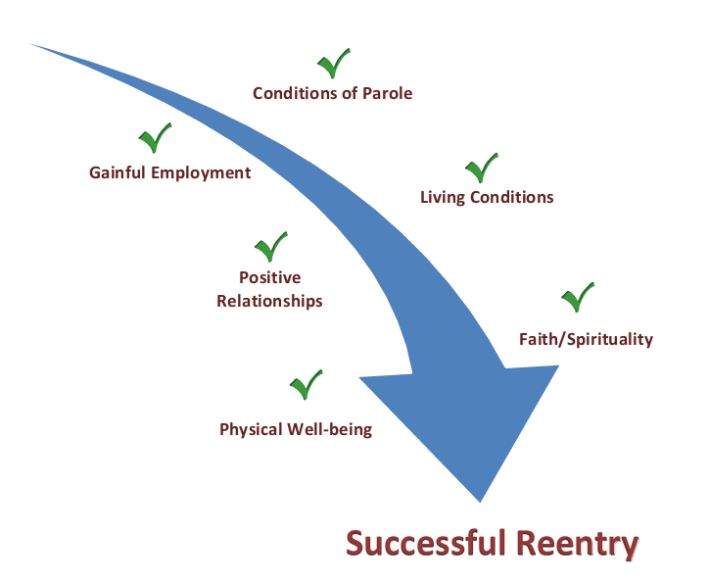
Path to Successful Reentry

Slide 11
What will you need when you walk out the door?

Slide 12
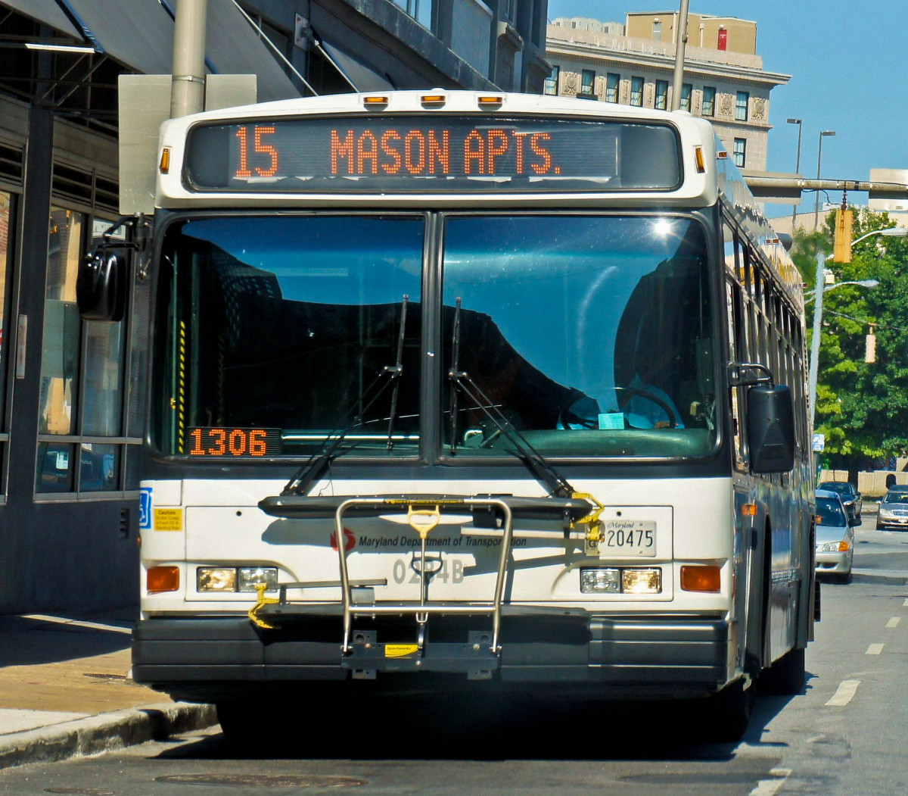
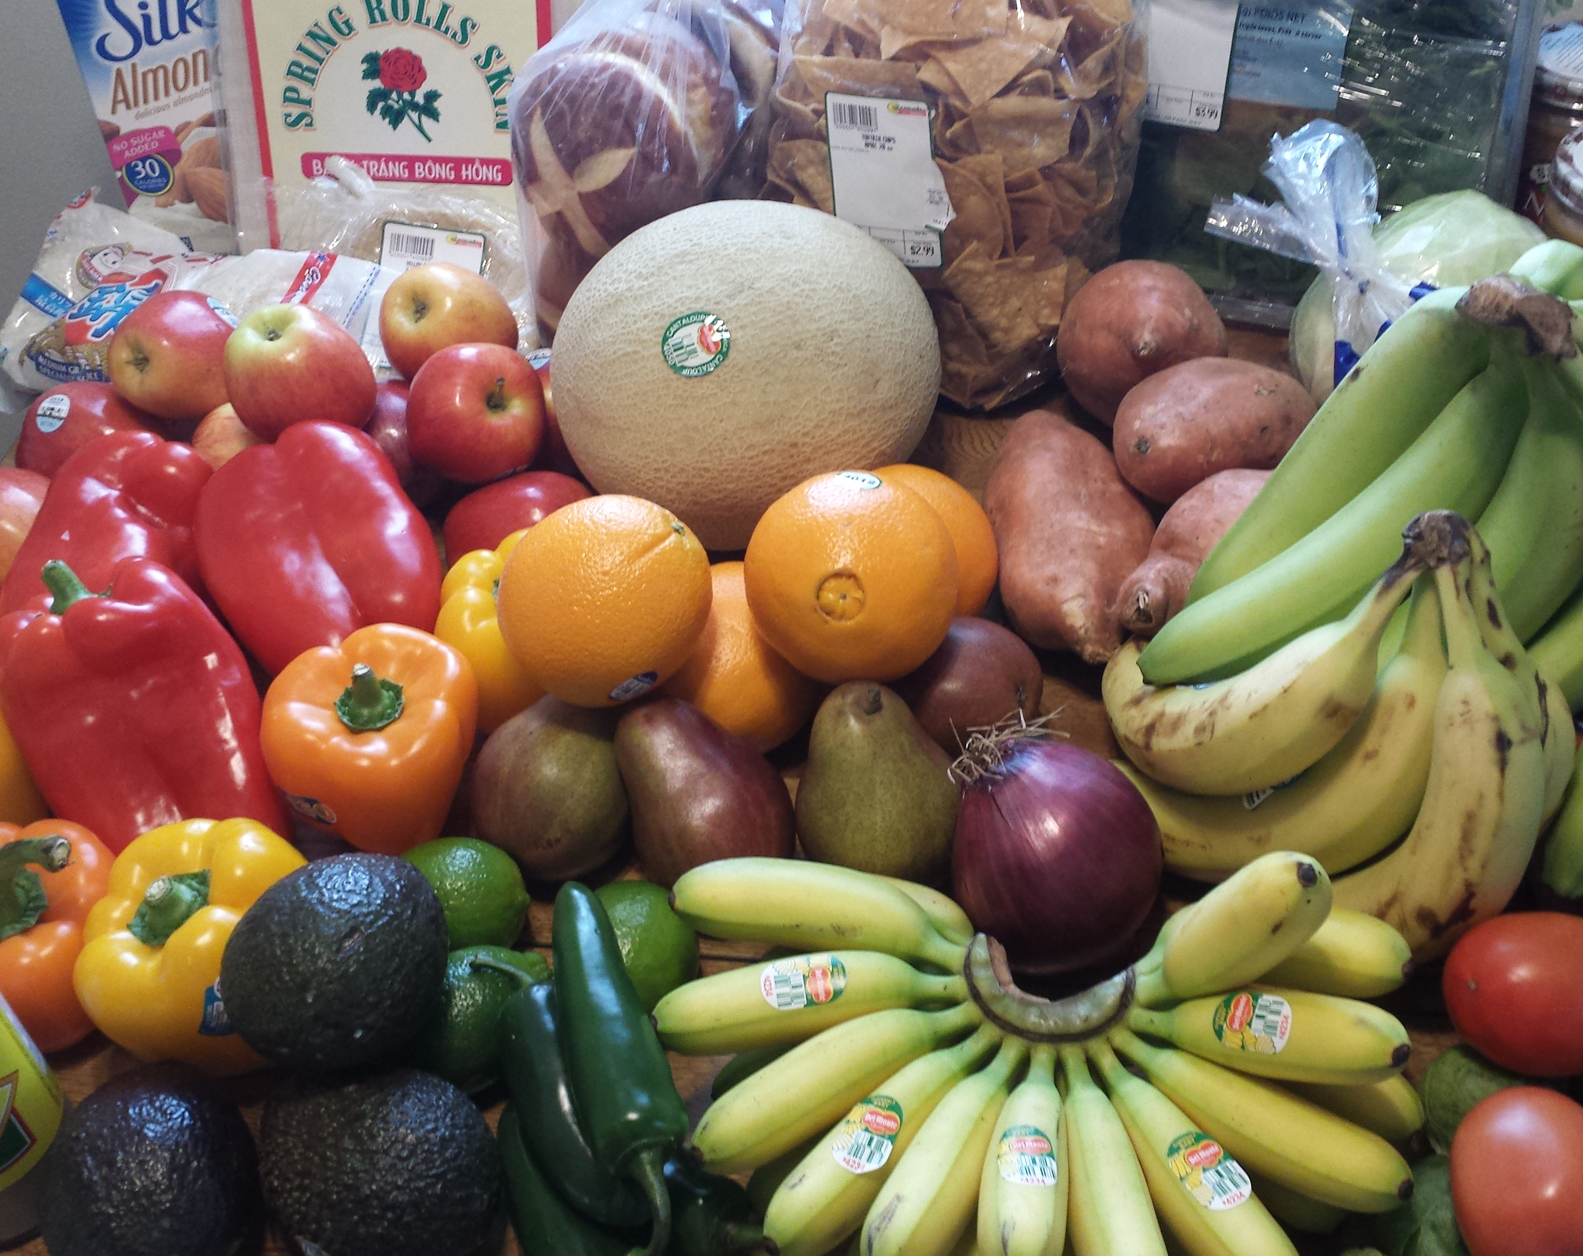
Health
Transportation
Clothing
Housing
Food
Conditions of Parole

Slide 13
Short-Term Resources
www.compass.state.pa.us

Slide 14
PA Reentry Map

Slide 15
Continue to Part II

