Slide 2
Building Your Financial House
WELCOME
Notes:
Good afternoon everyone!
Thank you for joining us as we discuss Creating a Financial Resource Center on-site, at you development or agency.
We hope this presentation will help you bring vetted, unbiased financial education resources to your residents or clients that they can use right now.
So let’s get started.

Slide 3
Housekeeping
Please mute your phone or computer to eliminate background noise.
To maximize bandwidth:
(Turn camera off)
Close unused apps or webpages
Please raise hand or use chat feature for questions.
Notes:
Good afternoon everyone!
Thank you for joining us as we discuss Creating a Financial Resource Center on-site, at you development or agency.
We hope this presentation will help you bring vetted, unbiased financial education resources to your residents or clients that they can use right now.
So let’s get started.

Slide 4
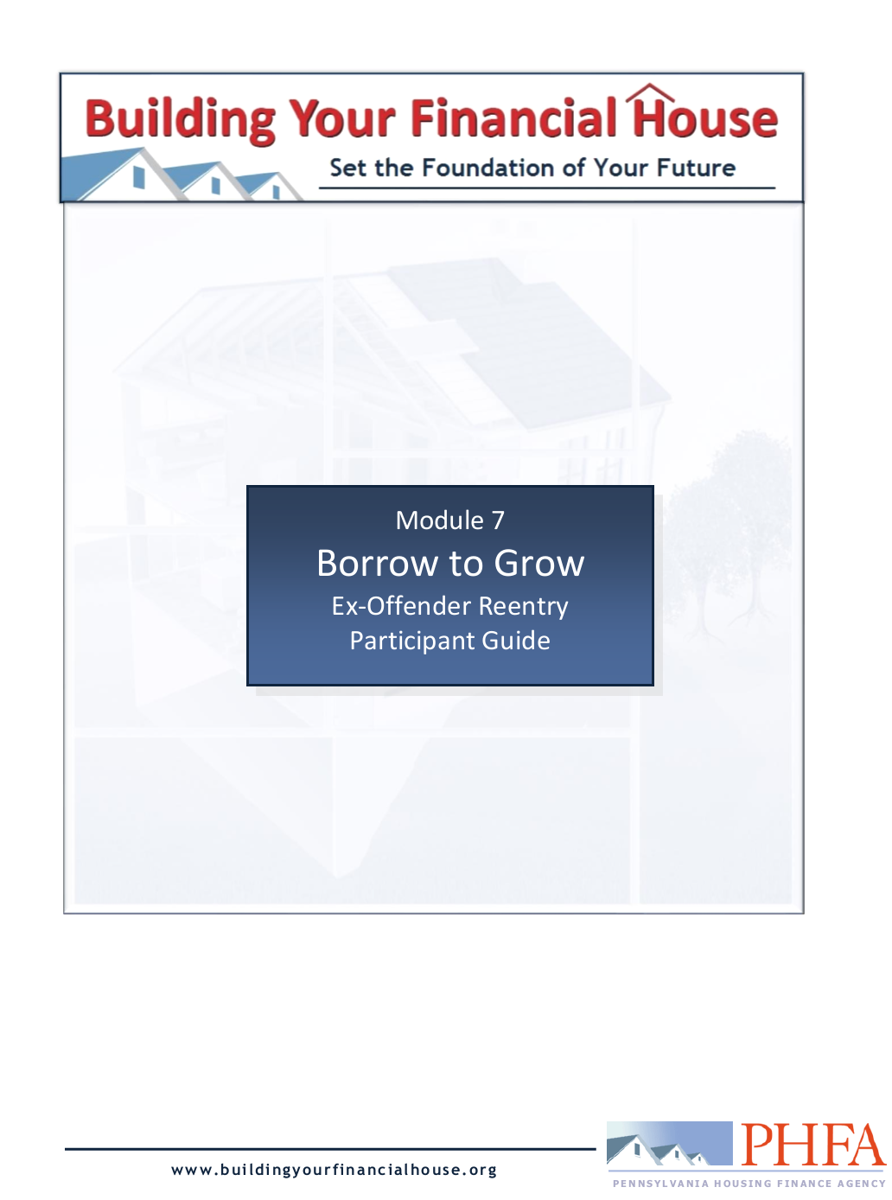
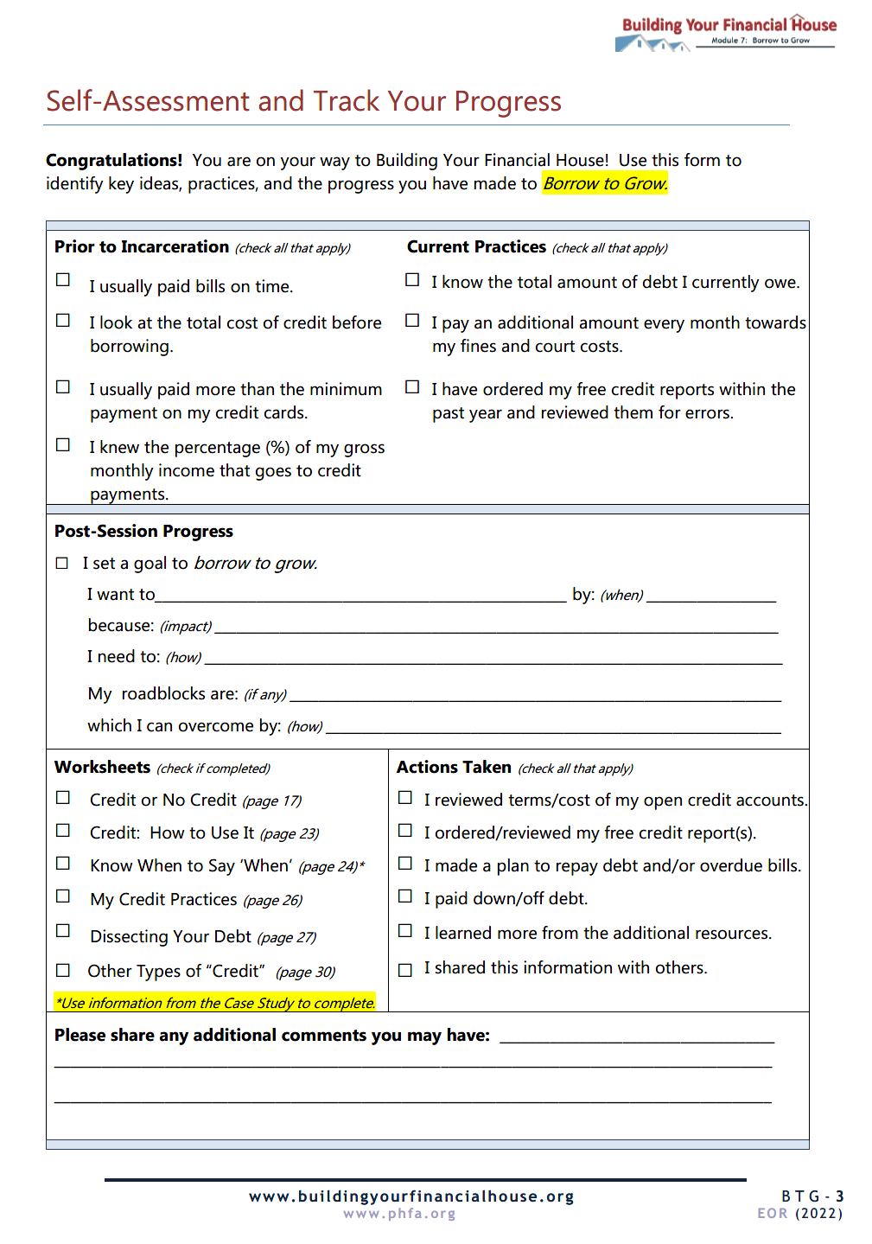
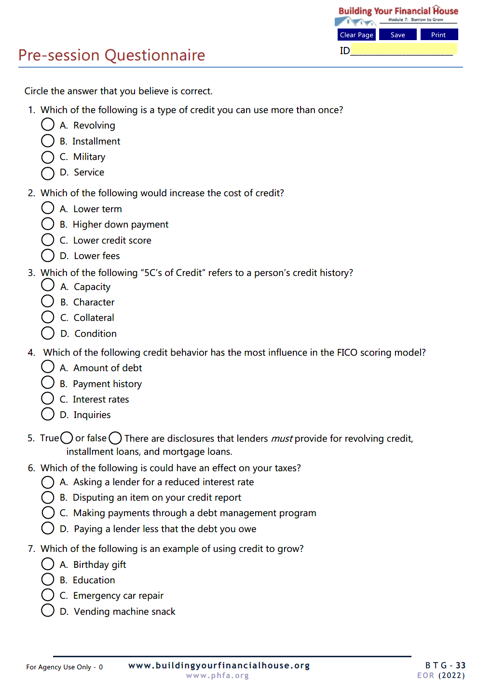
Prior to Today’s Session

Slide 5
Today’s Topics
Types of Credit
Getting and Using Credit
Credit Reports and Scores
Dissecting Your Debt
Avoiding Predatory Lending
Notes:
Today we’re going to talk about:
Money values and setting financial goals
Creating a Money Map
Making good financial choices
Knowing how your cash flows

Slide 6
6
Protect Your Potential
5
Make Money Work
4
Check Taxes
3
Spend Sensibly
7
Borrow to Grow
2
Maximize Earnings
1
Invest in Yourself

Slide 7
Finally, only borrow to buy things (assets) that will grow and feed your financial future, like seeds of a fruit tree.
Borrowing in excess, similar to overwatering a seedling, can slow your financial growth, weigh it down, and drown it out.
7
Borrow to Grow

Slide 8
Identify the types and appropriate uses of “other people’s money” (OPM)
Identify the four main factors that affect the total cost of credit
Be familiar with credit reports and scores, how to get them, and how lenders use them
Recognize the credit risk to cost relationship and way to improve credit worthiness
Be familiar with information lenders must provide to you when borrowing money

Slide 9
Take your reentry seriously; the difference between success and failure is a choice.
Ask for help; there are many resources available to you.
Work hard, stay focused, and don’t be distracted by the nay-sayers.
Have realistic expectations.
Stay flexible and be patient; the first steps you make are only transitions to something better.
Do whatever it takes, including getting right with yourself and being in the right place with the right people.
Destination:
Successful Reentry

Slide 10
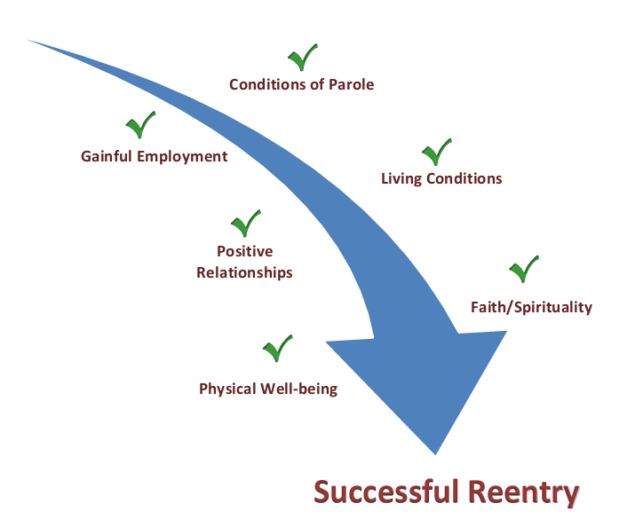
Path to Successful Reentry

Slide 11
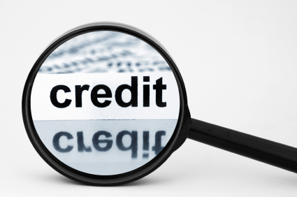
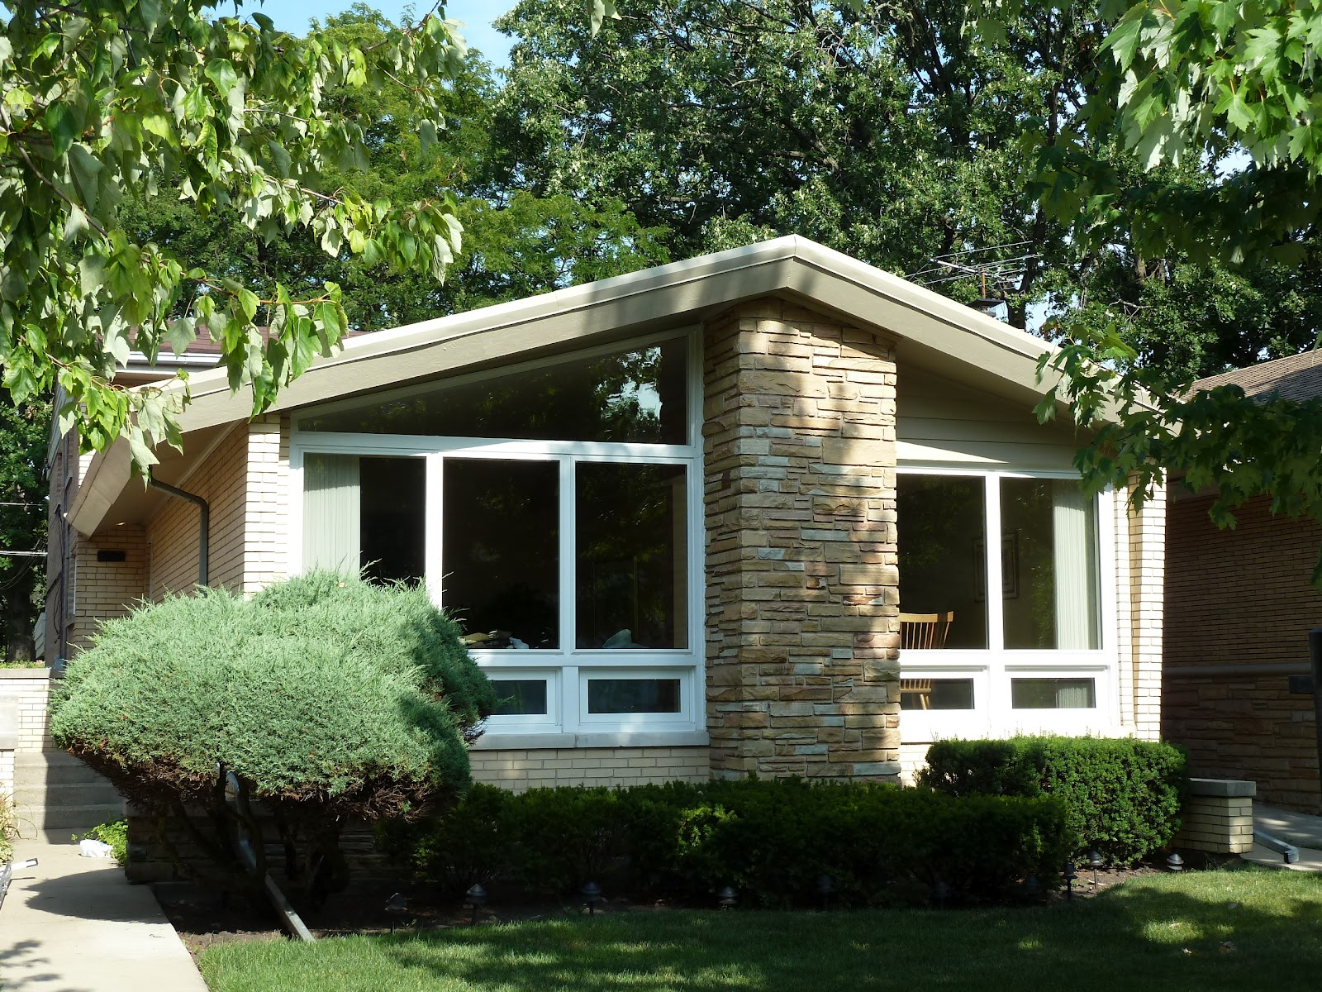
What Do These Have In Common?

Slide 12
This is
NOT. YOUR.
MONEY.
It is
OTHER PEOPLE’S MONEY!
This Photo by Unknown Author is licensed under CC BY-ND

Slide 13
Credit vs. Debt
CREDIT
Permission to
use OPM
DEBT
OPM used and must be repaid
OTHER PEOPLE’S MONEY!

Slide 14
Types of Credit
Revolving
Installment
Service
Reusable
Example: credit cards
Payments: flexible, based on balance
Default: purchases denied, fees, penalty interest rate
Once and done
Example: auto loan
Payments: fixed, based on amount, time, and rate
Default: repossession, wage garnishment
Month-to-month
Example: cell phone
Payments: based on usage
Default: service shut-off

Slide 15
Types of Debt
Secured
Unsecured
Garnishments

Slide 16
Credit: How to Get It – The 5 C’s
Capacity (income)
Capital (cash)
Collateral (guarantee)
Condition
Character (history)

Slide 17
Continue with Part II

