Slide 2
Building Your Financial House
WELCOME
Notes:
Good afternoon everyone!
Thank you for joining us as we discuss Creating a Financial Resource Center on-site, at you development or agency.
We hope this presentation will help you bring vetted, unbiased financial education resources to your residents or clients that they can use right now.
So let’s get started.

Slide 3
Housekeeping
Please mute your phone or computer to eliminate background noise.
To maximize bandwidth:
(Turn camera off)
Close unused apps or webpages
Please raise hand or use chat feature for questions.
Notes:
Good afternoon everyone!
Thank you for joining us as we discuss Creating a Financial Resource Center on-site, at you development or agency.
We hope this presentation will help you bring vetted, unbiased financial education resources to your residents or clients that they can use right now.
So let’s get started.

Slide 4
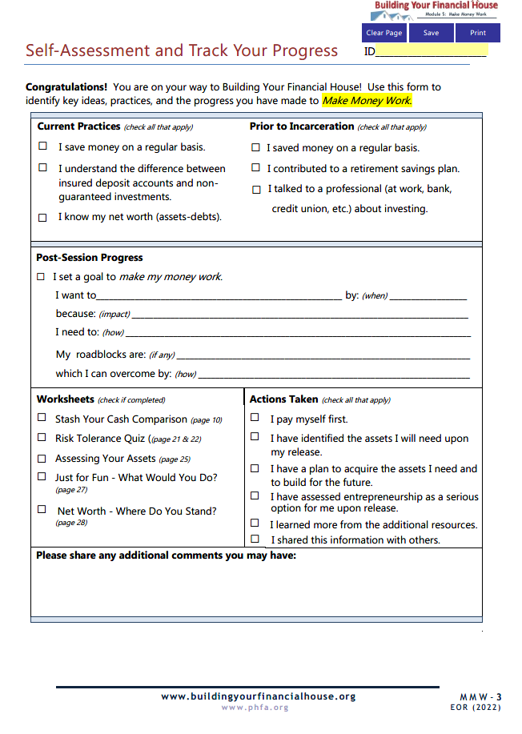
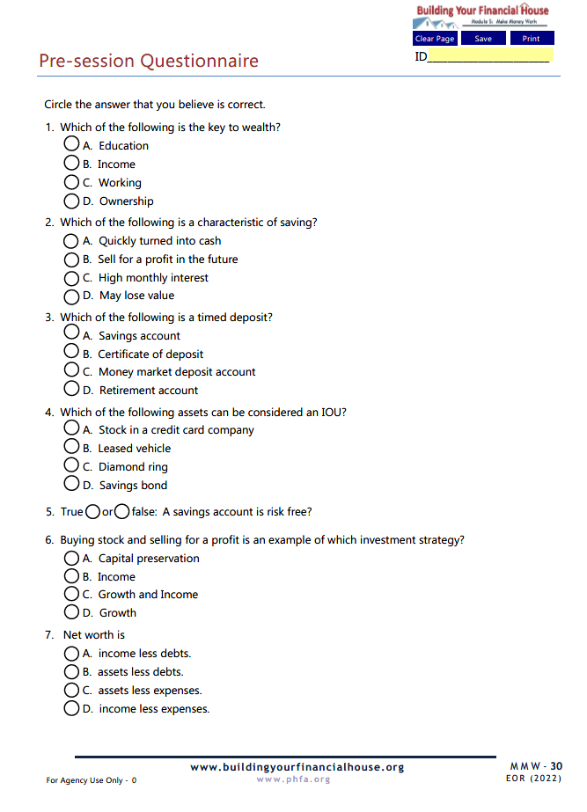
Prior to Today’s Session

Slide 5
Today’s Topics
Working vs. Wealth
Saving vs. Investing
Time Value of Money
Types of Assets, Uses, Risk, and Costs
Net Worth
Investing Strategies and Accessibility
Notes:
Today we’re going to talk about:
Money values and setting financial goals
Creating a Money Map
Making good financial choices
Knowing how your cash flows

Slide 6
6
Protect Your Potential
5
Make Money Work
4
Check Taxes
3
Spend Sensibly
7
Borrow to Grow
2
Maximize Earnings
1
Invest in Yourself

Slide 7
5
Make Money Work
Much like adding an extra room in the attic, you can expand your financial house by making your money work through saving, investing and monitoring what you own.

Slide 8
Differentiate between working and wealth
Recognize that growing money starts with saving money
Identify the power of compounding and time when building assets
Distinguish between types of assets, their uses, risks, and costs
Recognize net worth as a measure of wealth

Slide 9
Take your reentry seriously; the difference between success and failure is a choice.
Ask for help; there are many resources available to you.
Work hard, stay focused, and don’t be distracted by the nay-sayers.
Have realistic expectations.
Stay flexible and be patient; the first steps you make are only transitions to something better.
Do whatever it takes, including getting right with yourself and being in the right place with the right people.
Destination:
Successful Reentry

Slide 10
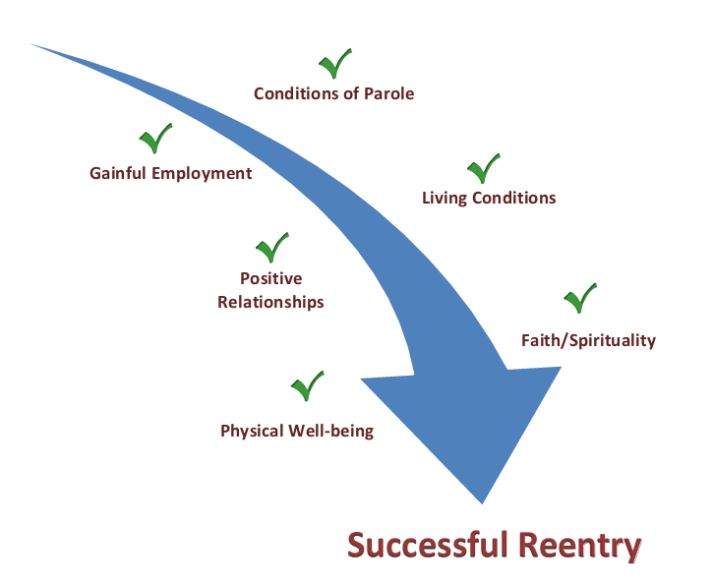
Path to Successful Reentry

Slide 11
Chat Box
What is the difference between saving and investing?

Slide 12
Saving vs. Investing
Saving is setting cash aside.
Use now or in the short-to-medium term (one to four years)
Liquid (easily turned into cash)
Safe (no loss, guaranteed)
Earns little interest (in exchange for safety)
Saving

Slide 13
Saving vs. Investing
Investing is using cash to buy/build assets for income or gain.
Use in the future (five or more years)
Less liquid (harder to turn into cash)
Some risks (may lose value, not guaranteed)
Future cash earnings or sell for profit
Investing

Slide 14
Chat Box
What challenges or roadblocks have you had when it comes to saving?

Slide 15
roadblocks to saving
where should I save?
unexpected expenses get in the way
procrastination
no money left at the end of the month
saving is too hard
inflation
i can’t afford to save
i don’t know how
Notes:
Question: Why aren’t we saving?

Slide 16
TAKE THE STEPS!
Make the Commitment to Save
Decide: IT IS POSSIBLE.

Slide 17
3. Pay Yourself First
Make it the first “expense”
Off-the-top deductions
Priority!
2. No Amount Too Small
The little things add up.
Save spending leaks.
1. Make the Commitment
You can’t complain about the results you didn’t get from the things you didn’t do.
MAKE IT A HABIT
Notes:
Steps to Saving:
Saving is Necessary – You can’t complain about the results you didn’t get from the things that you didn’t do.
Pay Yourself First – Make it the first “expense”/Off-the-top deductions/Direct deposit to separate savings account
No Amount is Too Small – The little things add up. Save spending leaks.

Slide 18
It’s only a $2 cup of coffee!
1 week $10
1 year $520
10 years $5,200
20 years $10,400
Spending leaks!
Notes:
Adrian
Explain:
So what if your ‘numbers’ don’t mesh with what is actually left over in your wallet? First go back to and check to make sure there aren’t any transfer errors from your pay or What Comes In worksheet. If you have fluctuating income due to seasonal work or overtime, that may affect this month’s numbers.Then look at the expenses you tracked. Look for missing entries, special expenses you may have incurred this month, and spending leaks. If it still doesn’t seem right, realize that it may take three months to get a really good idea of your spending. And that’s ok because it will mean you have a better chance at putting together a manageable plan.
Next-

Slide 19
Chat Box
Please share any other saving strategies that you are using.

Slide 20
Where should I stash my cash?

Slide 21
Mainstream Financial Institutions
Benefits
Safe
Guaranteed
Insured
Liquid
Cost
Convenience
Relationships

Slide 22
Mainstream Financial Institutions
Benefits
Safe
Guaranteed
Insured
Liquid
Cost
Convenience
Relationships

Slide 23
Types of Accounts and Products
US Treasury Savings Bonds
Individual Retirement Accounts
Time Deposits
Money Market Deposit Accounts
Savings Accounts
Cash Management Accounts

Slide 24
Savings Accounts
General accounts
Goal accounts (vacation club, Christmas or holiday club, young savers, etc.)
May have ATM card
Cannot overdraw!
May have to maintain minimum balance
Pays very low interest

Slide 25
Types of Accounts and Products
Money Market Deposit Accounts
Savings Accounts

Slide 26
Money Market Deposit Account
Hybrid between savings and checking
Limited check-writing privileges
Higher opening and maintaining minimum balance
Pays higher interest than general savings account
MMDA

Slide 27
Types of Accounts and Products
Time Deposits
Money Market Deposit Accounts
Savings Accounts

Slide 28
Time Deposits
Money deposited for a fixed-amount of time
Higher interest than savings or MMDA
Typically pays higher interest for longer term
Caution:
Penalties if withdrawn before maturity date
Automatic renewal
Certificates of Deposit (CD’s)

Slide 29
Types of Accounts and Products
Individual Retirement Accounts
Time Deposits
Money Market Deposit Accounts
Savings Accounts

Slide 30
Individual Retirement Accounts
A ‘bucket’ that holds savings vehicles or investments for retirement
Vehicles are savings account, MMDA, or CD’s within the ‘bucket’
Interest depends on the vehicle inside
IRA

Slide 31
Individual Retirement Accounts
Traditional
IRA
ROTH IRA
Contributions may be tax-deductible
Earnings grow federal income tax-deferred
10% early withdrawal penalty (or 50% late withdrawal penalty)
May use up to $10,000 for first-time home purchase without 10% penalty (but may owe tax on earnings)
Contributions made with after-tax dollars
Earnings grow federal income tax-free
Access to contributions after five years without penalty or income tax on earnings
May use up to $10,000 for first-time home purchase without 10% penalty (but may owe tax on earnings if less than five years)

Slide 32
Types of Accounts and Products
US Treasury Savings Bonds
Individual Retirement Accounts
Time Deposits
Money Market Deposit Accounts
Savings Accounts

Slide 33
Did you know, that you can no longer buy US Savings Bonds at a bank or credit union?

Slide 34
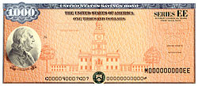
US Treasury Savings Bonds
Purchases and redemption of existing paper bonds now must be done online
Series EE and I available at low minimum purchase ($25/$50)
30-year maturity
Payroll Savings Plan direct from your employer
Allocate tax refund (Series I-via Form 8888)
T-bills, notes, and bonds
treasurydirect.gov

Slide 35
How to Choose?

Slide 36
Sample Uses
US Treasury Savings Bonds
Higher interest rate
Long-term goals
Tax-free college savings*
Ok with limited access
Higher interest rate
Medium-term goals
Laddering strategies
Time Deposits
Check writing privileges
Higher interest rate
Short-term goals
Big emergencies
MMDA’s
Savings Accounts
Need easy access
Short-term goals
Small emergencies
*For qualified taxpayers, expenses, and eligible institutions

Slide 37
Chat Box
What comes to mind when you hear the words invest, investing, and investment?

Slide 38
Where Does Your Cash Come From?
Now
Future
WORKING
YOU working HARD
for money!
WEALTH
(Ownership)
MONEY working HARD
for YOU!
BUILD ASSETS

Slide 39
Rules for building assets
Diversify!
Stay Invested!
Start Early!

Slide 40
Time Value of Money
55
$200/month
$34,210
$25/month
$4,276
45
$200/month
$101,507
$25/month
$12,688
35
$200/month
$233,591
$25/month
$29,236
25
$200/month
$494,308
$25/month
$ 61,789
Start Age
Age
65
This time value of money illustration assumes an average annual return of 7%.

Slide 41
The Cost of Waiting
$250,000
55 yrs old
$1325/month
45 yrs old
$465/month
35 yrs old
$205/month
25 yrs old
$100/month
This time value of money illustration assumes an average annual return of 7%.

Slide 42
Stay Invested!
Start Early!

Slide 43
The One Tree Forest
Year Three
Year Four
Year Two
Year One

Slide 44
Compounding Pays!
$1,000+
$ 100
$1,100+
$ 110
$1,210+
$ 121
$1,331+
$ 133
Compound
$464
$1,000
10%
Year One
Year Two
Year Three
Year Four
$1,000
$1,000
$1,000
$1,000
Simple
$400
$100
$100
$100
$100

Slide 45
Continue to Part II

