Slide 2
Building Your Financial House
WELCOME
Notes:
Good afternoon everyone!
Thank you for joining us as we discuss Creating a Financial Resource Center on-site, at you development or agency.
We hope this presentation will help you bring vetted, unbiased financial education resources to your residents or clients that they can use right now.
So let’s get started.

Slide 3
Housekeeping
Please mute your phone or computer to eliminate background noise.
To maximize bandwidth:
(Turn camera off)
Close unused apps or webpages
Please raise hand or use chat feature for questions.
Notes:
Good afternoon everyone!
Thank you for joining us as we discuss Creating a Financial Resource Center on-site, at you development or agency.
We hope this presentation will help you bring vetted, unbiased financial education resources to your residents or clients that they can use right now.
So let’s get started.

Slide 4
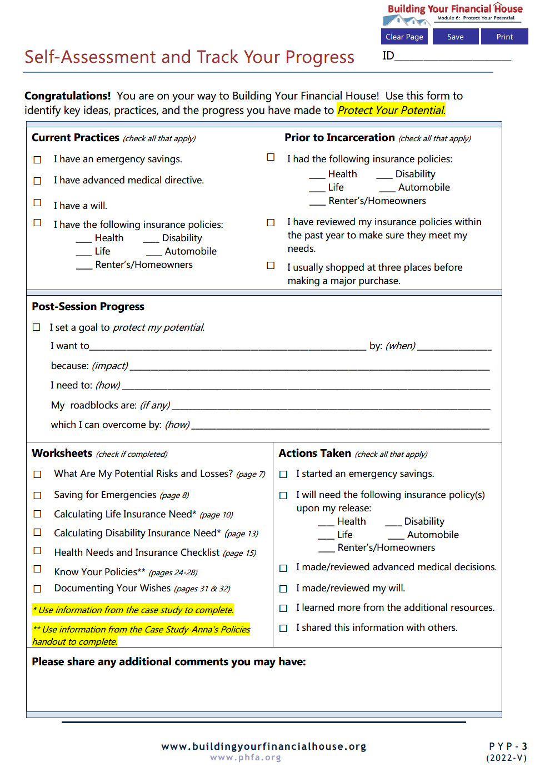
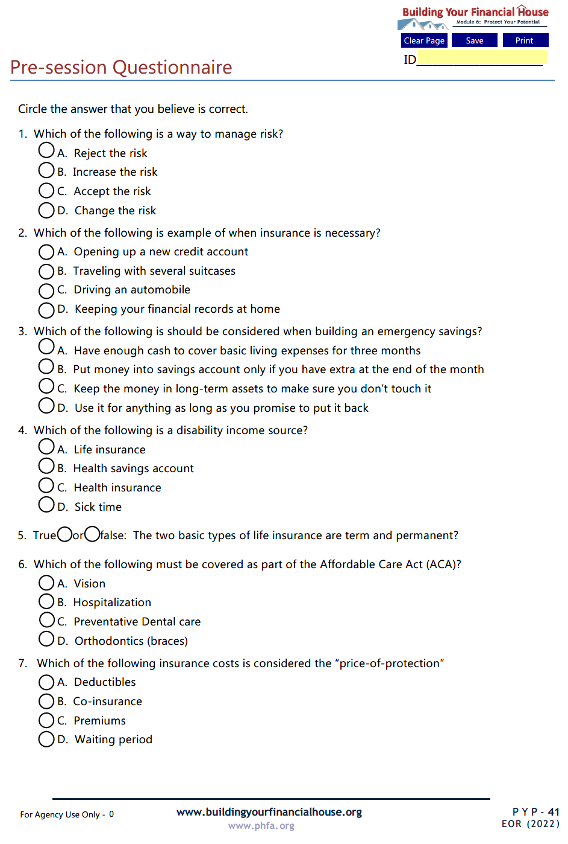
Prior to Today’s Session

Slide 5
Today’s Topics
Managing Risk
Building an Emergency Fund
Types of Insurance
Cost of Insurance
Consumer Protection
Notes:
Today we’re going to talk about:
Money values and setting financial goals
Creating a Money Map
Making good financial choices
Knowing how your cash flows

Slide 6
6
Protect Your Potential
5
Make Money Work
4
Check Taxes
3
Spend Sensibly
7
Borrow to Grow
2
Maximize Earnings
1
Invest in Yourself

Slide 7
6
Protect Your Potential
Just as a roof protects a house, protect your potential by having a cash savings for emergencies, managing risk with the right insurance, and being a smart consumer.

Slide 8
Identify potential risks which could result in financial catastrophe and ways to manage them
Identify the types of insurance used to transfer risk and their associate costs
Recognize the importance of getting affairs in order and steps to take
Recognize ways to comparison shop, avoid identity theft, and access consumer protection resources
Identify types of organizations and professionals which make up the financial services system and the services they provide

Slide 9
Take your reentry seriously; the difference between success and failure is a choice.
Ask for help; there are many resources available to you.
Work hard, stay focused, and don’t be distracted by the nay-sayers.
Have realistic expectations.
Stay flexible and be patient; the first steps you make are only transitions to something better.
Do whatever it takes, including getting right with yourself and being in the right place with the right people.
Destination:
Successful Reentry

Slide 10
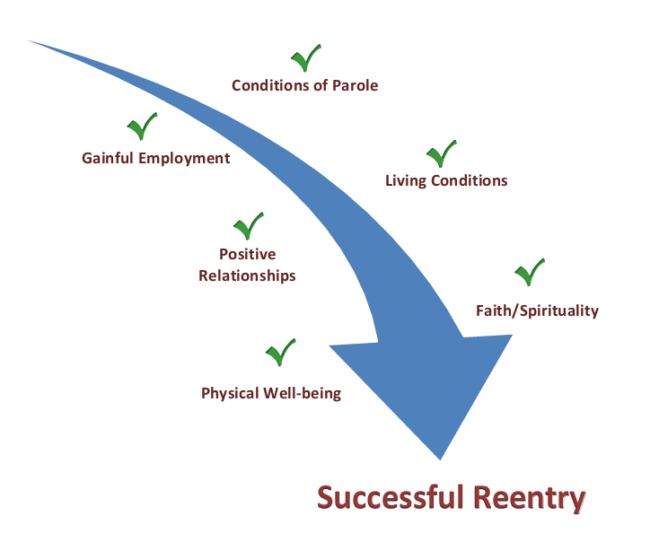
Path to Successful Reentry

Slide 11
Chat Box
What is risk?

Slide 12
the chance of loss from some type of danger
-or-
uncertainty about the outcome
of a situation or event
Risk

Slide 13
Anna’s Risks

Slide 14
Risks
Quit Job
Mom Moves In
Buy a House
Marry Barry
Manage

Slide 15
Risk Management Process
Identify the possible risk
Consider how serious the loss would be
Consider options to manage loss
Take action

Slide 16
Risk Management Process
Options:
Eliminate
Reduce
Retain
Transfer

Slide 17
When to Transfer
Optional
Covered by savings
Low probability
Necessary
Financial ruin
High probability
Required by law
Important
Force to borrow
Medium probability

Slide 18
Emergency Savings – First Line of Defense
Three (to six) months of expenses
Cash (liquid)
Accessible but not too accessible

Slide 19
Chat Poll:
What insurance is currently required by law?

Slide 20
Transferrable Losses
Health
Income
Property

Slide 21
Loss of Income
Life Insurance
Common:
Health examination (non-group policies)
Suicide clause
Term:
Set period of time
Renewal based on health
Good for temporary needs, i.e., college, mortgages
Permanent:
Coverage for entire life
Whole, universal, and universal life policies
Cash value feature
Loss Due to Death

Slide 22
Loss of Income
Income Sources
Savings
Sick-time
Worker’s Compensation
Social Security disability (with waiting period and diagnosis limitations)
Employer-sponsored plans (tied to your employer and not covered under COBRA)
Individual disability insurance (more costly but not tied to an employer)
Loss Due to Disability

Slide 23
Loss of Income
Disability Insurance
Definition of job
Own occupation
Any occupation
Typically replaces 60-65% of monthly income
Coordination of benefits
Short-term (up to six months)
Long-term (six months+)
May have maximum time limits to receive benefits
Loss Due to Disability

Slide 24
Transferrable Losses

Slide 25
Loss of Health
Health Insurance
Ten essential benefits (ACA)
Emergency, in- and out-patient care
Laboratory services
Rehabilitative services
Prescription drugs
Pregnancy, maternity, and newborn care including birth control and breastfeeding
Pediatric care (including oral and vision care)
Mental health and substance use disorders
Preventative, wellness, and chronic disease management
Optional benefits – adult dental, vision, hearing, etc.
Temporary

Slide 26
Loss of Health
Types of Plans
Indemnity - major medical with flexibility to visit almost any doctor or hospital of your choice
Preferred Provider (PPO’s)-arrangement between company and hospitals/doctors for discounted services
Health Maintenance (HMO’s)-typically requires you to choose a primary care physician; you may need a referral for out-of-network provider
High Deductible Health Plans (HDHP) - lower monthly premiums in exchange for higher deductibles
Government benefits – Medicare, Medicaid, CHIP, etc.
Temporary

Slide 27
Did you know the median monthly cost of a nursing home in PA is over $10,000?
*PA median costs for a semi-private room as reported in the 2021 Genworth Cost of Care Survey.

Slide 28
Loss of Health
Long-term Care (LTC)
Types and costs:*
In-home care ($4,957/mo)
Assisted living facility ($4,100/mo)
Skilled care/nursing home ($10,403/mo)
Paying for LTC:
Medicare (100-day maximum with service restrictions)
Medicaid (asset and facility choice limitations)
Long-term care insurance (expensive with benefit limitations)
Other options (reverse mortgages or life insurance with accelerated death benefits
Permanent
*PA median costs for a semi-private room as reported in the 2021 Genworth Cost of Care Survey.

Slide 29
Transferrable Losses
Property

Slide 30
Loss of Property
Homeowner/Renter’s Insurance
Dwelling and other structures
Personal property
Loss of use
Medical payments
Personal liability
Property
Automobile Insurance
Required by law in PA
Medical benefits
Bodily injury liability
Property damage liability
Options Coverage
Un- or under-insured motorist
Collision/comprehensive
GAP

Slide 31
Continue to Part II

