Slide 1
Part II

Slide 2
Did you know, if you divide 72 by annual rate of return, that is the number of years it will take to double your money?

Slide 3
Fun Fact
72 ÷ Rate of return (%) =
Number of years to double
4%
72 ÷ 4 = 18 years
7.2%
72 ÷ 7.2 = 10 years
10%
72 ÷ 10 = 7 years
Rule of 72

Slide 4
Rate of Return Matters!
26 years
31 years
42 years
72 years
This time value of money illustration shows number of years it will take to reach $250,000 goal, saving $200 per month at the state rates of return.

Slide 5
Diversify!
Stay Invested!
Start Early!

Slide 6
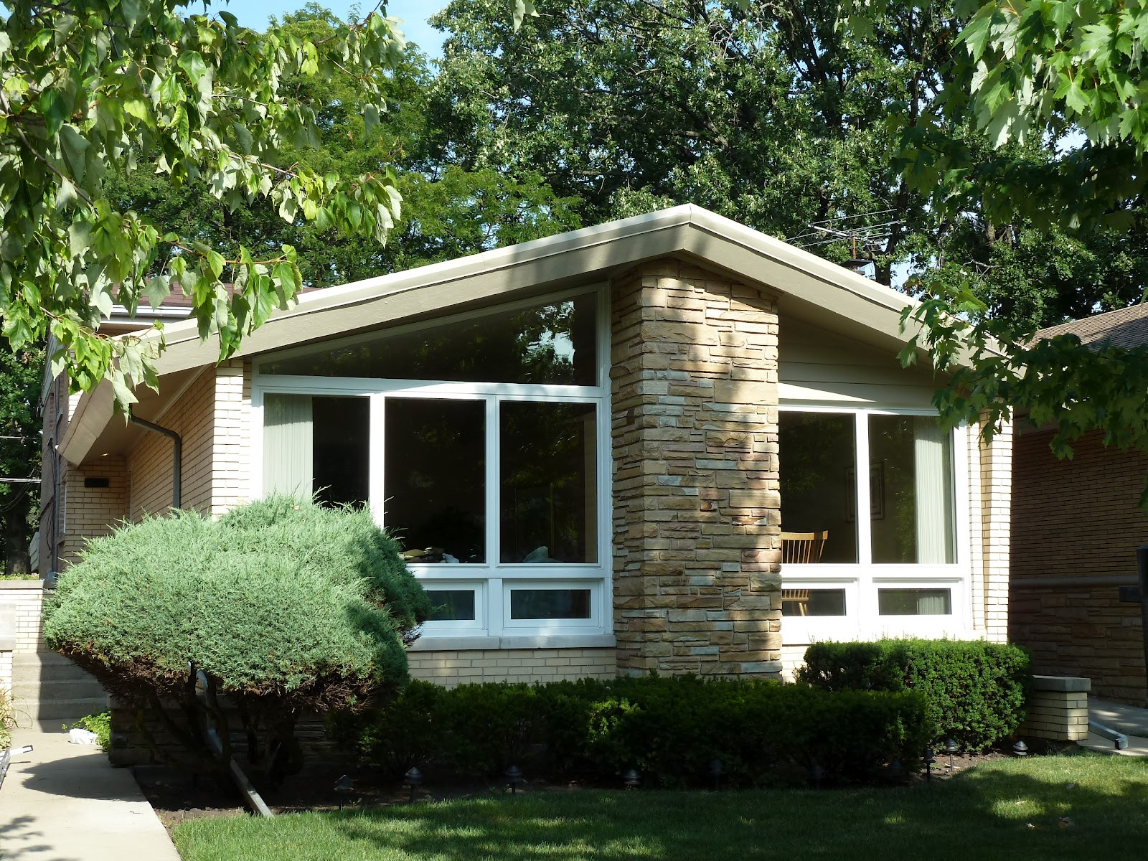
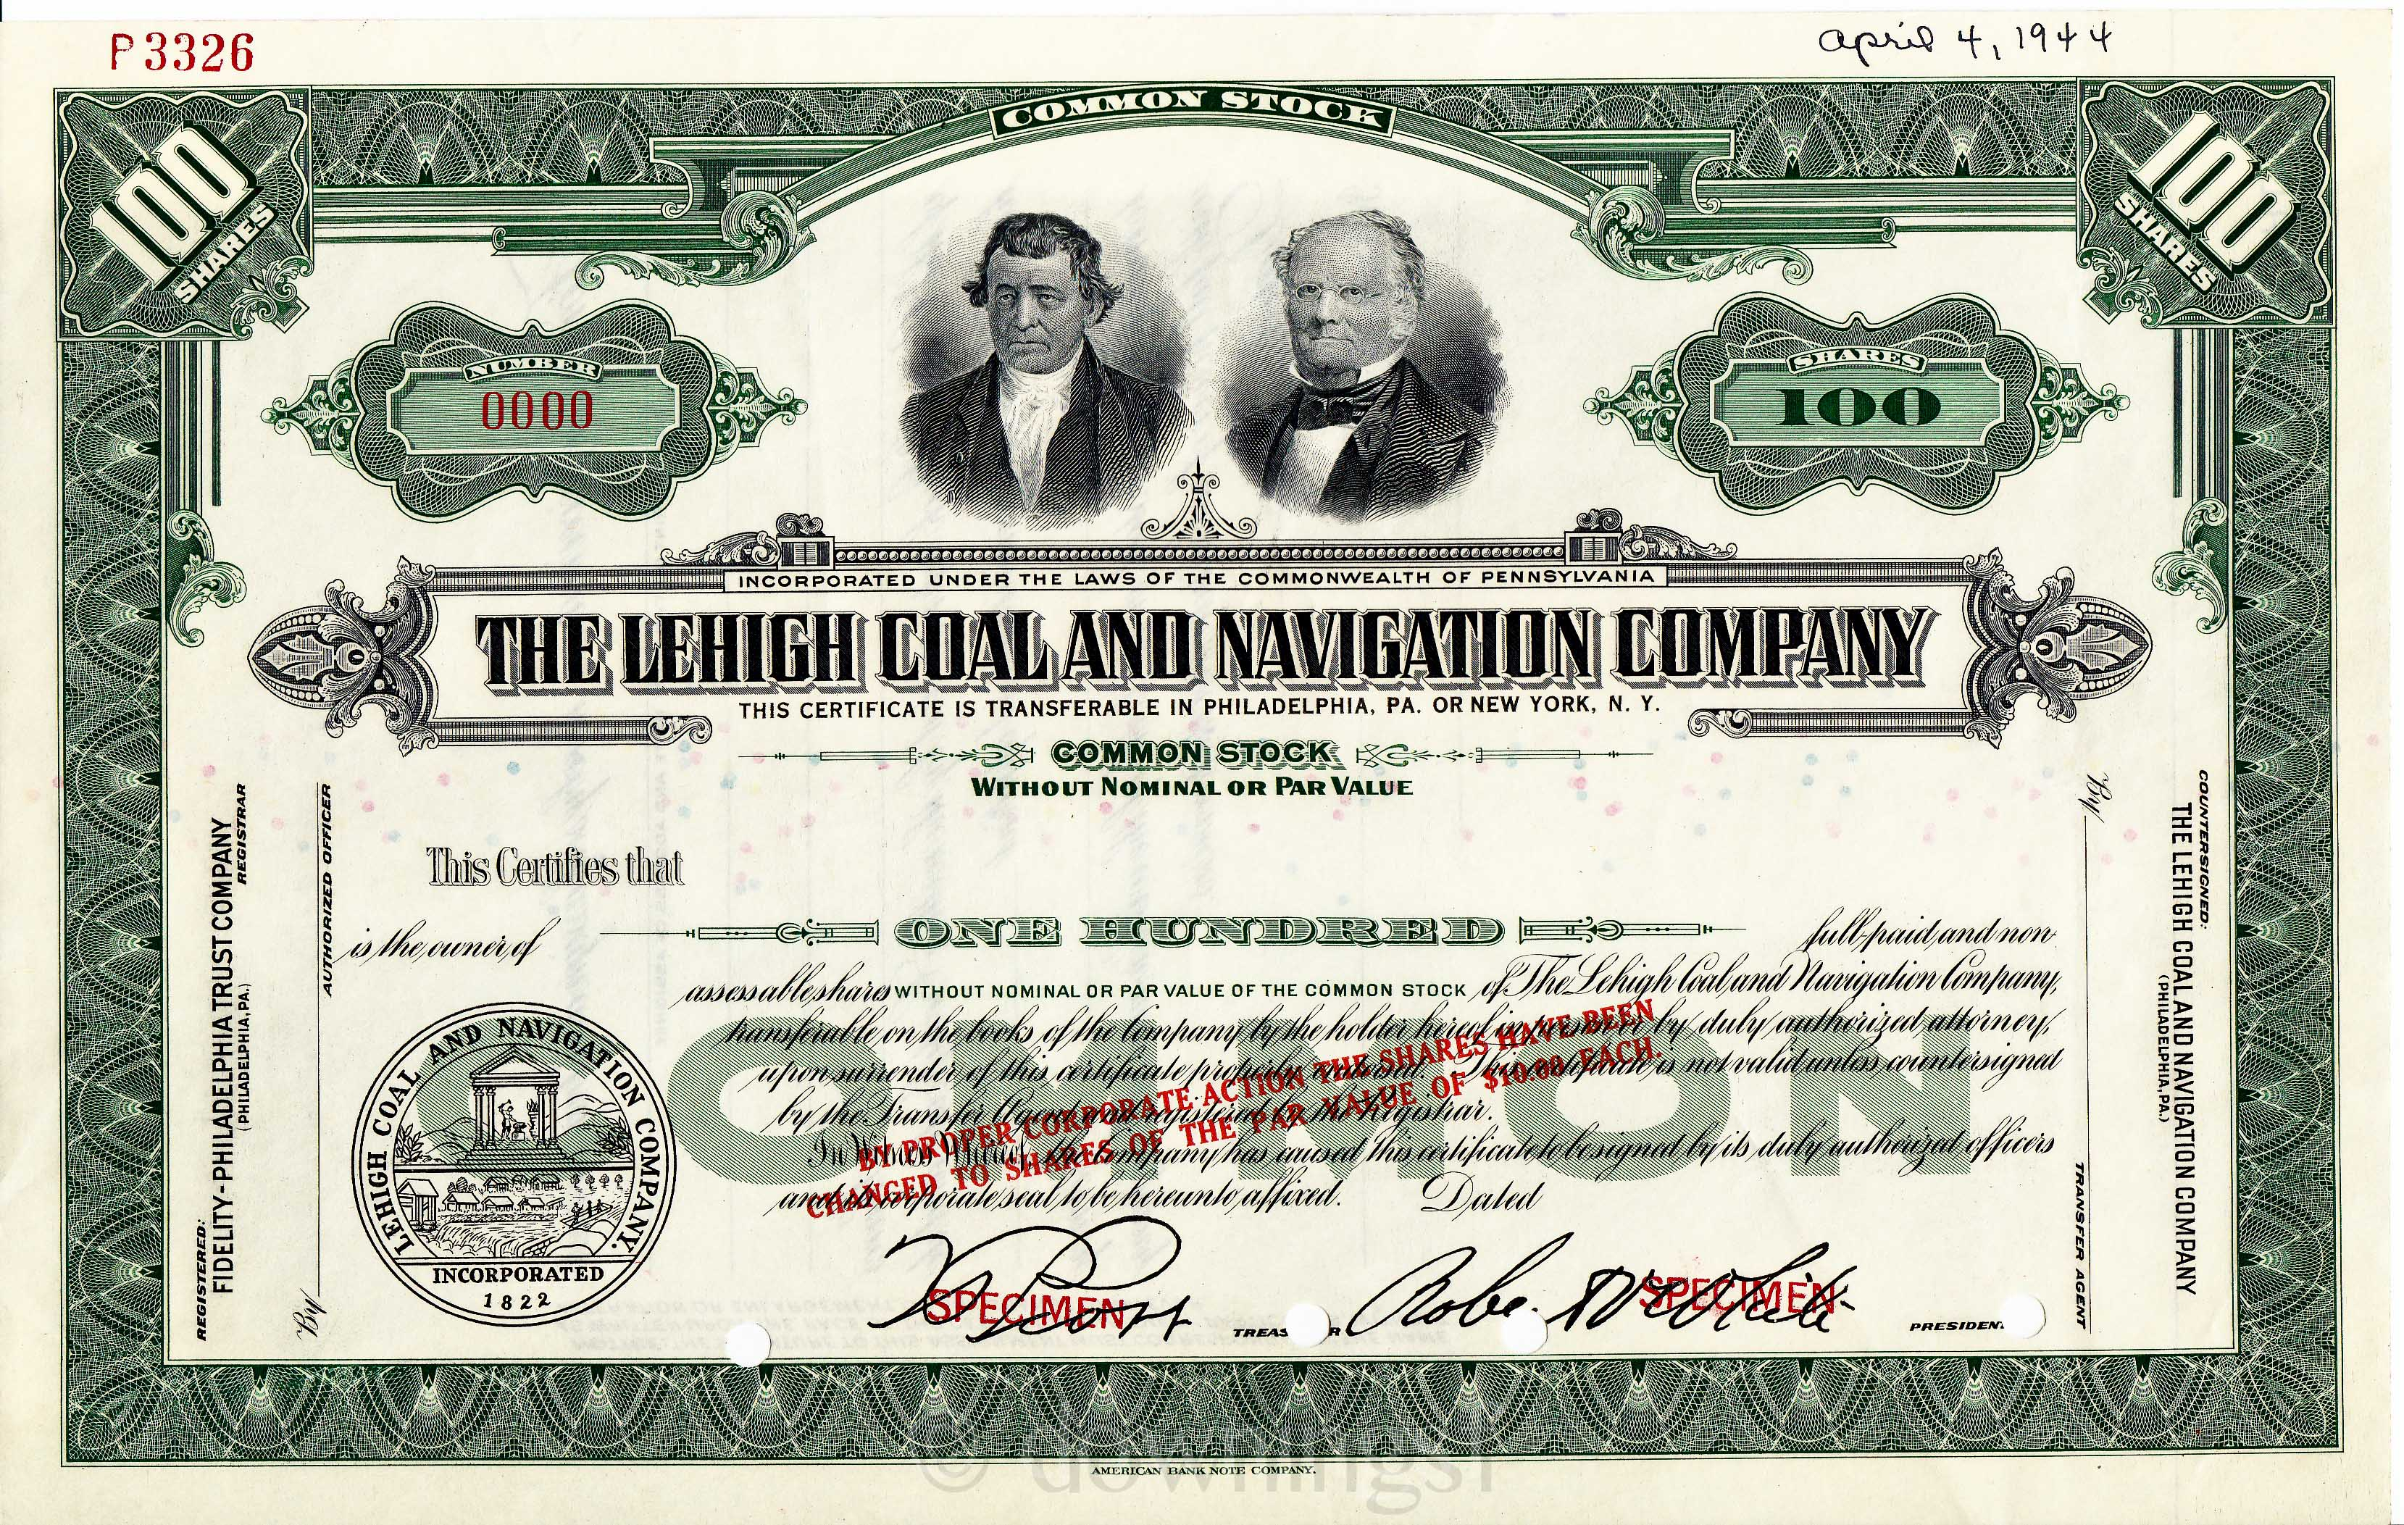
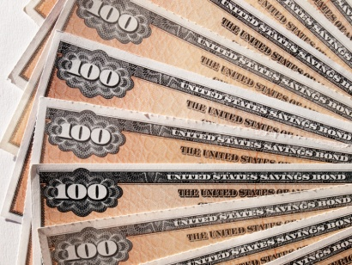
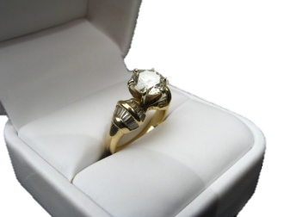
Diversify – Mix it up!
Financial
Small business
Real property
Personal property

Slide 7
Chat Box
What is the biggest asset of most Americans?

Slide 8
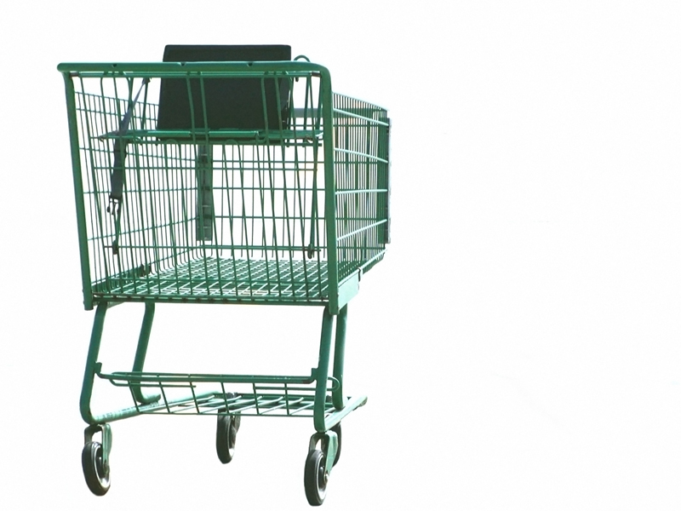
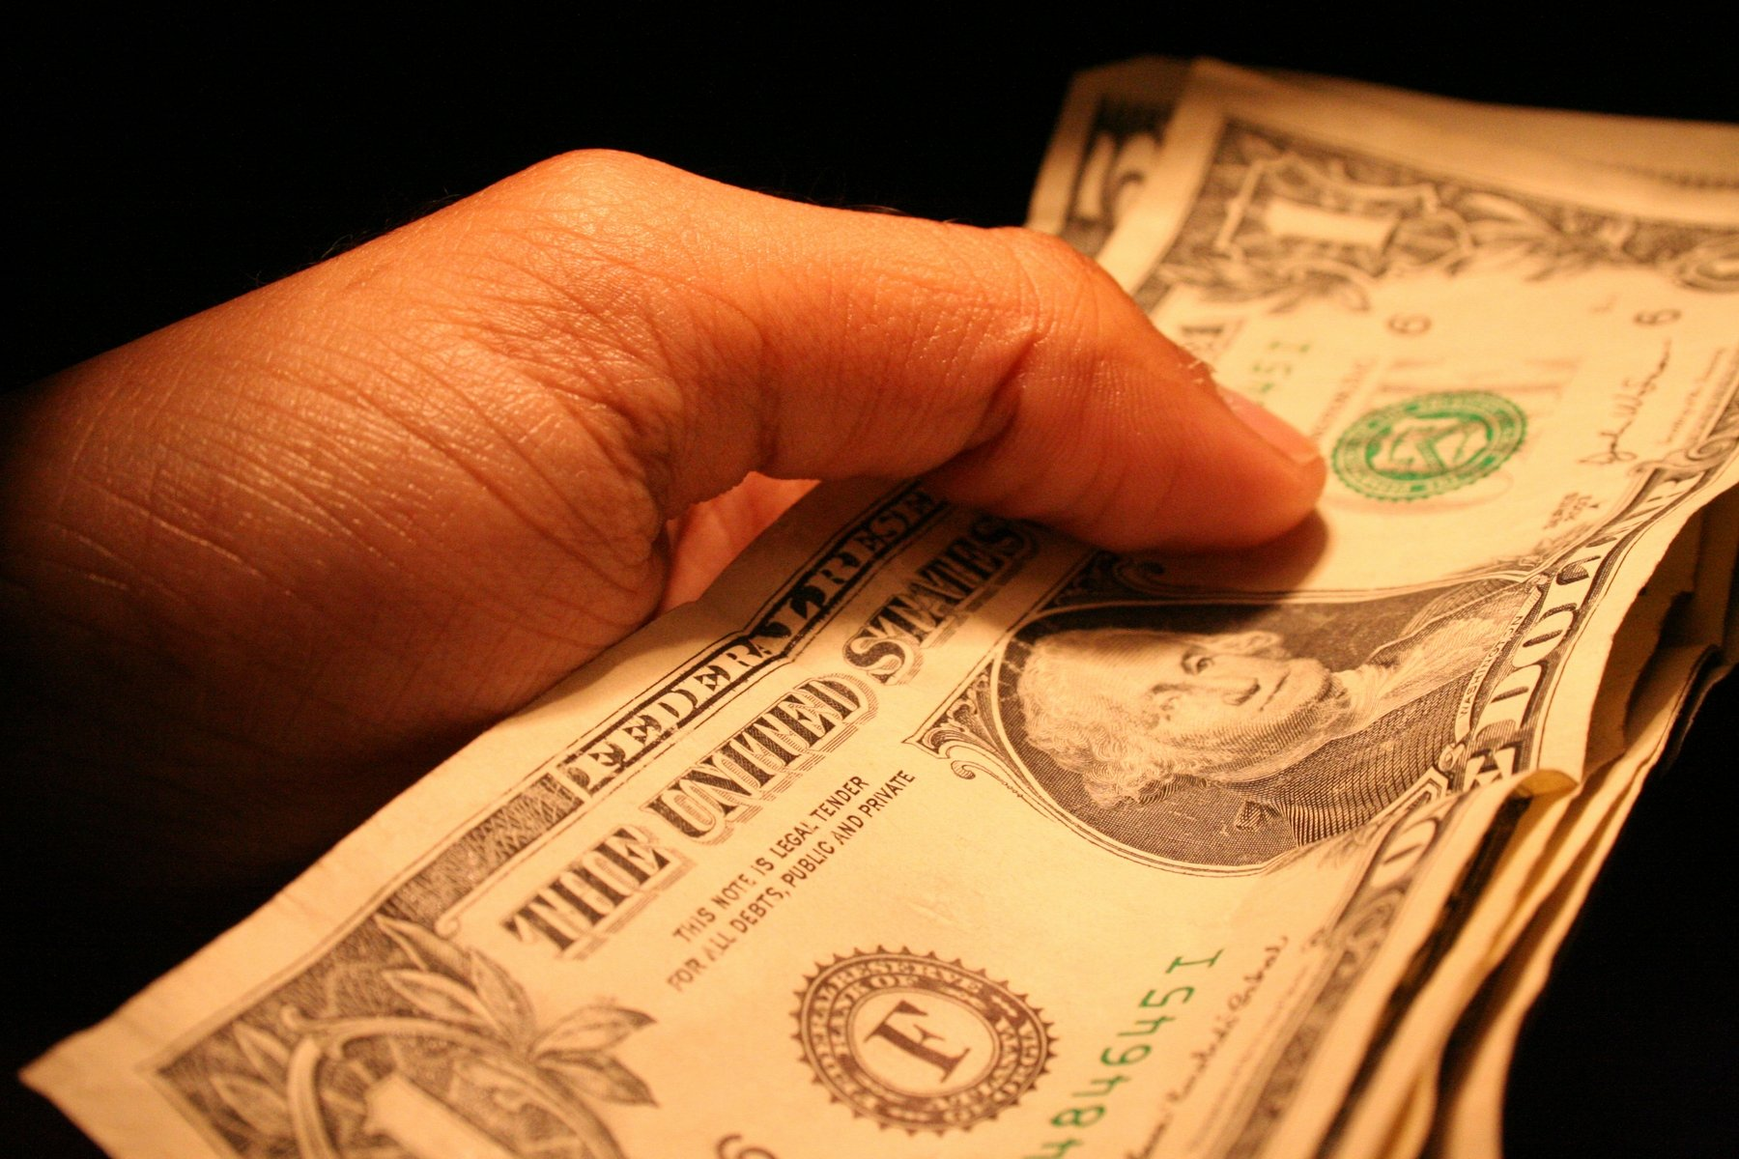
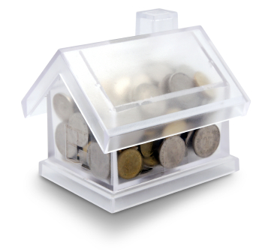
No
No
This Photo by Unknown Author is licensed under CC BY

Slide 9
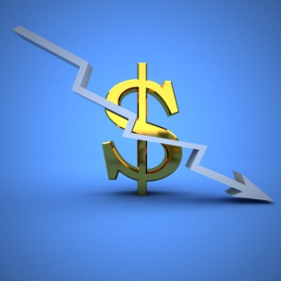
Financial Assets

Slide 10
Continue to Part II

Slide 11
Anna’s Notion of Noodles

Slide 12
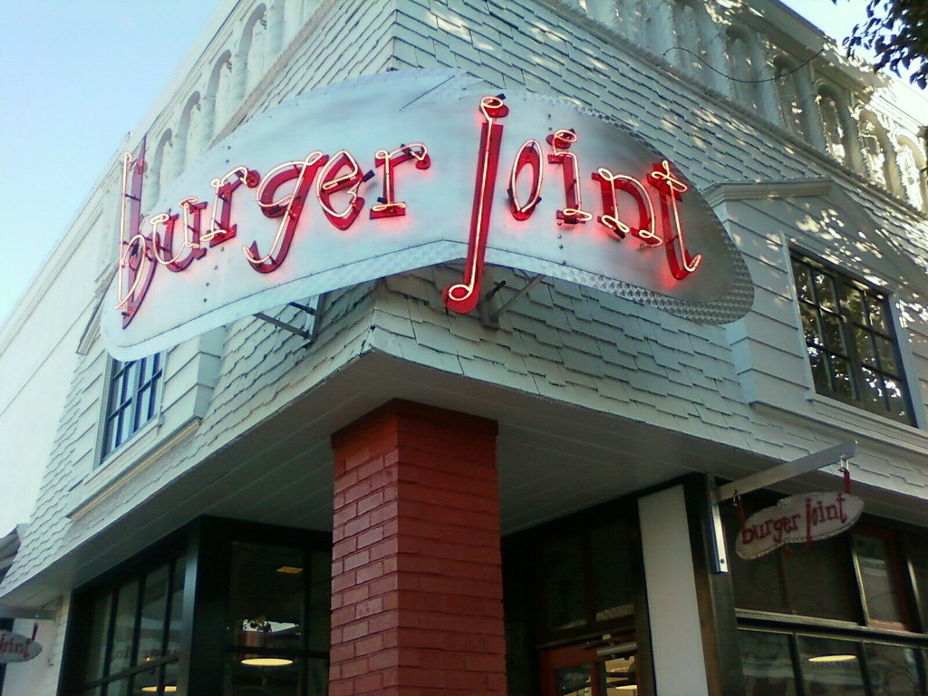
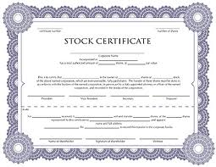
Taking the Fear Out of Stocks
Investor has cash
Company needs cash

Slide 13
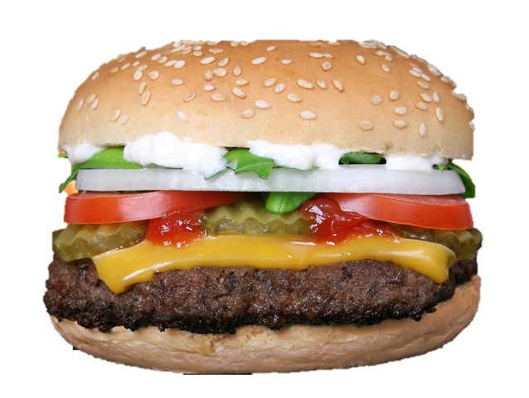
Taking the Fear Out of Stocks
Pays dividend
No dividend
Sell for a profit!
Sell for a loss
Me too!
Not me!

Slide 14
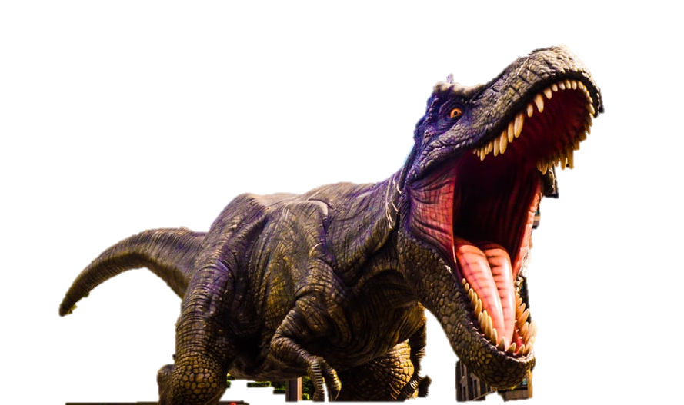
Taking the Fear Out of Bonds
I.O.U.
%
Investor has cash
City needs cash

Slide 15
Taking the Fear Out of Bonds
I.O.U.
%
Pays interest
No interest
Repays loan
Default
Lower interest
Higher interest

Slide 16
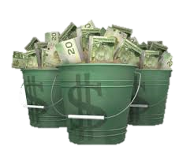
Taking the Fear Out of Mutual Funds
Investors have cash
Money manager can invest their cash

Slide 17
Taking the Fear Out of Mutual Funds
I.O.U.
%
Pays interest and dividends
No interest and dividends
Sell for a profit!
Sell for a loss

Slide 18
Continue to Part III

