Slide 2
Building Your Financial House
WELCOME
Notes:
Good afternoon everyone!
Thank you for joining us as we discuss Creating a Financial Resource Center on-site, at you development or agency.
We hope this presentation will help you bring vetted, unbiased financial education resources to your residents or clients that they can use right now.
So let’s get started.

Slide 3
Housekeeping
Please mute your phone or computer to eliminate background noise.
To maximize bandwidth:
(Turn camera off)
Close unused apps or webpages
Please raise hand or use chat feature for questions.
Notes:
Good afternoon everyone!
Thank you for joining us as we discuss Creating a Financial Resource Center on-site, at you development or agency.
We hope this presentation will help you bring vetted, unbiased financial education resources to your residents or clients that they can use right now.
So let’s get started.

Slide 4
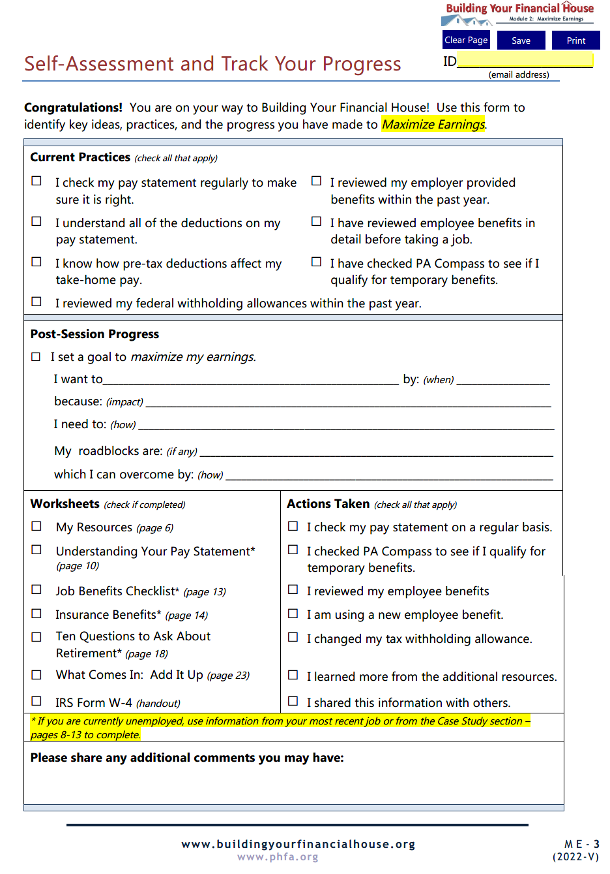
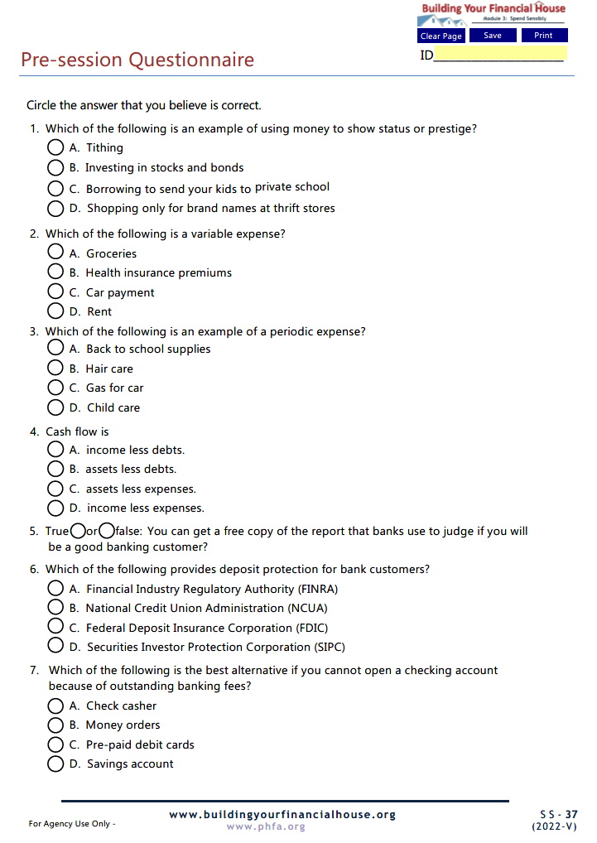
Prior to Today’s Session

Slide 5
Today’s Topics
Money Values
Needs vs. Wants
Creating a Money Map
Managing Cash Flow
Mainstream Banking
Notes:
Today we’re going to talk about:
Money values and setting financial goals
Creating a Money Map
Making good financial choices
Knowing how your cash flows

Slide 6
6
Protect Your Potential
5
Make Money Work
4
Check Taxes
3
Spend Sensibly
7
Borrow to Grow
2
Maximize Earnings
1
Invest in Yourself

Slide 7
Spend sensibly to fill your home with the things you need and keep it in order; overspending can result in physical and financial chaos.
3
Spend Sensibly
Map your money to start on the journey to your financial growth and succe$$.

Slide 8
Identify money values & spending habits
Distinguish between needs & wants to prioritize spending
Identify the steps to create & use a money map
Recognize the role of transactional accounts & services in managing cash

Slide 9
Spend Sensibly
Notes:
Spending gets a bad rap, but it’s something we do almost every day. The key is to:

Slide 10
Money Values
Indulgent
I want it now!
No worries!
Everything will be just fine!
Prestige
Most Expensivest!
Security
Penny pincher
Tool
Build my dreams!

Slide 11
Chat Box
What comes to mind when you the word budget?

Slide 12
BUDGET
BUDGET
BUDGET
BUDGET
BUDGET
BUDGET
BUDGET
BUDGET
BUDGET
BUDGET

Slide 13
Creating a Money Map
Follow Your Map
Plan Your Route
Make Choices
Cash Flow
Expenses
Income

Slide 14
What Comes In?
Follow Your Map
Sources of Income
Earned
Unearned
Cash
Non-Cash
Plan Your Route
Make Choices
Cash Flow
Expenses
Income

Slide 15
Anna’s Income

Slide 16
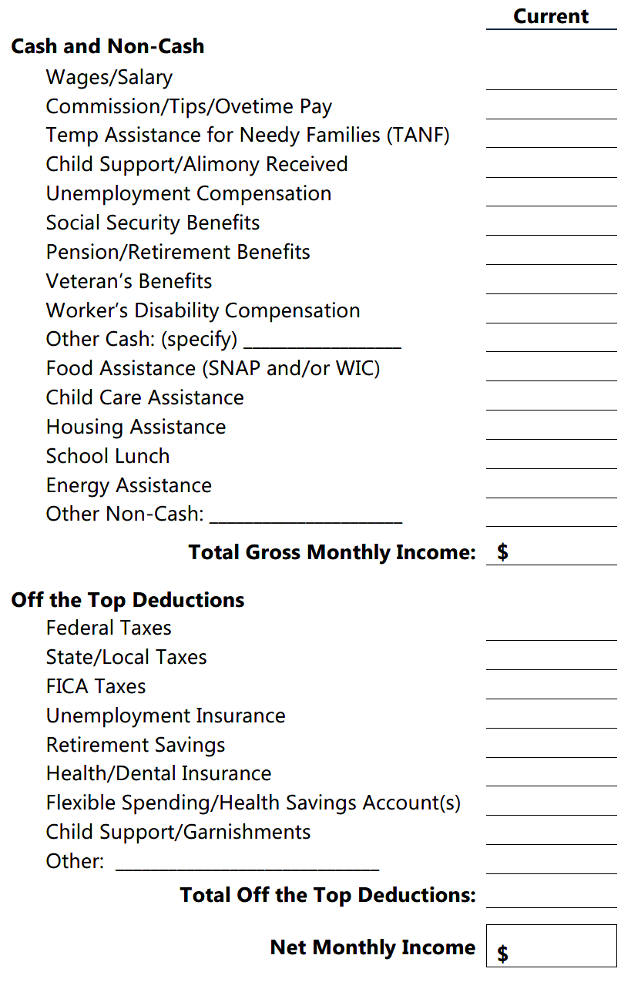
$3,567
$ 210
$ 100
$ 410
$ 115
4,402
Net Monthly Income
=
Total Gross less OTT
Transportation Allowance
$ 120
$ 147
$ 248
$ 173
$ 50
$ 1
$739
Group Life Insurance
3,663

Slide 17
Ok, so I know what comes in, but where does it go?

Slide 18
Where Does It Go?
Track and record expenses
Expenses
Income

Slide 19
Chat Box
What are some ways to track expenses?

Slide 20
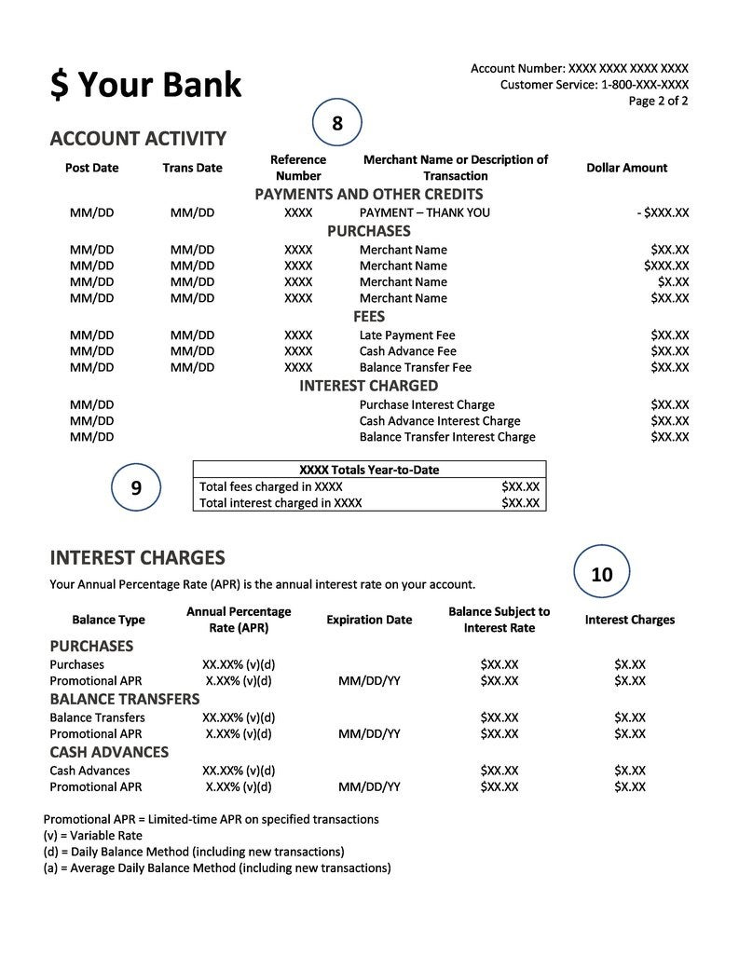
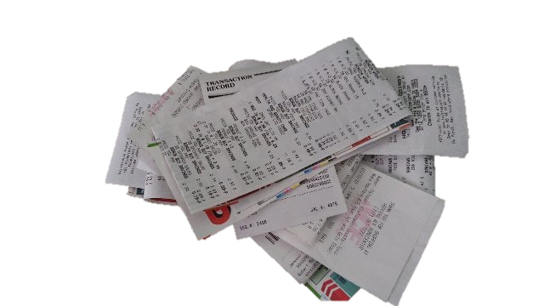
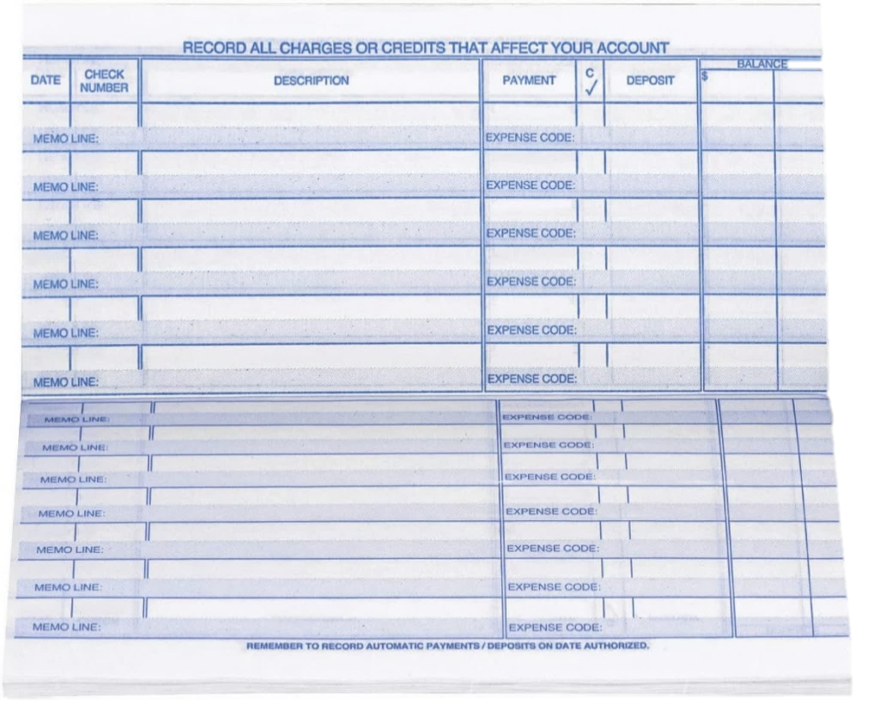
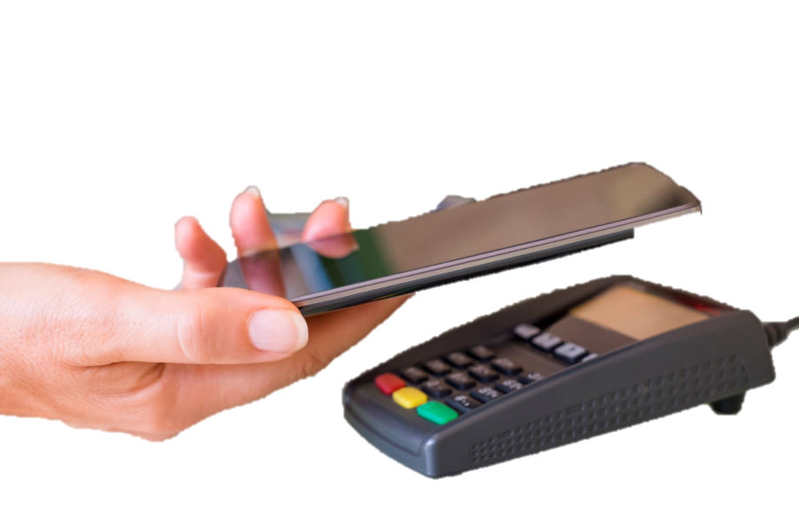
Track and record expenses
6/1
Gas $25
Breakfast $6.30
Snack machine $1.50
6/2
Kid’s art supplies $11
Birthday cake $15.66
6/3
Groceries $142.57
Cigarettes $10
410.65
(25 .00)
385. 65
(28. 00)
357 .65
(10 .00)
347.65
(143. 25)
204.40
6/1 696 Hertownship– Water/Trash
6/2 670 Get There Fast Transit
6/2 671 Dr. Allbetter
6/3 672 A-1 Groceries

Slide 21
Entertainment
Personal Care
Obligations
Categorize Expenses
Set-Asides
Transportation
Health
Children
Housing
Food

Slide 22
Categorize Expenses
Entertainment
Obligations
Rent/Mortgage
Taxes & Insurance
Personal Care
Electric/Heat
Children
Water/Sewer/Trash
Health
Phone(s)
Transportation
Cable/Internet
Food
Housing
Set-Asides

Slide 23
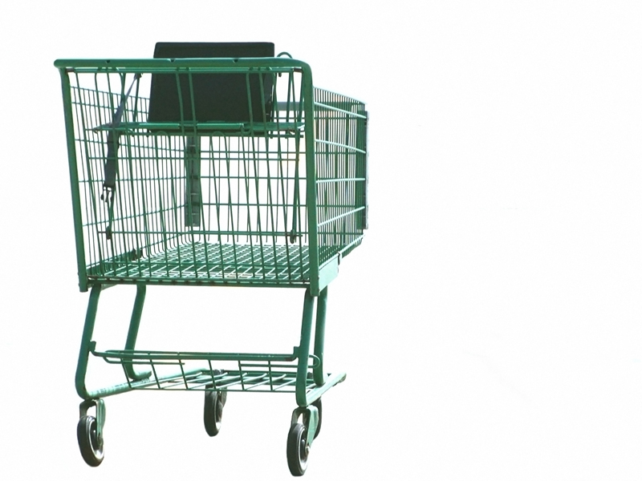
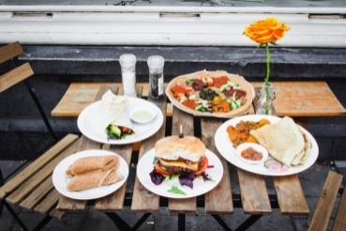
Categorize Expenses
Groceries
Eating Out
School Meals
Food
Formula
Housing

Slide 24
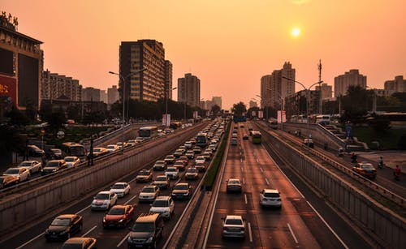
Transportation
Car Loan Payment
Car Insurance
Food
Gas/Maintenance/Repair
Public Transportation

Slide 25
Doctor/Dental Copays
Eye Care/Glasses
Health
Medicines
Transportation
Hospital/Clinic
Life/Disability Insurances

Slide 26
Personal Care
Children
Health
Day Care
Clothing
Diapers
Cleaning Supplies
School/Activity Fees
Hair/Nail Care
Allowance
Notes:
Adrian
Explain:
Emergency Savings….First line of defense for a loss. Experts’ say we should have three to six months worth of EXPENSES saved up in case of an emergency.
Our emergency fund should be ‘liquid’ meaning in cash form, like a savings account at a bank or credit union. Note that having a stash of cash in our homes is not the safest place to keep it.
The cash should be accessible but not too accessible. For example, having cash in a bank or credit union is accessible, but forego the ATM card. Maybe even open up a separate account at a different bank or credit union so it’s not too easy to get to.
-Next-

Slide 27
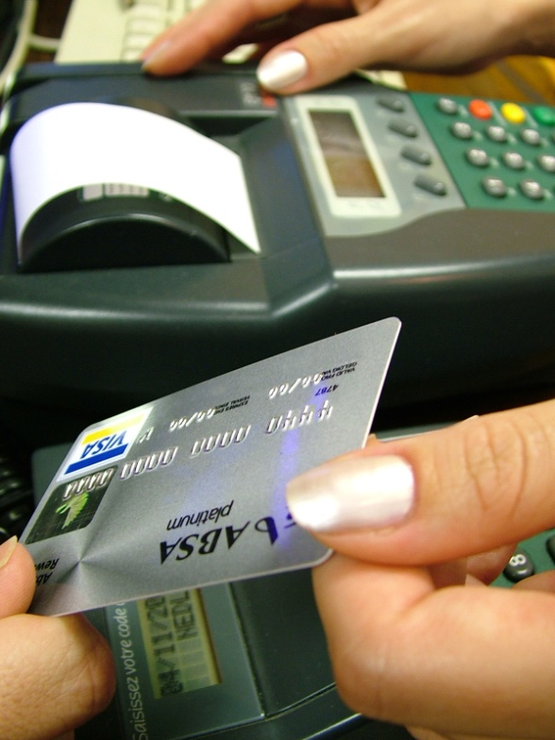
Obligations
Past Due Bills
Personal Care
Credit Cards
Children
Student Loans
Donations/Gifts
Pets
Notes:
Adrian
Explain:
Emergency Savings….First line of defense for a loss. Experts’ say we should have three to six months worth of EXPENSES saved up in case of an emergency.
Our emergency fund should be ‘liquid’ meaning in cash form, like a savings account at a bank or credit union. Note that having a stash of cash in our homes is not the safest place to keep it.
The cash should be accessible but not too accessible. For example, having cash in a bank or credit union is accessible, but forego the ATM card. Maybe even open up a separate account at a different bank or credit union so it’s not too easy to get to.
-Next-

Slide 28
Entertainment
Obligations
Books/Movies/Music
Hobbies
Vacation
Clubs/Memberships
Vices
Notes:
Adrian
Explain:
Emergency Savings….First line of defense for a loss. Experts’ say we should have three to six months worth of EXPENSES saved up in case of an emergency.
Our emergency fund should be ‘liquid’ meaning in cash form, like a savings account at a bank or credit union. Note that having a stash of cash in our homes is not the safest place to keep it.
The cash should be accessible but not too accessible. For example, having cash in a bank or credit union is accessible, but forego the ATM card. Maybe even open up a separate account at a different bank or credit union so it’s not too easy to get to.
-Next-

Slide 29
Anna’s Expenses

Slide 30
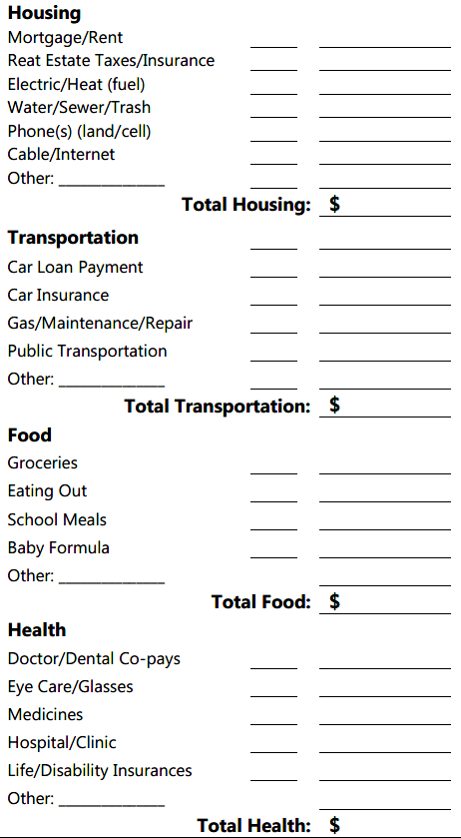
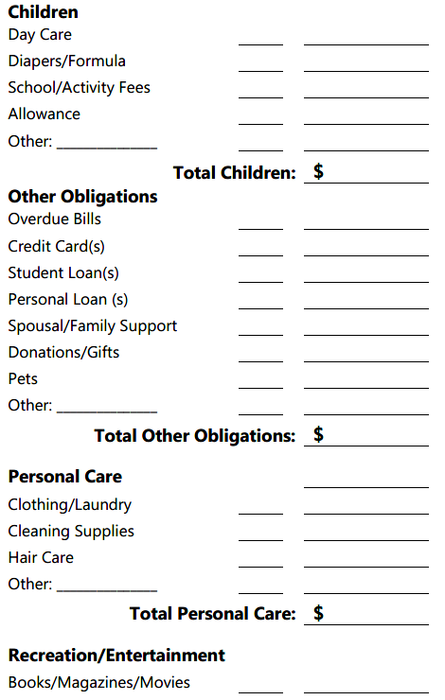
Total Expenses
Entertainment
F $1,480
V $ 240
V $ 230
1,950
F $ 0
V $ 60
F $ 130
190
V $ 600
V $ 100
F $ 115
815
V $ 25
25
Obligations
V $ 80
80
V $ 40
V $ 55
F $ 278
V $ 108
481
V $ 230
V $ 80
310
V $ 90
V $ 100
V $ 43
233
Personal Care
Children
Health
Transportation
Food
Housing

Slide 31
One More Way to Classify Expenses
Entertainment
F $1,480
V $ 240
V $ 230
1,950
F $ 0
V $ 60
F $ 130
190
V $ 600
V $ 100
F $ 115
815
V $ 25
25
Obligations
V $ 80
80
V $ 40
V $ 55
F $ 278
V $ 108
481
V $ 230
V $ 80
310
V $ 90
V $ 100
V $ 43
233
Personal Care
Fixed (predictable, consistent, less flexibility)
Mortgage
Loan payments
Childcare
Variable (less predictable, flexibility, choice)
Food
Credit card payments
Entertainment
Children
Health
Transportation
Food
Housing

Slide 32
Compare Income and Expenses
Cash Flow
What comes in less where it goes!
JARGON ALERT!
Cash Flow
Expenses
Income

Slide 33
Cash Flow
Choices
Expenses
Income
Income
Income
Expenses
Expenses
$$ for Goals!

Slide 34
Anna’s Cash Flow

Slide 35
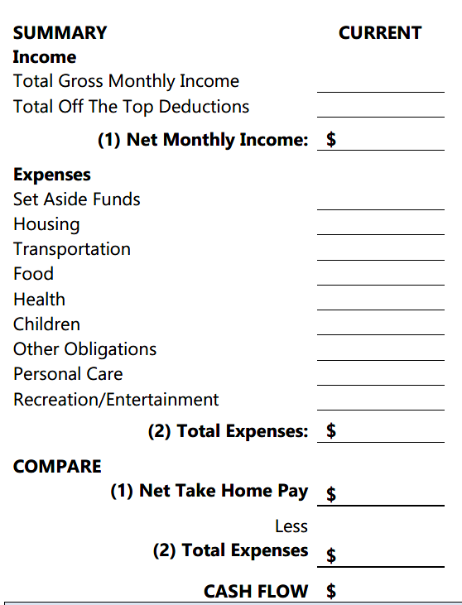
$ 4,402
($ 739)
3,663
$ 0
$ 1,950
$ 190
$ 815
$ 25
Cash Flow
What comes in less where it goes!
$ 80
$ 481
$ 310
$ 233
4,084
3,663
4,084
-421
Notes:
Adrian
Explain:
These four pages are designed to help you know, plan, and follow your map.
Notice on each page there is a Current, Plan, and Actual column.
The Current column will contain the amounts for where you are now.
The Plan column is for the amounts that will get you to your goal.
The Actual is a follow-up column to show what you’ve actually done.
-Next-

Slide 36
Transfer errors
Missing entries
Periodic expenses
Spending leaks
Numbers don’t mesh?
Notes:
Adrian
Explain:
So what if your ‘numbers’ don’t mesh with what is actually left over in your wallet? First go back to and check to make sure there aren’t any transfer errors from your pay or What Comes In worksheet. If you have fluctuating income due to seasonal work or overtime, that may affect this month’s numbers.Then look at the expenses you tracked. Look for missing entries, special expenses you may have incurred this month, and spending leaks. If it still doesn’t seem right, realize that it may take three months to get a really good idea of your spending. And that’s ok because it will mean you have a better chance at putting together a manageable plan.
Next-

Slide 37
It’s only a $2 cup of coffee!
1 week $10
1 year $520
10 years $5,200
20 years $10,400
Spending leaks!
Notes:
Adrian
Explain:
So what if your ‘numbers’ don’t mesh with what is actually left over in your wallet? First go back to and check to make sure there aren’t any transfer errors from your pay or What Comes In worksheet. If you have fluctuating income due to seasonal work or overtime, that may affect this month’s numbers.Then look at the expenses you tracked. Look for missing entries, special expenses you may have incurred this month, and spending leaks. If it still doesn’t seem right, realize that it may take three months to get a really good idea of your spending. And that’s ok because it will mean you have a better chance at putting together a manageable plan.
Next-

Slide 38
Chat Box
What are some expenses that don’t happen on a monthly basis?

Slide 39
Anna’s Periodic Expenses

Slide 40
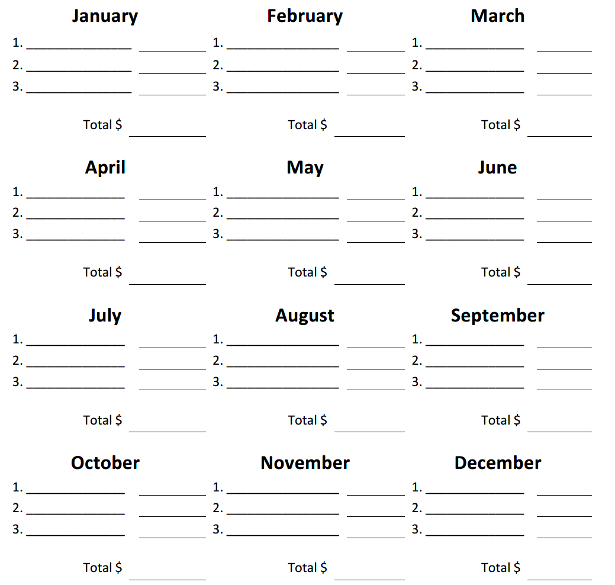
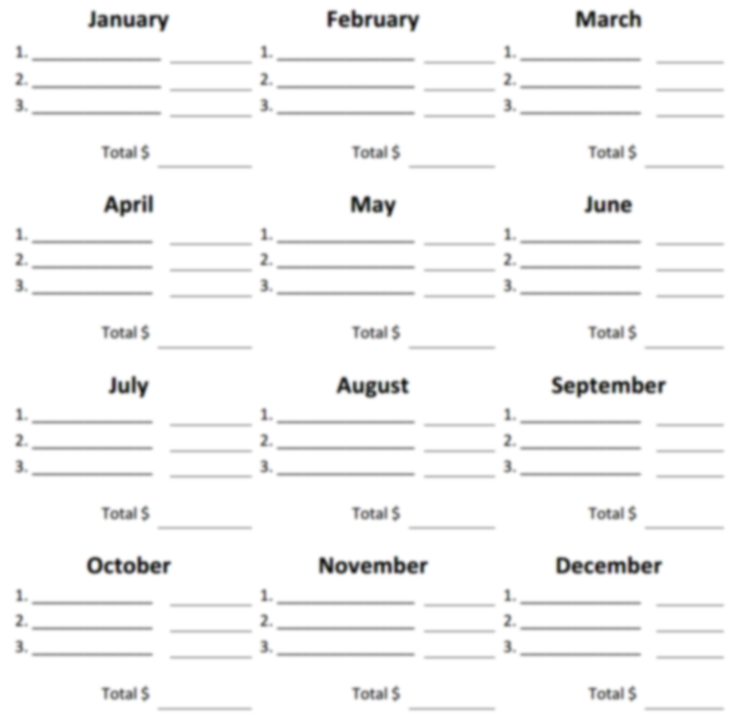
Periodic Expenses
Car Insurance $ 870
$ 870
Add periodic expenses:
Feb: $ 870
Aug: $ 1,270
Dec: $ 500
Total: $2,640 ÷12 months
Set-asides: $220/month
Car Insurance $ 870
Back-to-School $ 400
$1,270
Gifts $ 500
$ 500

Slide 41
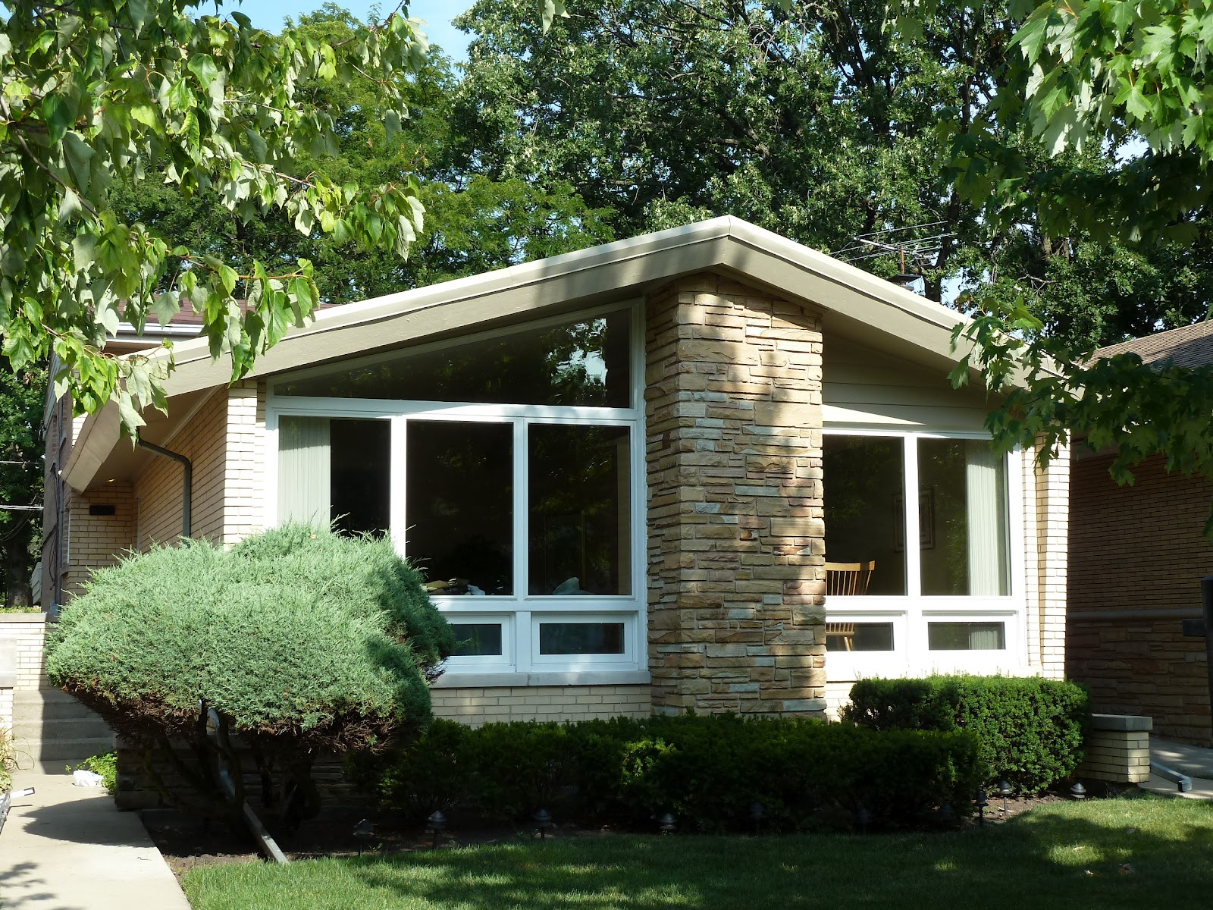
Set-Asides
Entertainment
Obligations
Emergency Savings
Personal Care
Children
Periodic Expenses
Health
Transportation
Food
Savings Goals
Housing
Set-Asides
This Photo by Unknown Author is licensed under CC BY

Slide 42
Make Choices
Increase Income
More hours
Part-time job
Adjust withholding
Make Choices
Decrease Expenses
Needs vs. wants
Spending priorities
Major decisions
Cash Flow
Expenses
Income
Combination

Slide 43
Needs vs. Wants
Cost $40
Take-home pay $15/hr
2.7hrs
It takes nearly THREE hours of HARD work to pay for it.
IS IT WORTH IT?

Slide 44
Anna’s Needs vs. Wants

Slide 45
Spending Pyramid
WANTS
5
4
3
2
1
Off The Top
Lottery
Tobacco
Eating Out
Movies
Hair Care
Donations
Overdue Bills
Kids’ Allowance
Cable
Credit Card
Set-asides
Cell Phone
Emergency Savings
Money Orders
Groceries
School Meals
Rent
Transportation
Federal, State, Local ,
& FICA Taxes
Utilities
NEEDS
Health Insurance

Slide 46
Housing
Transportation
Family
Major Decisions
Notes:
Adrian
Explain:
So what if your ‘numbers’ don’t mesh with what is actually left over in your wallet? First go back to and check to make sure there aren’t any transfer errors from your pay or What Comes In worksheet. If you have fluctuating income due to seasonal work or overtime, that may affect this month’s numbers.Then look at the expenses you tracked. Look for missing entries, special expenses you may have incurred this month, and spending leaks. If it still doesn’t seem right, realize that it may take three months to get a really good idea of your spending. And that’s ok because it will mean you have a better chance at putting together a manageable plan.
Next-

Slide 47
Plan Your Route
Plan Your Route
Make Choices
Cash Flow
Expenses
Income

Slide 48
Anna’s Plan

Slide 49
Plan Your Route
Start with income and plan any changes:
Earnings
Assistance
Withholding
Deductions
Highlight any planned differences.
Notes:
Explain:
Now we need to set the plan. We’ll be working with the Plan column. Use the Current column numbers as a guide and decide if it will stay the same or change in the Plan column.
Since the cash flow equation has two parts, Income and Expenses, you can make changes in both. Increase income, decrease and/or reallocate expenses to put your plan in place.
What’s important to remember in this process is that you want to account for every penny coming into your house and then tell it where it needs to go.
-Next-

Slide 50
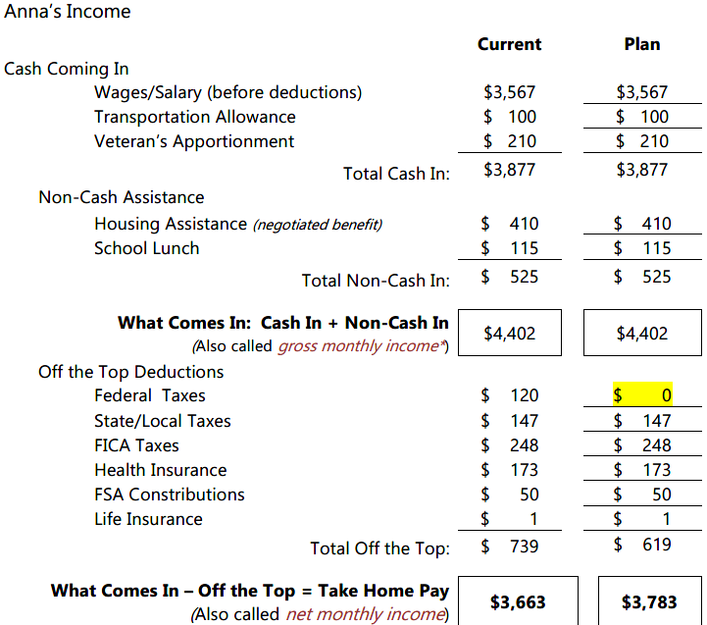
Anna’s Income Plan
Notes:
Explain:
Now we need to set the plan. We’ll be working with the Plan column. Use the Current column numbers as a guide and decide if it will stay the same or change in the Plan column.
Since the cash flow equation has two parts, Income and Expenses, you can make changes in both. Increase income, decrease and/or reallocate expenses to put your plan in place.
What’s important to remember in this process is that you want to account for every penny coming into your house and then tell it where it needs to go.
-Next-

Slide 51
Plan Your Route
Do the same with expenses; include set-asides and SMART goals.
Highlight any planned differences.
Notes:
Explain:
Now we need to set the plan. We’ll be working with the Plan column. Use the Current column numbers as a guide and decide if it will stay the same or change in the Plan column.
Since the cash flow equation has two parts, Income and Expenses, you can make changes in both. Increase income, decrease and/or reallocate expenses to put your plan in place.
What’s important to remember in this process is that you want to account for every penny coming into your house and then tell it where it needs to go.
-Next-

Slide 52
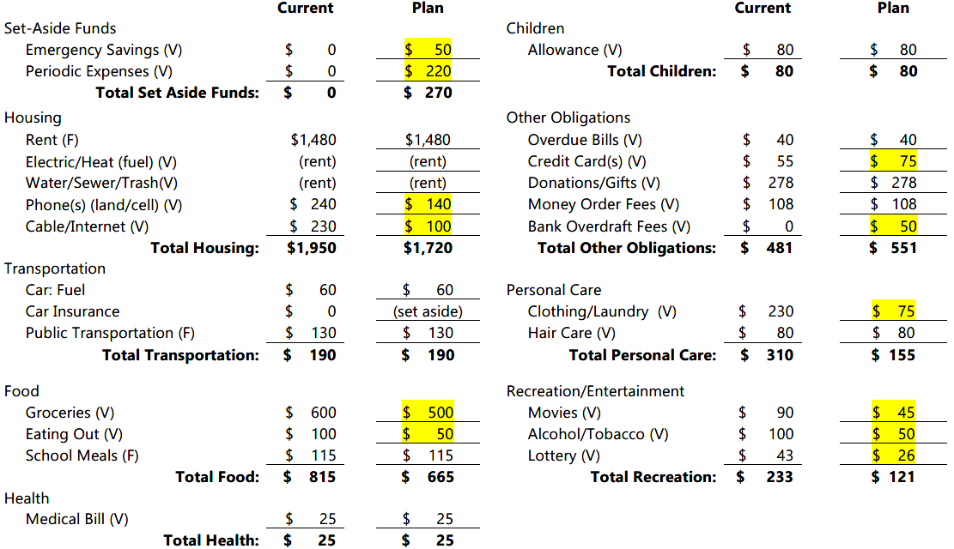
Anna’s Expense Plan
Notes:
Explain:
Now we need to set the plan. We’ll be working with the Plan column. Use the Current column numbers as a guide and decide if it will stay the same or change in the Plan column.
Since the cash flow equation has two parts, Income and Expenses, you can make changes in both. Increase income, decrease and/or reallocate expenses to put your plan in place.
What’s important to remember in this process is that you want to account for every penny coming into your house and then tell it where it needs to go.
-Next-

Slide 53
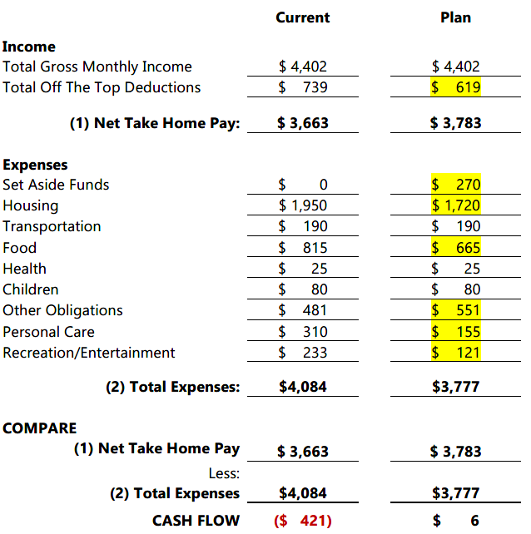
Calculate planned cash flow.
Highlight any planned changes.
Notes:
Adrian
Explain:
Now that you have income and expenses, you need to summarize and compare. Enter the totals from each of your income and expense categories listed.
Click
Then compare net take home pay to total expenses to get your cash flow. What’s CASH FLOW?
-Next-

Slide 54
Follow Your Map
Follow Your Map
Plan Your Route
Make Choices
Cash Flow
Expenses
Income

Slide 55
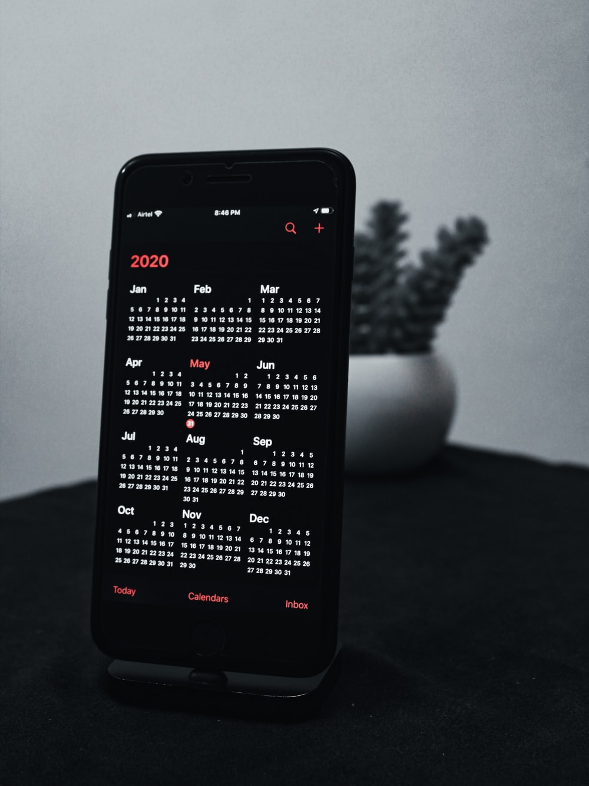
How Does Your Cash “Flow?”
Income and expenses may not be timed perfectly on a monthly basis
Seasonal employment
Fluctuating hours
Fluctuating benefits
When it comes in
When it goes out

Slide 56
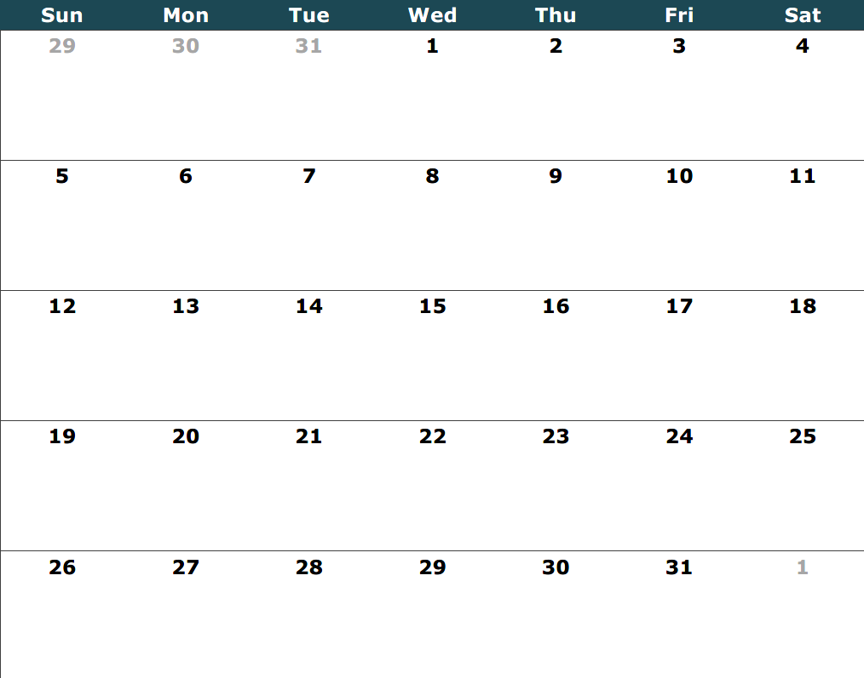
Use a Calendar and Plan Weekly
Pay Day!
Veteran’s Benefit
Allowances
Groceries
Set-asides
RENT
Transit
Cable
Allowances
Medical
Bill
Groceries
Tithe
Transit
Pay Day!
Allowances
Groceries
Set-asides
Tithe
Credit Card
Cell phone
Transit
Electric
Allowances
Groceries
Tithe
Water
Veteran’s
Benefit
Transit
Pay Day!
Tithe
Set-asides
RENT
Allowances
Groceries

Slide 57
Why should I use a bank or a credit union?

Slide 58
Mainstream Financial Institutions
Banks/Thrifts
For-profit
Stockholder-focused
Take deposits
Make loans
Other services
Insured by FDIC
Credit Unions
Not-for-profit
Member focused
Take deposits
Make loans
Other services
Insured by NCUA

Slide 59
Mainstream Financial Institutions
Benefits
Safe
Guaranteed
Insured
Liquid
Cost
Convenience
Relationships

Slide 60
Cash Management Accounts
Direct Deposit
Bills
Checking
Deposit Checks
Savings
Deposit Cash
Cash

Slide 61
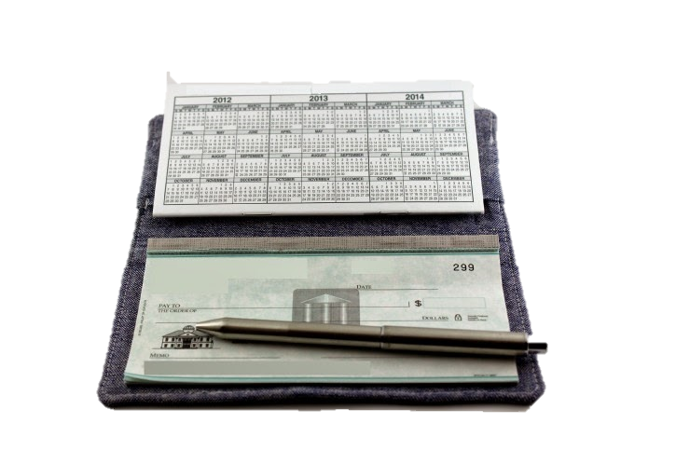
Cash Management Accounts
Access thru checks, debit cards, ATM’s
Overdraft fees/protection
May have to maintain minimum balance
May or may not pay interest
Back-office check conversion
Checking Accounts

Slide 62
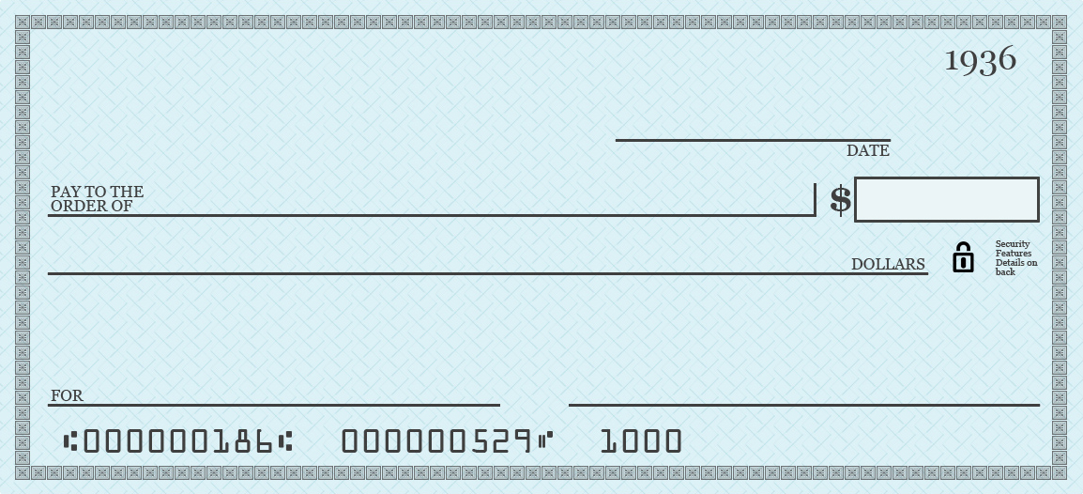
Side Bar: Mishandling a Checking Account
Check verification
Additional fees from merchants
Refusal from merchants
Bank/credit union can close your account
Reported to ChexSystems

Slide 63
Side Bar: Mishandling a Checking Account
Returned checks
Account closures
Financial institution inquiries and in what time frames
Check orders you have placed and how often
Check cashing activities
Suspected fraud

Slide 64
Side Bar: Finding the Right Fit
Savings
Checking
Services
Fee$
Loans

Slide 65
How to Choose?

Slide 66
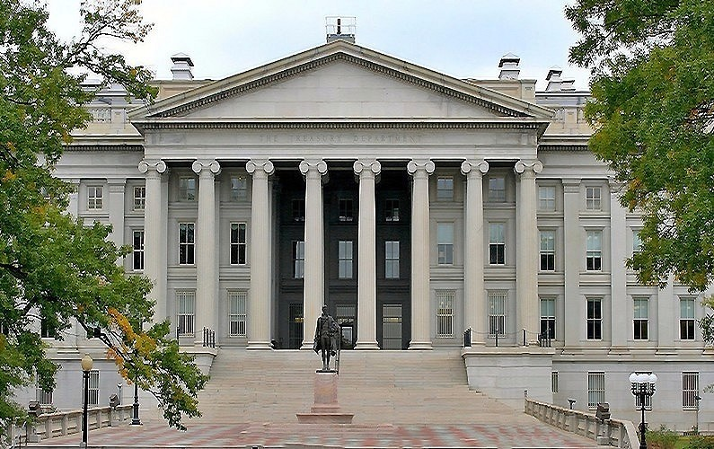
Side Bar: Finding the Right Fit
FDIC or NCUA insured
Languages spoken
Convenient branches/ ATM’s
Hours
Minimum balances
Interest earned
Fees
Choosing an institution

Slide 67
Side Bar: Finding the Right Fit
Check cashers
Money orders
Prepaid debit cards
Money transmitters
Mattress or coffee can
Alternatives

Slide 68
What exactly is financial technology?

Slide 69
According to Investopedia, FinTech is technology that seeks to improve and automate the delivery and use of financial services.
It’s like what the assembly line did for automobile manufacturing.
Financial technology (a.k.a. FinTech)

Slide 70
Financial Technology
These are computer programs for budgeting, investing, tax preparation and electronic filing.
Examples:*
Quicken
TurboTax
IRS’s e-File
Software
*This is in no way an endorsement of any company, product, or service. As with any financial technology, use caution and review security measures to protect your personal information.

Slide 71
Financial Technology
These are websites that can access all your financial accounts and display them in a single place.
Examples:*
Mint.com
Personal Capital
Tiller
Account aggregates
*This is in no way an endorsement of any company, product, or service. As with any financial technology, use caution and review security measures to protect your personal information.

Slide 72
Financial Technology
These are digital wallets that store payment information, such as a credit card or bank account numbers, on a mobile device.
Examples:*
Apple Pay
Samsung Pay
Android Pay
Mobile wallets
*This is in no way an endorsement of any company, product, or service. As with any financial technology, use caution and review security measures to protect your personal information.

Slide 73
Financial Technology
These online payment service providers process electronic payments directly using linked credit cards and debit accounts.
Examples:*
PayPal
WePay
Stripe
Payment platforms
*This is in no way an endorsement of any company, product, or service. As with any financial technology, use caution and review security measures to protect your personal information.

Slide 74
Financial Technology
These mobile apps transfer money from a mobile device to people you know by linked credit cards or debit accounts.
Examples:*
Venmo
Zelle
Cash App
Peer-to-peer (P2P)
*This is in no way an endorsement of any company, product, or service. As with any financial technology, use caution and review security measures to protect your personal information.

Slide 75
Financial Technology
Roboadvisors
Crowd funding
Peer-to-peer lending
Cryptocurrencies
Others
*This is in no way an endorsement of any company, product, or service. As with any financial technology, use caution and review security measures to protect your personal information.

Slide 77
Money Values
Needs vs. Wants
Creating a Money Map
Managing Cash Flow
Mainstream Banking
Today’s Topics
Notes:
Today we’re going to talk about:
Money values and setting financial goals
Creating a Money Map
Making good financial choices
Knowing how your cash flows

Slide 78
Live within means
Track and prioritize spending
Create & use a manageable money map
Establish a relationship with a government-insured financial institution

Slide 79
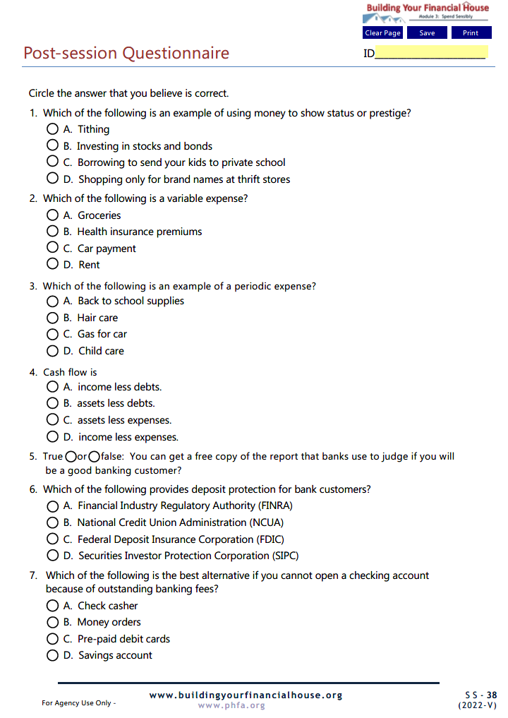
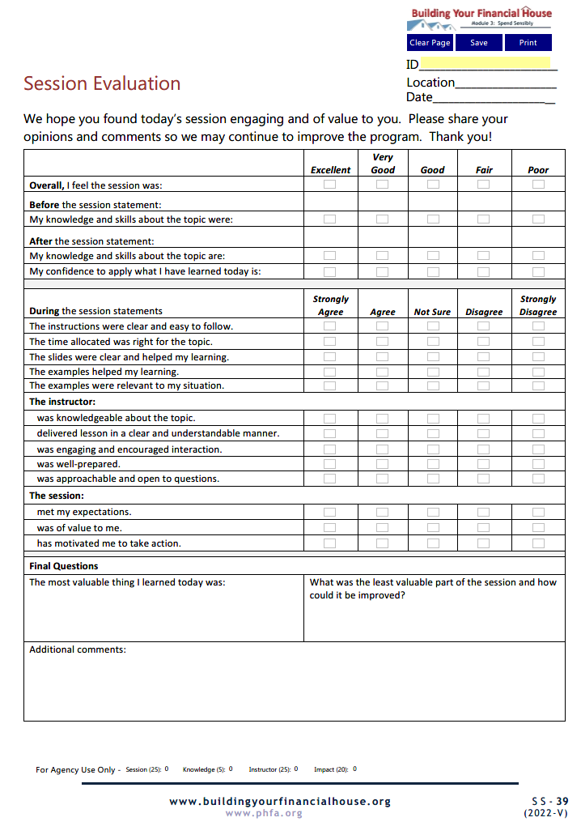
Complete Today

Slide 80
Email the Post-Session Questionnaire and the Session Evaluation to:

Slide 81
Now, it’s your turn!
Note: For best results, view in Adobe Reader DC or Nuance.

Slide 82
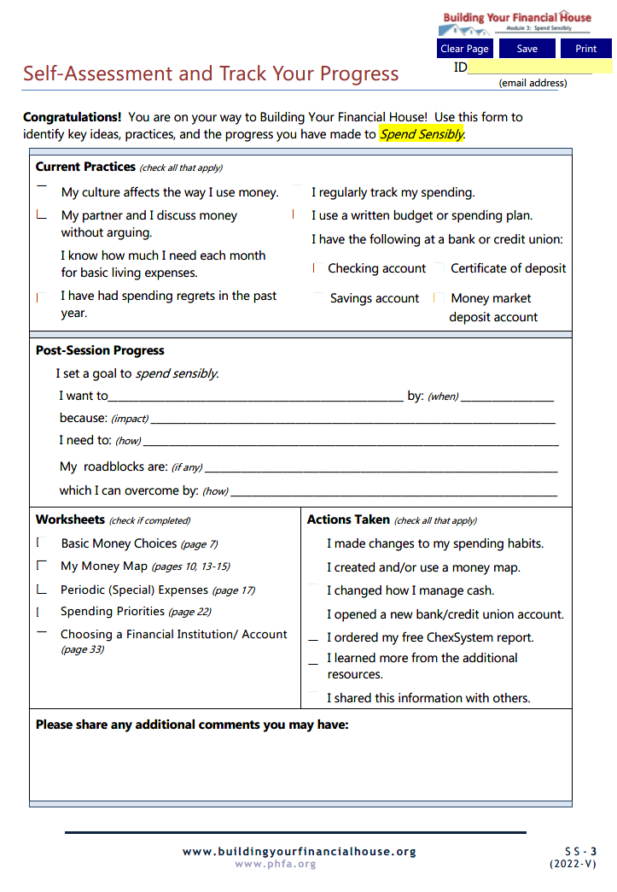
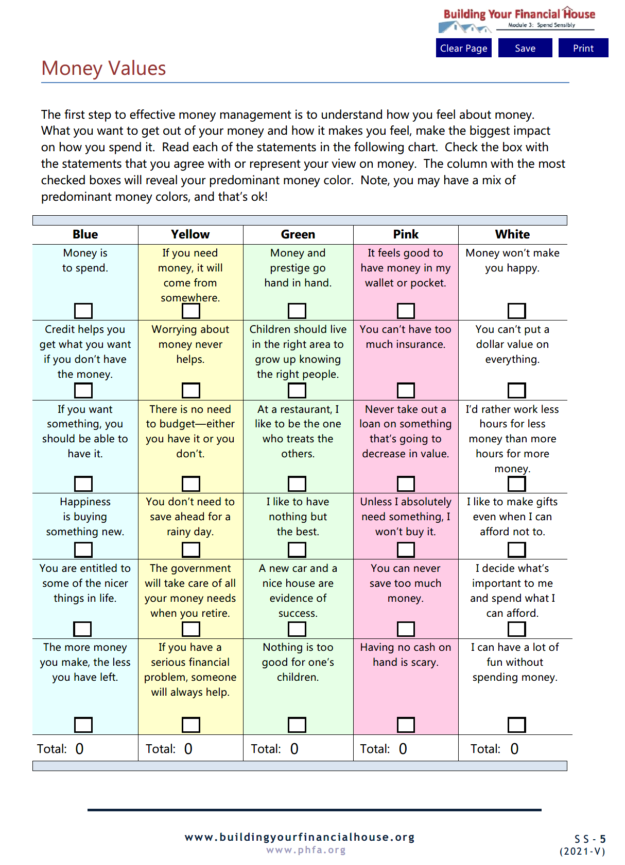
Homework

Slide 83
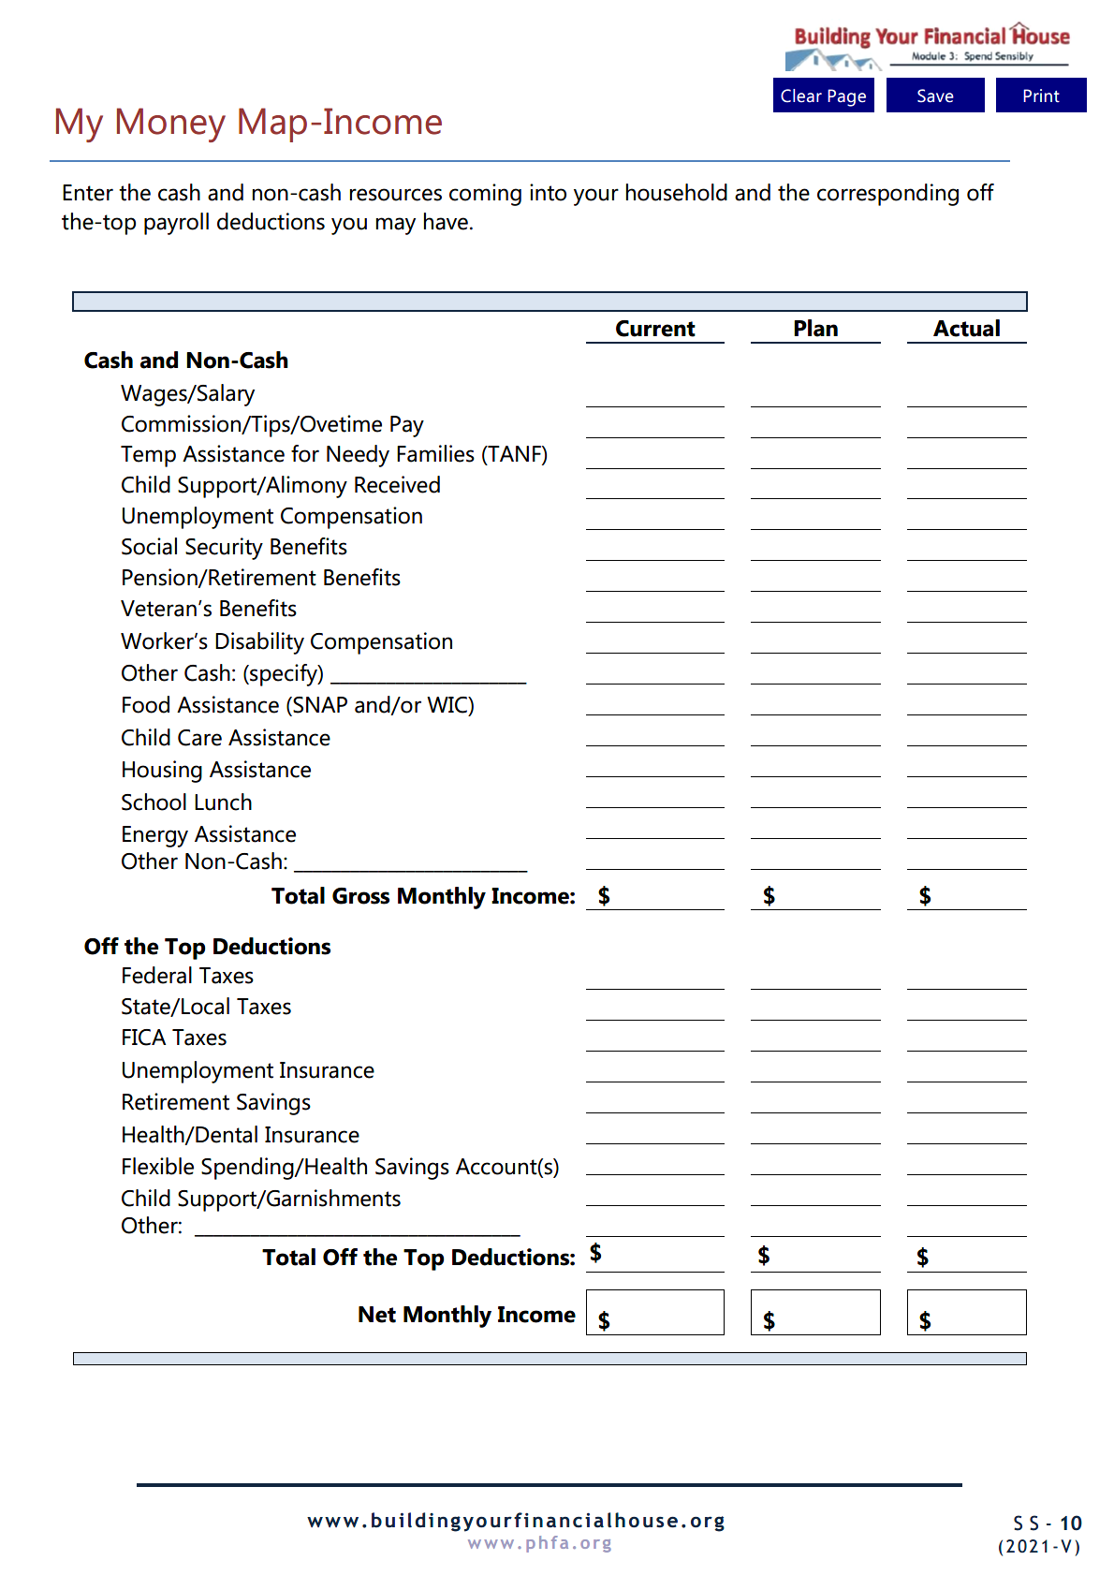

Slide 84
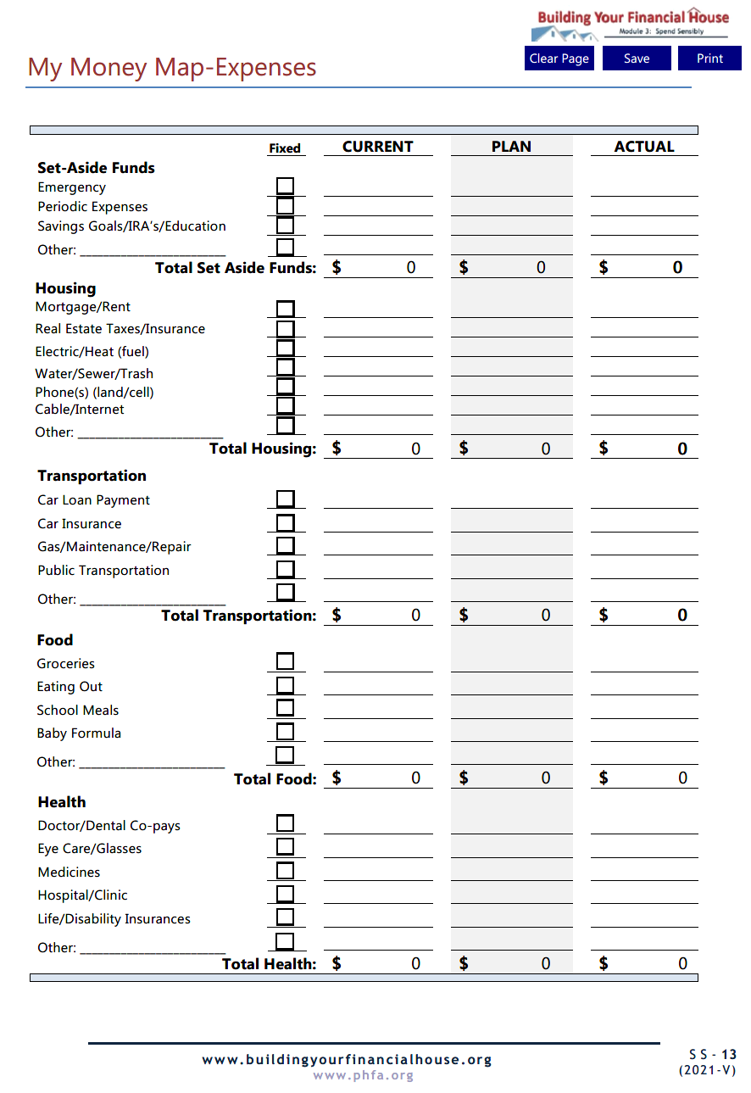
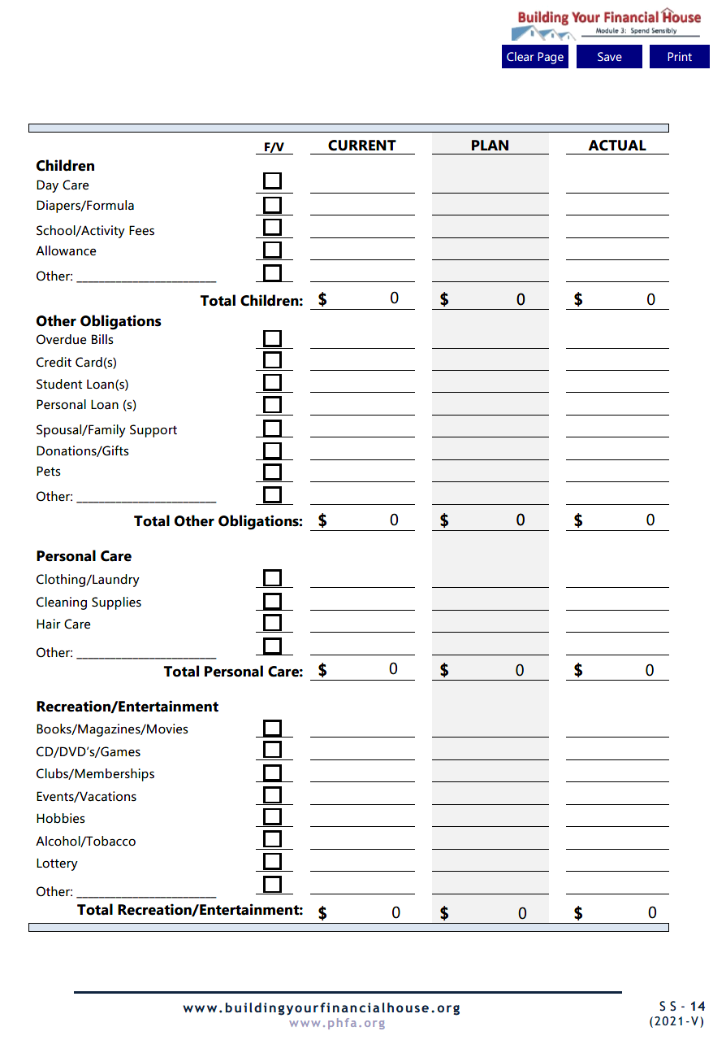

Slide 85
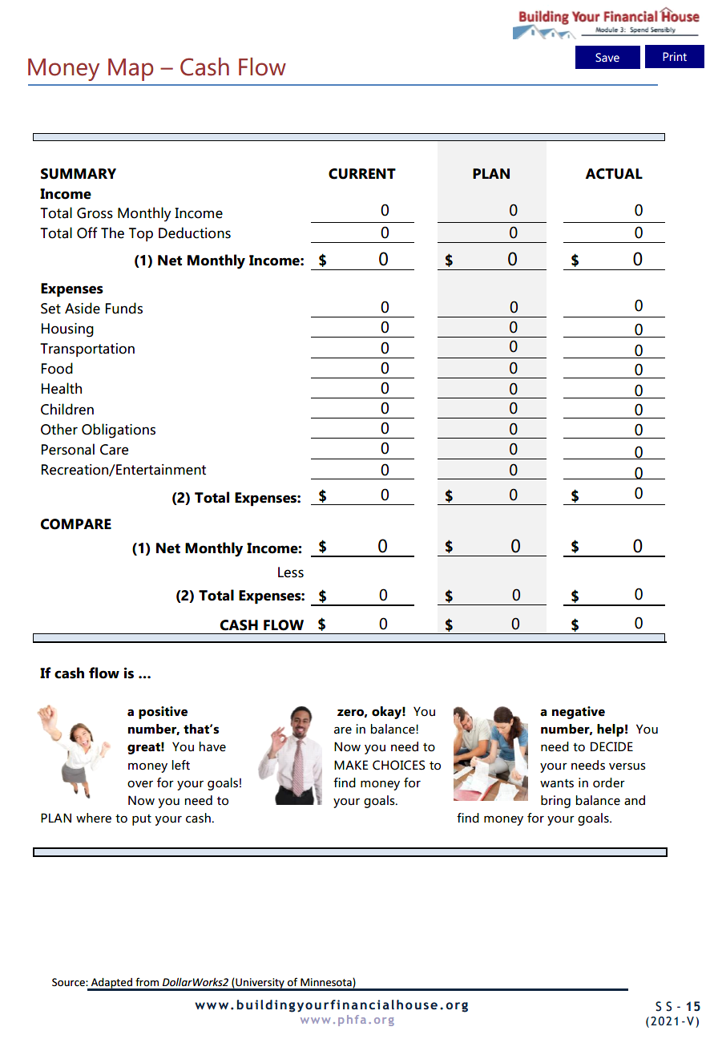
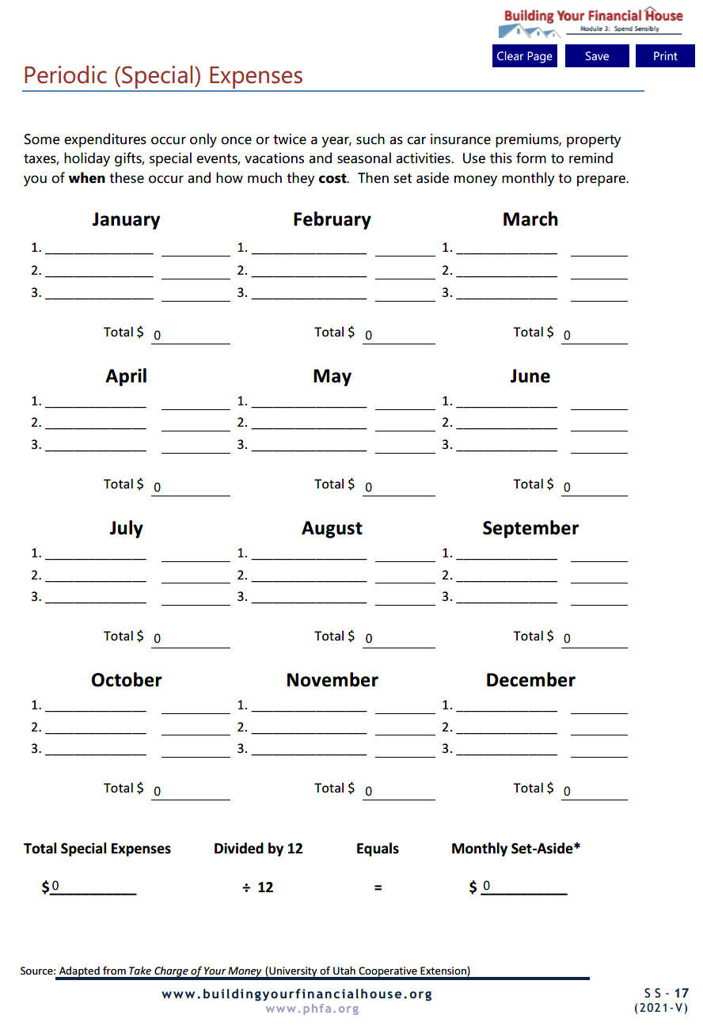

Slide 86
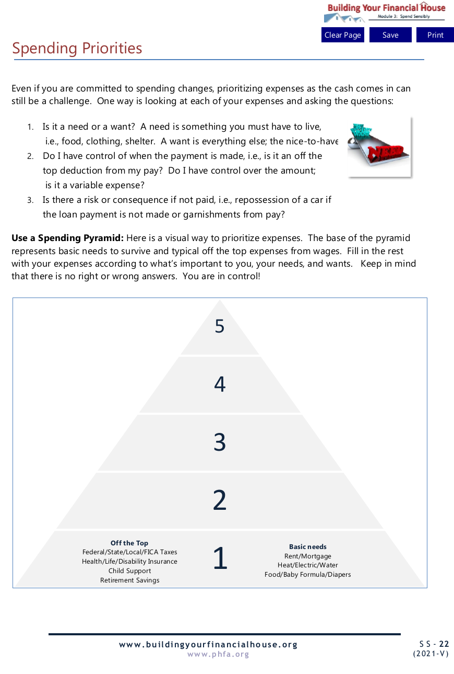
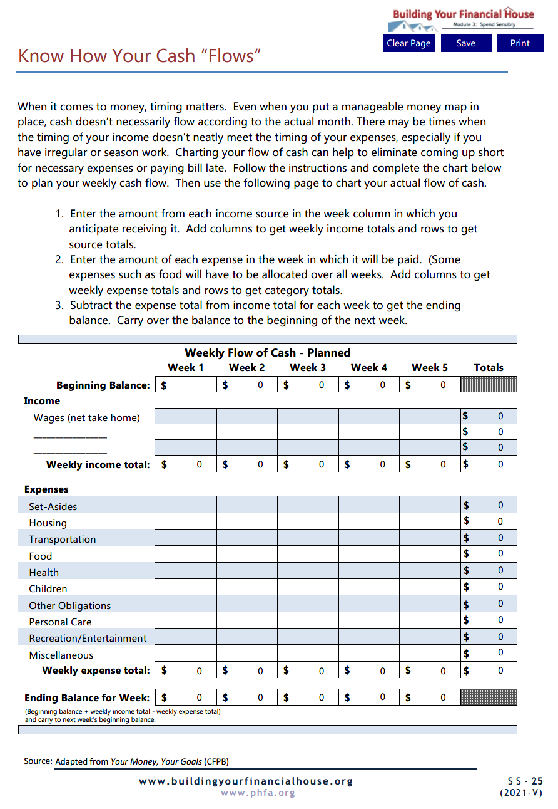

Slide 87
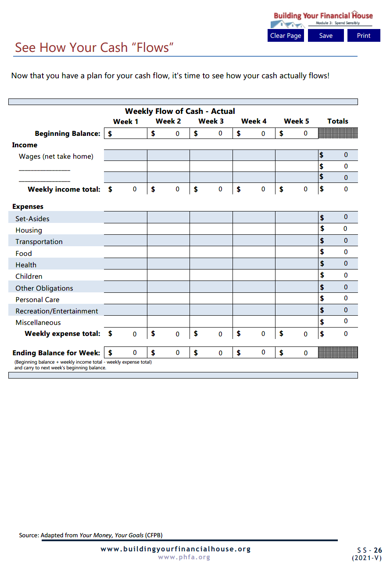
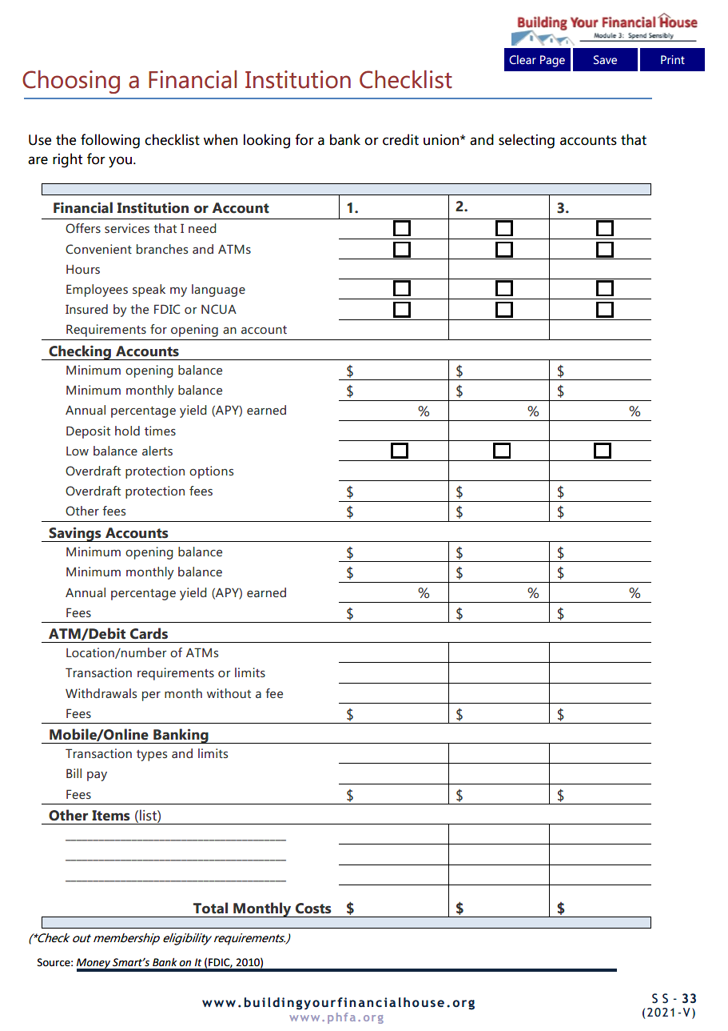

Slide 88
PRIOR TO NEXT SESSION,
email completed homework to:

Slide 89
Next Time:
Check Taxes

Slide 90
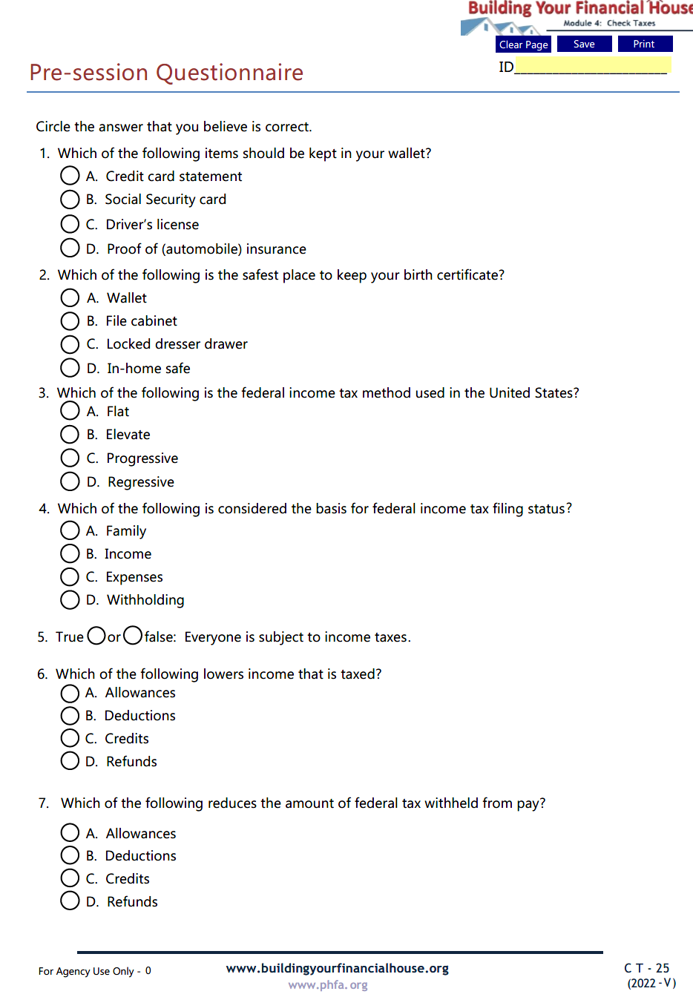
Check Taxes Pre-Session Questionnaire
Email Spend Sensibly Pre-Session Questionnaire to:

Slide 91
Questions?

Slide 92
Thank You!

