Slide 2
Building Your Financial House
WELCOME
Notes:
Good afternoon everyone!
Thank you for joining us as we discuss Creating a Financial Resource Center on-site, at you development or agency.
We hope this presentation will help you bring vetted, unbiased financial education resources to your residents or clients that they can use right now.
So let’s get started.

Slide 3
Housekeeping
Please mute your phone or computer to eliminate background noise.
To maximize bandwidth:
(Turn camera off)
Close unused apps or webpages
Please raise hand or use chat feature for questions.
Notes:
Good afternoon everyone!
Thank you for joining us as we discuss Creating a Financial Resource Center on-site, at you development or agency.
We hope this presentation will help you bring vetted, unbiased financial education resources to your residents or clients that they can use right now.
So let’s get started.

Slide 4
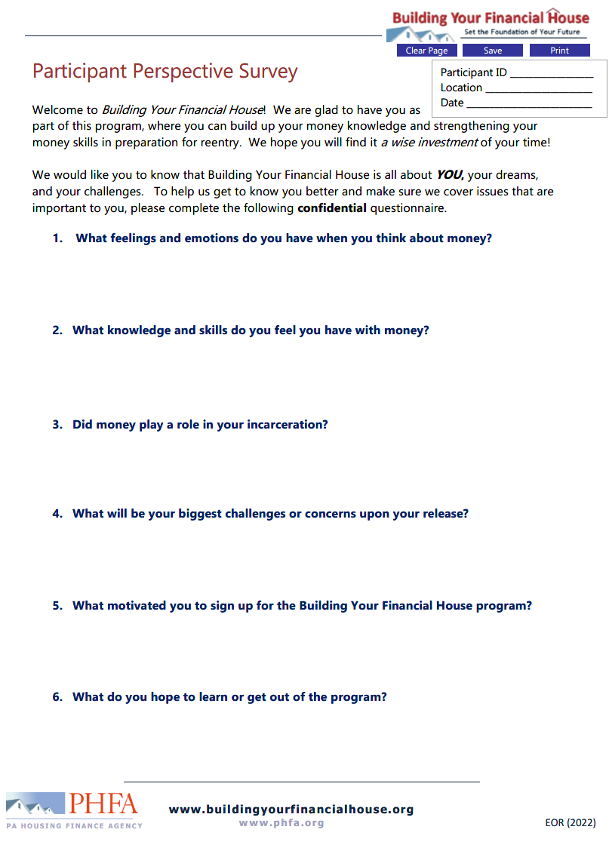
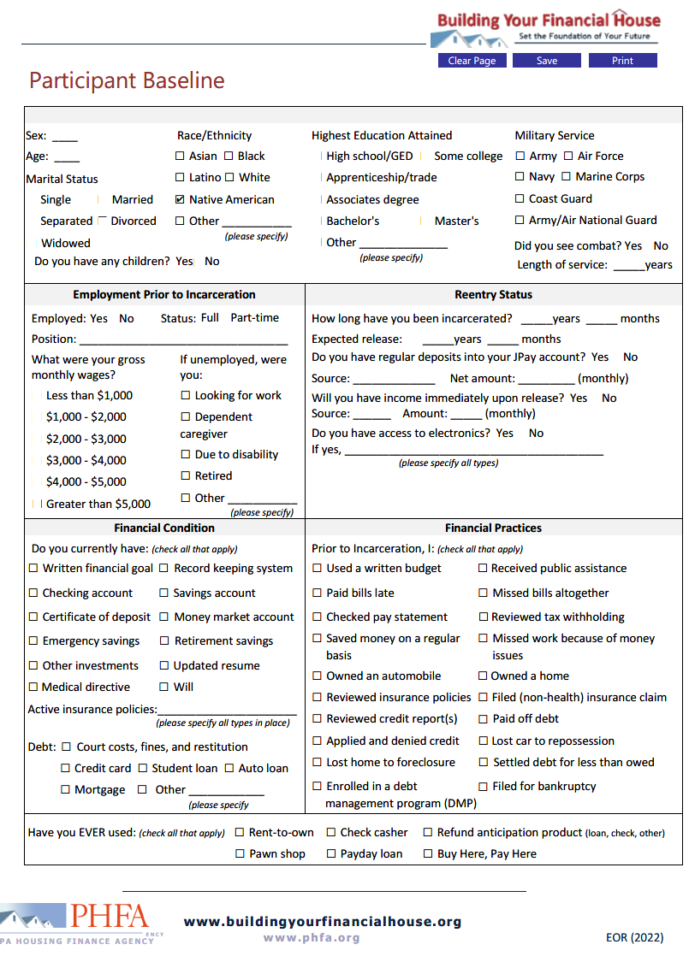
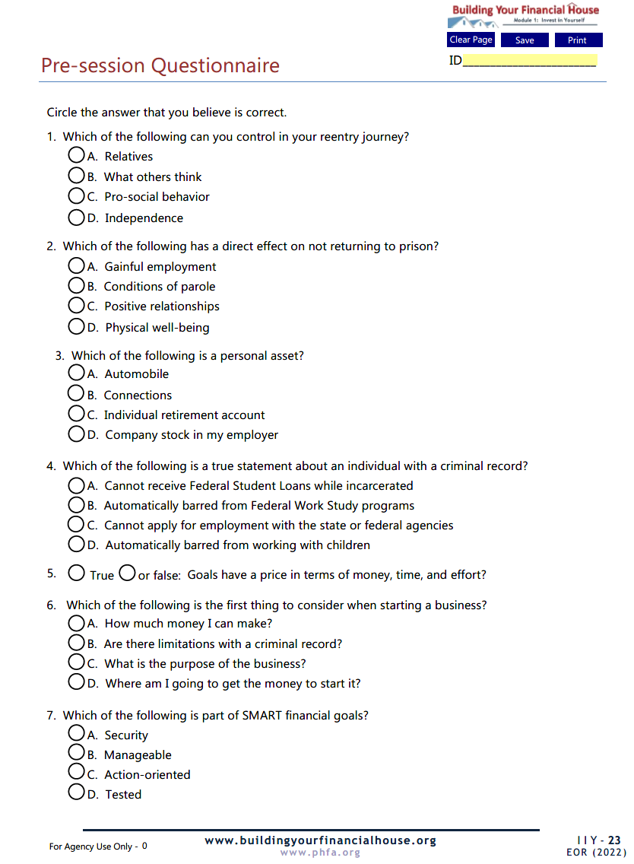
Prior to Today’s Session

Slide 5
Today’s Topics
Program Introduction and Objectives
What is Success
Personal Assets and Opportunities
Learning = Earning
Setting Your Destination
The Framework
Notes:
Today we’re going to talk about:
Money values and setting financial goals
Creating a Money Map
Making good financial choices
Knowing how your cash flows

Slide 6
Program Introduction and Objectives
What is Success
Personal Assets and Opportunities
Learning = Earning
Setting Your Destination
The Framework
Today’s Topics
Notes:
Today we’re going to talk about:
Money values and setting financial goals
Creating a Money Map
Making good financial choices
Knowing how your cash flows

Slide 7
Program Objectives
Become more comfortable talking about money
Identify the Framework for Building Your Financial House
Get facts and skills needed to build your own financial house
Gain confidence to make good money choices
Be in a better position for long-term financial stability and success
Notes:
Good afternoon everyone!
Thank you for joining us as we discuss Creating a Financial Resource Center on-site, at you development or agency.
We hope this presentation will help you bring vetted, unbiased financial education resources to your residents or clients that they can use right now.
So let’s get started.

Slide 8
What is the best $50 you’ve ever spent?
What is the worst $50 you’ve ever spent?

Slide 9
How Do We Learn About Money?
You Are Here!

Slide 10
Financial Education!
Confidence
Skills
Knowledge

Slide 11
The Framework

Slide 12
6
Protect Your Potential
5
Make Money Work
4
Check Taxes
3
Spend Sensibly
7
Borrow to Grow
2
Maximize Earnings
1
Invest in Yourself

Slide 13
A well-built financial house starts with a strong foundation of investing in yourself, developing new skills, and recognizing opportunities.
1
Invest in Yourself

Slide 14
Define what success means
Identify four categories of personal assets
Recognize the education-to-income relationship
Recognize opportunities for advancement using personal assets
Identify priorities and SMART financial goals

Slide 15
Take your reentry seriously; the difference between success and failure is a choice.
Ask for help; there are many resources available to you.
Work hard, stay focused, and don’t be distracted by the nay-sayers.
Have realistic expectations.
Stay flexible and be patient; the first steps you make are only transitions to something better.
Do whatever it takes, including getting right with yourself and being in the right place with the right people.
Destination:
Successful Reentry

Slide 16
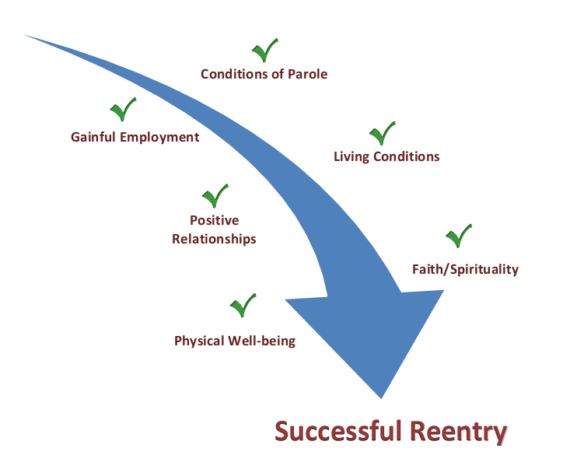
Path to Successful Reentry

Slide 17
What is Success?

Slide 18
What we think of ourselves.
What we value and
have control of in our lives.
Decisions we make.
How we talk and relate to others.
How we use our personal assets.

Slide 19
Control in My Life
knowledge
self-belief
what others think
family time
decision making
health
income
behavior
recreation
what i think
goals
housing
transportation
attitude
childcare
job
relatives
housekeeping

Slide 20
Something of value as in a possession or quality
What is an asset?
This Photo by Unknown Author is licensed under CC BY-SA

Slide 21
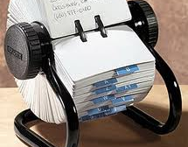
What are personal assets?
This Photo by Unknown Author is licensed under CC BY

Slide 22
Education
Diplomas and degrees
Apprenticeships
Career certificates
Workplace training
Personal enrichment
Self-study

Slide 23
Skills and Talents
Physical
Strength
Endurance
Academic
Problem solving
Communications
Practical
Crafts
Hobbies

Slide 24
Personality
Describe yourself
How would a friend, co-worker or family member describe you?
What brings you joy?
What is your biggest fear?
What is your biggest dream?

Slide 25
Connections
Circle of influence
Who do you respect and why?
Do you have a mentor?
Who could you call if your car broke down?
Who has helped you along the way?

Slide 26
Personal Assets
Things that nobody can take away from you!

Slide 27
Chat Share
Please share:
Something you like to do
Something that comes naturally to you
The last compliment you received
An accomplishment that made you proud

Slide 28
Assets Employers Want
self-starter
work well under pressure
flexible
time management
positive attitude
team player
good communication skills
focused
strong work ethic
problem-solver
get along with people of different backgrounds
organizational skills

Slide 29
Connect Personal Assets to Job Skills
I am the go-to person for planning family events (weddings, anniversaries, etc.).
If I can coordinate details of major life events, I know I will be able to meet the organizational demands of the job.
Time management
Organizational skills
Meet deadlines
Work with difficult people
I know how to throw a good party!

Slide 30
Connect Personal Assets to Job Skills
When the dishwasher broke, I downloaded the user manual, looked up how-to videos, and fixed it on my own.
My ability to research and solve mechanical problems will help me keep the company’s equipment in peak operating condition
Self-starter
Problem-solver
Focused
I figure out how to fix things.

Slide 31
Connect Personal Assets to Job Skills
My friends know that wherever we go, I will strike up a conversation with someone new.
If I can talk to complete strangers, I will be good at the reception desk, greeting customers, suppliers, and management from the home office.
Get along with people of different backgrounds
Positive attitude
Work well under pressure
I can talk to anyone!

Slide 32
Fact or Myth?
Individuals who have been convicted of a crime are automatically barred from employment.

Slide 33
Learning = Earning
Professional Degree
$98,436
The more you learn,
the more you earn.
Bachelor’s Degree
$67,860
Associates Degree
$48,776
High School Diploma
$40,612
No Diploma
$32,188
Source: bls.gov, 2020 Median annual wages by education

Slide 34
College at Any Age

Slide 35
Fact or Myth?
A person with a criminal record is not eligible to receive federal student aid.

Slide 36
Other Learning Opportunities
pennsylvania
DEPARTMENT OF EDUCATION

Slide 37
Job Paths
GENERAL MANAGER- $70k
GENERAL MANAGEROR
Bachelor’s Degree
EVENT PLANNER- $51k
Associates Degree
Public Speaking Course
KITCHEN MANAGER- $39k
ServSafe Food Manager
Microsoft Office
RELEASE!
ServSafe Certification
Banquet Server Training
BANQUET SERVER- $26k
Notes:
Housekeeper wages: $23,700 or $11.50/hour
Banquet server wages: $25,670 or $12.35/hour
Prep cook wages: lateral move: $13/hour
Assistant kitchen manager wages: $36,000 or $17.34/hour
Event Planner $45,850
Banquet Director $72,000

Slide 38
CREATE OPPORTUNITIES!
Update and send your resume and send to:
Current employer’s HR department*
Connections
*Don’t be afraid to sit down with your HR department and talk about job openings and training opportunities within your organization.

Slide 39
I’d rather be my own boss. Do I have what it takes?

Slide 40
Traits of Successful Business Owners
positive mental attitude
driven to achieve
resourceful
sets goals and plans ahead
objective and realistic
takes initiative
good communicator
uses money well
persistent
technical knowledge
a leader
willing to work 50 hours or more per week
leverages and improves skills

Slide 41
Before You Jump In with Both Feet
Management team
Employee benefits
Cash flow
Disaster preparedness
Business purpose and goals
Products and services
Customers
Formalize Your Idea
Research and Planning
Operations
Legal
Business structure
State registration/licenses
Tax ID
Zoning
Market analysis/strategy
Competition
Start-up costs

Slide 42
Meet Anna
Case Study

Slide 43
What are Anna’s personal assets?
Mother, kids
Co-workers, neighbors,
Good cook
Photography
Social media
Animated and outgoing

Slide 44
What’s important?
Roadblocks
Detours
Own a home
No savings
Needs a better job
Better job
Education
Needs a GED
GED
Children/boyfriend/time
Free, online GED

Slide 45
The Importance of Setting Goals
Notes:
Did you know that if you shoot at nothing, you’ll hit it every time!
That’s why it’s important to set goals and our values influence our goals.
So let’s get SMART about goals. Set SMART goals. Does that mean there are stupid goals?
No, SMART is simply a way of framing a goal to increase the chance of reaching it.

Slide 46
SMART Financial Goals
Specific
Measurable
Action-oriented
Realistic
Timely
(Yours)

Slide 47
SMART Financial Goals
Save a reserve of one month’s rent ($1,000) within two years
Specific
Measurable
Action-oriented
Realistic
Timely
(Yours)
$1,000 broken down to $50 per month
Open savings account, set-up auto-transfer from checking, stick to grocery list and limit eating out
Yes, given my situation
20 months, starting 2/1/2022 ending 10/1/2023
I will feel more secure having an emergency savings!

Slide 48
Set Your Destination
What are you willing to do?
DETOUR

Slide 50
The Framework
Personal Assets
Learning = Earning
Job Paths
Setting Your Destination
Session Recap
Notes:
Today we’re going to talk about:
Money values and setting financial goals
Creating a Money Map
Making good financial choices
Knowing how your cash flows

Slide 51
Establish a plan to achieve your success including roadblocks and detours
Create an inventory of your personal assets and make the connection between personal assets and job skills
Evaluate job paths to help identify skills and experiences
Create or update your resume
Create a reentry employment plan
Seek education and training
Set written financial goals according to your priorities

Slide 52
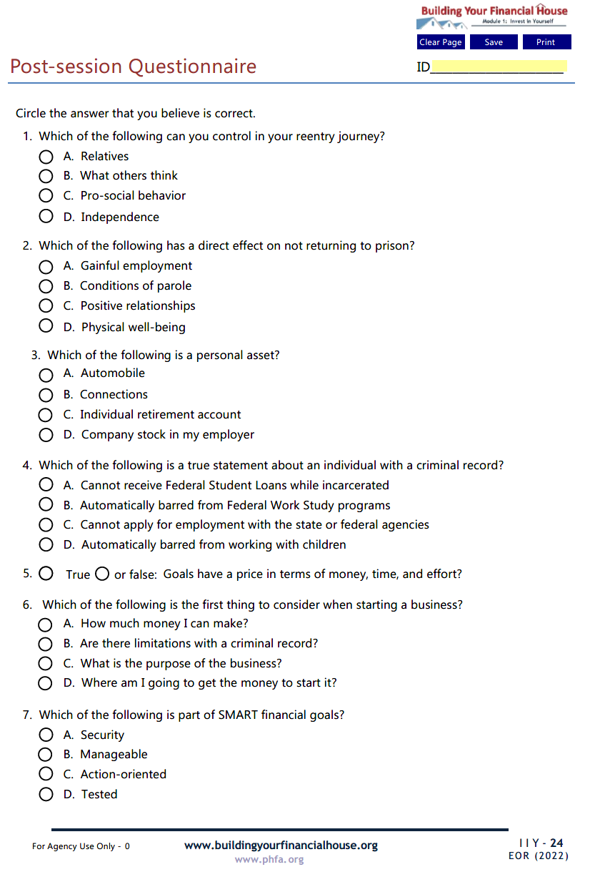
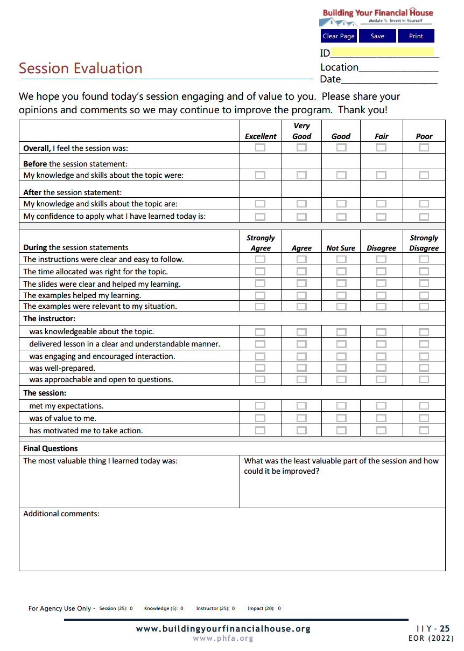
Complete Today

Slide 53
Email the Post-Session Questionnaire and the Session Evaluation to:

Slide 54
Now, it’s your turn!
Note: For best results, view in Adobe Reader DC or Nuance.

Slide 55
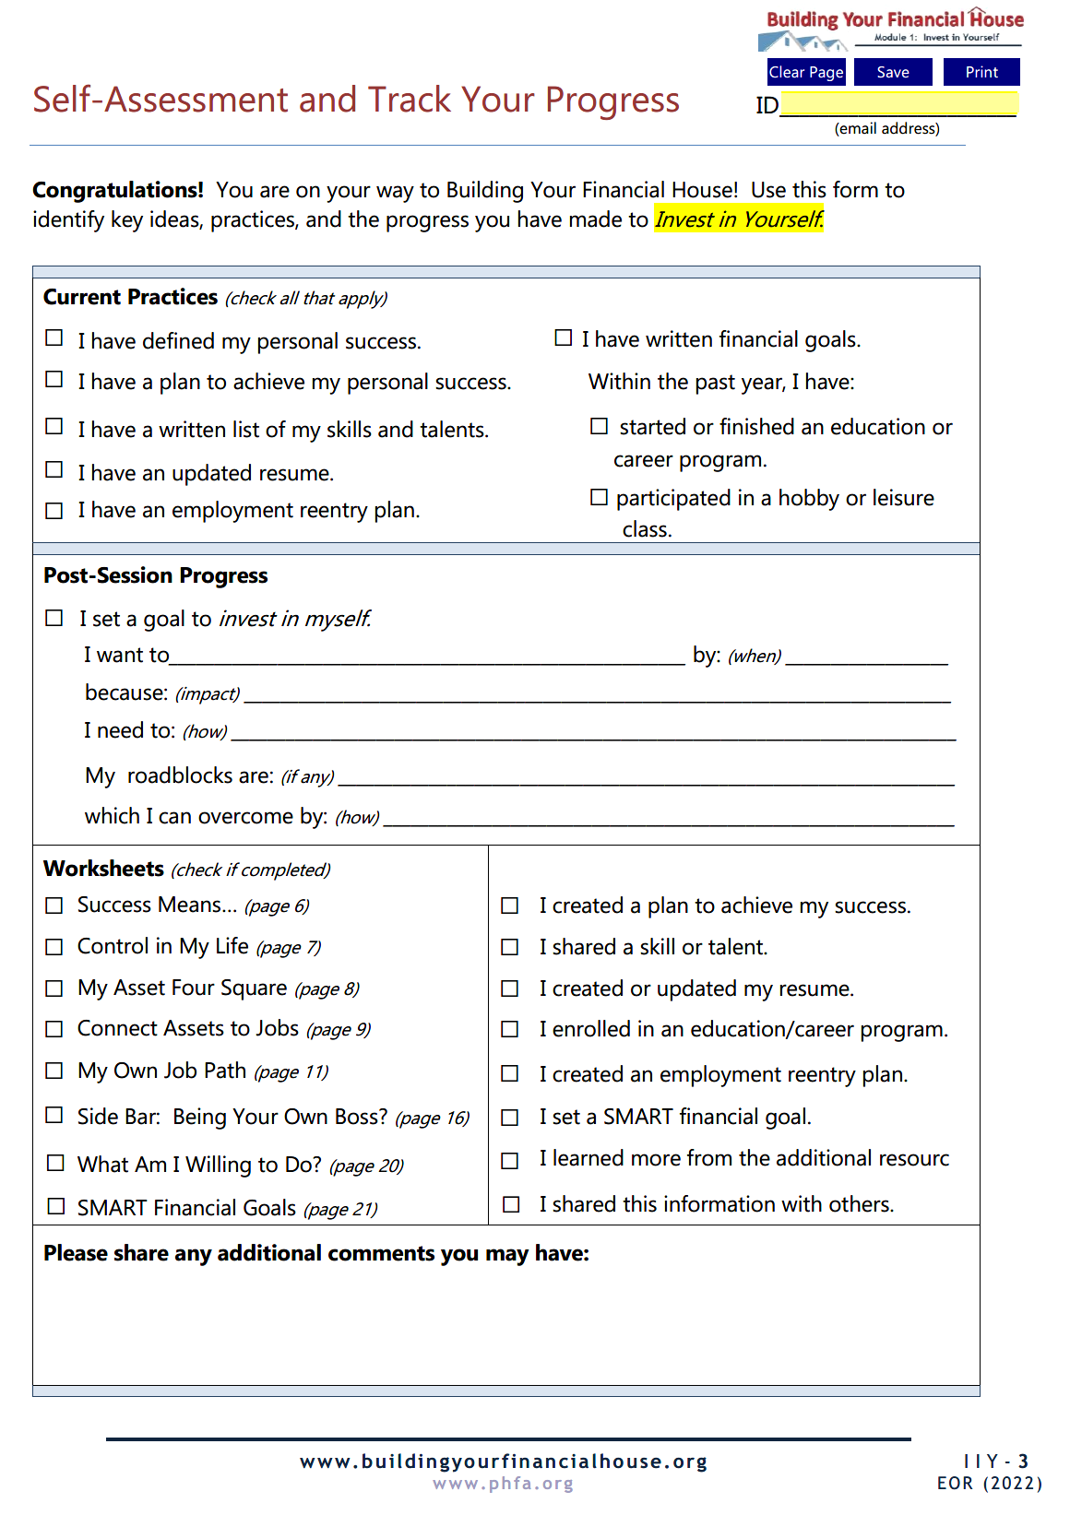
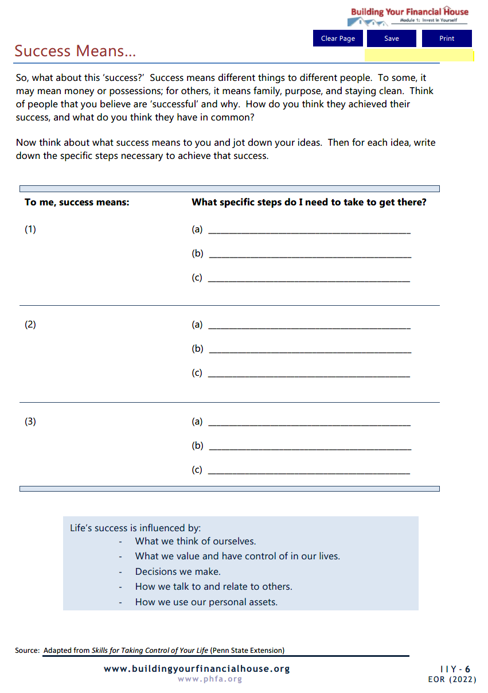
Homework

Slide 56
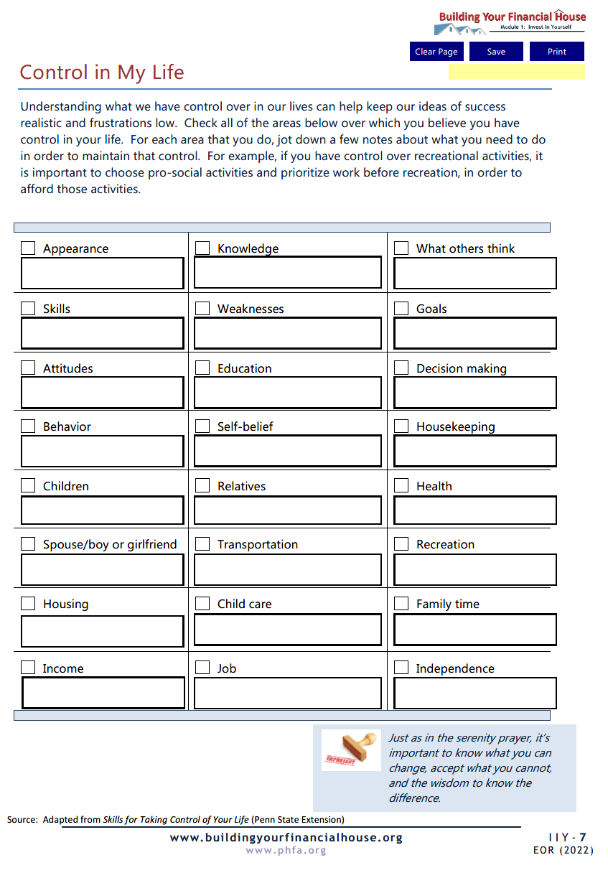
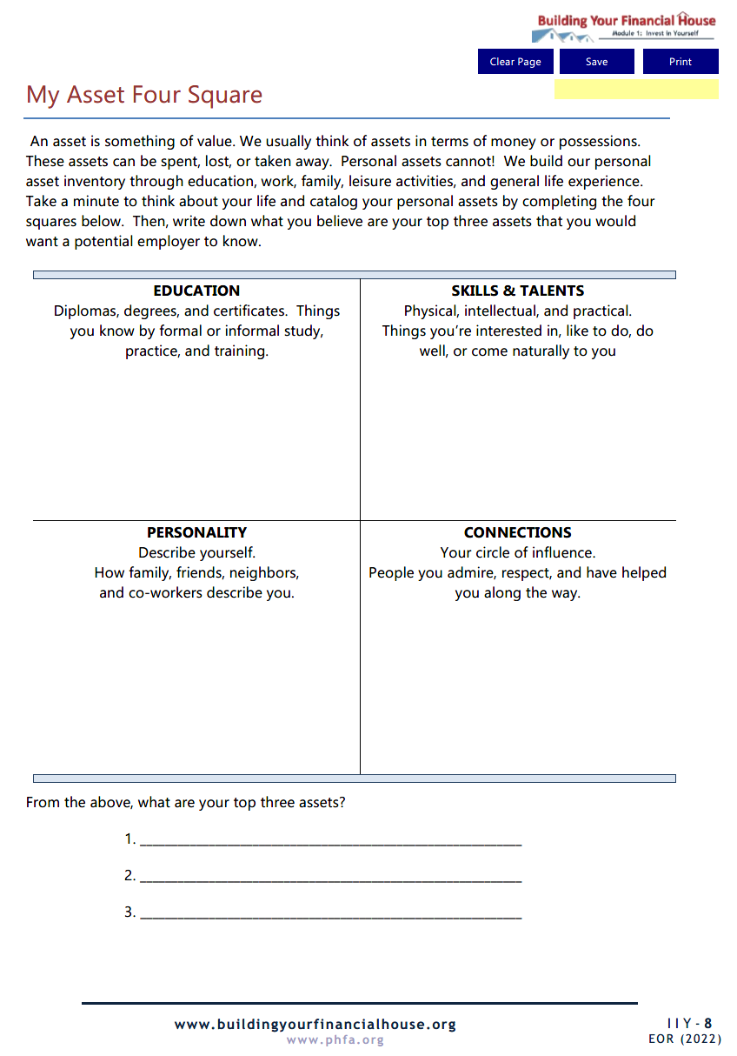

Slide 57
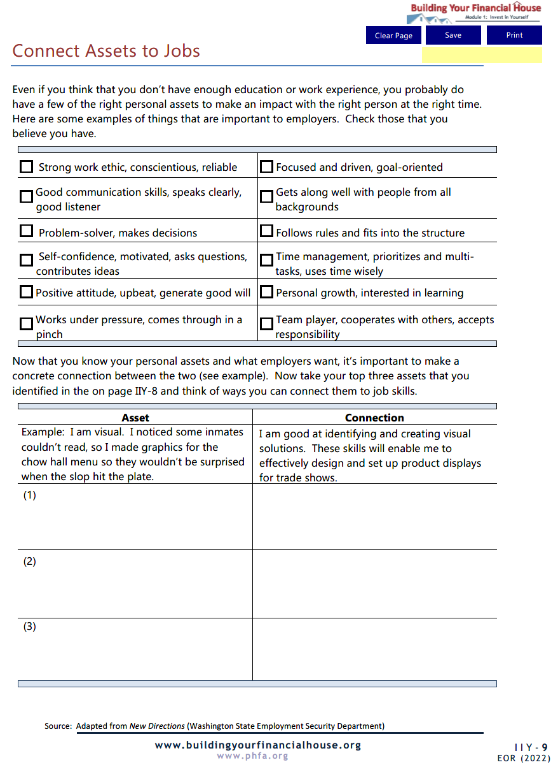
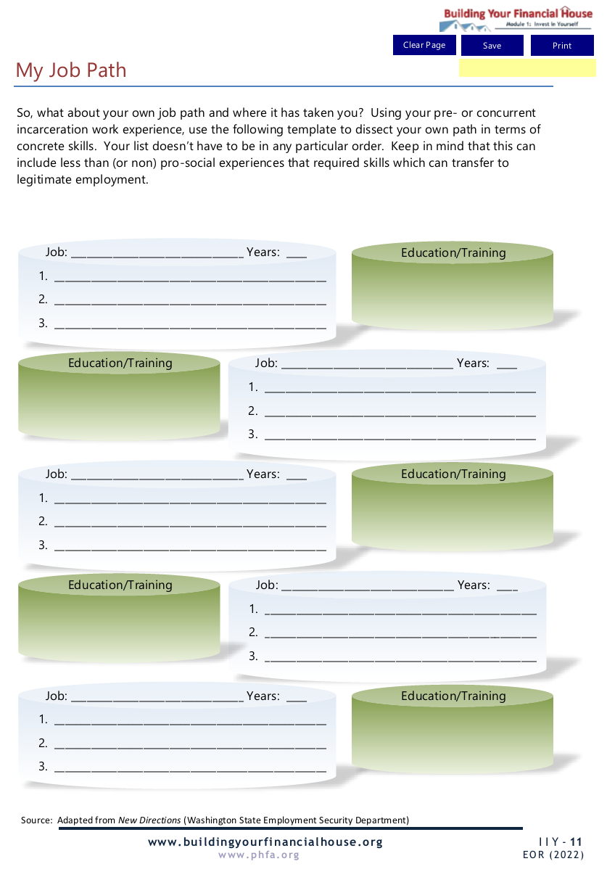

Slide 58
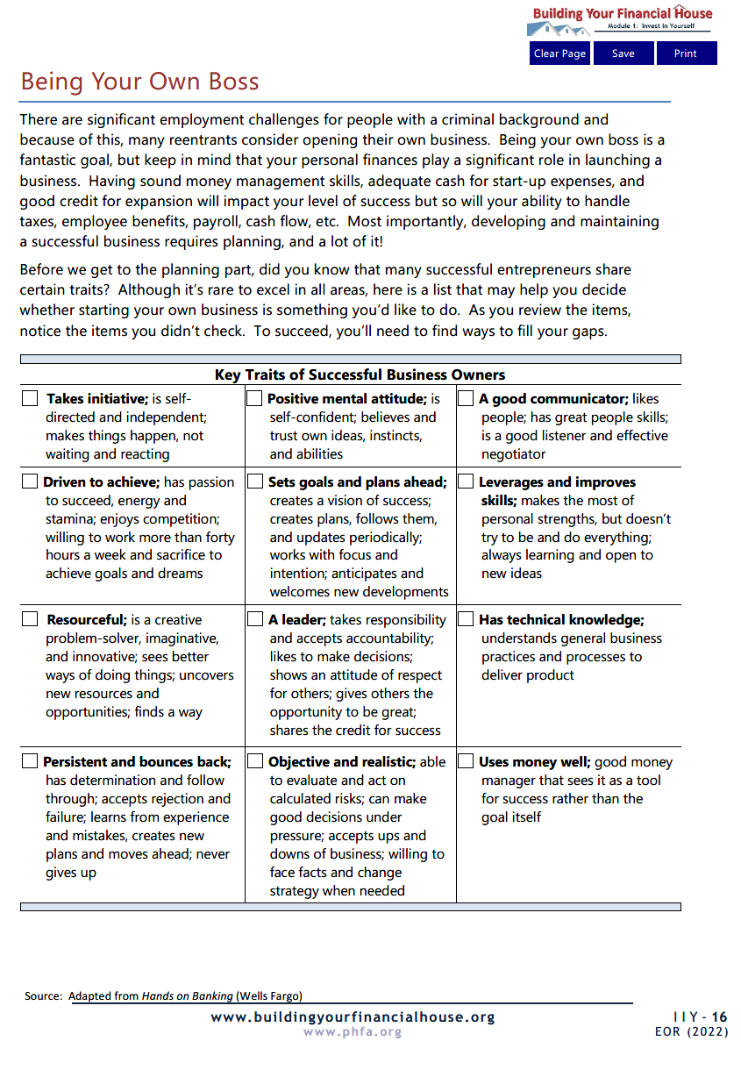
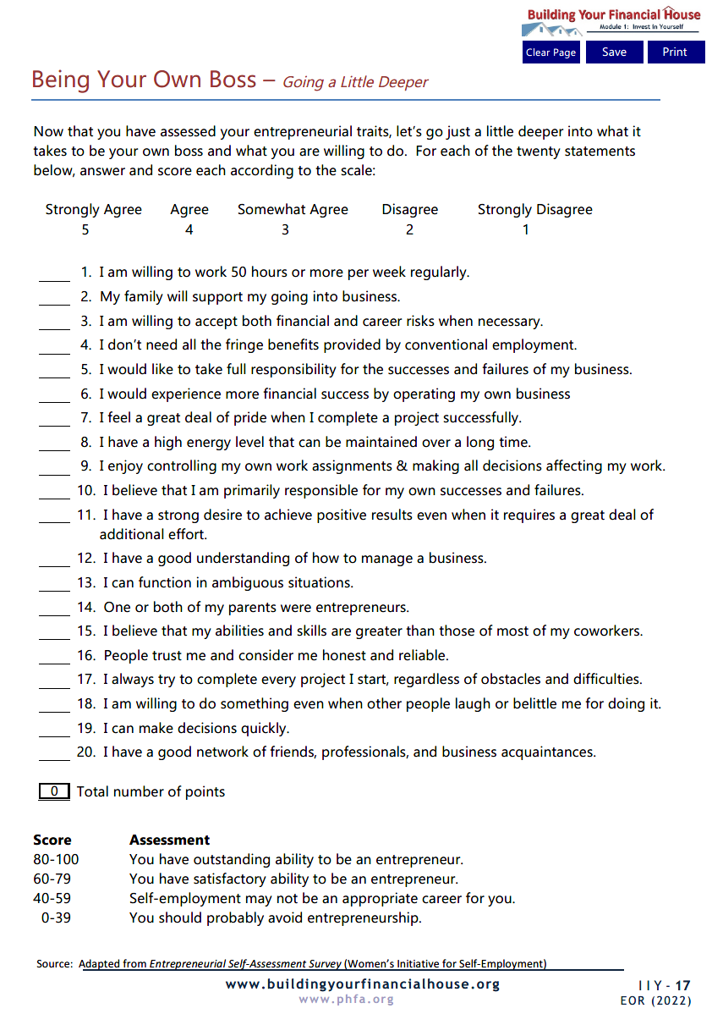

Slide 59
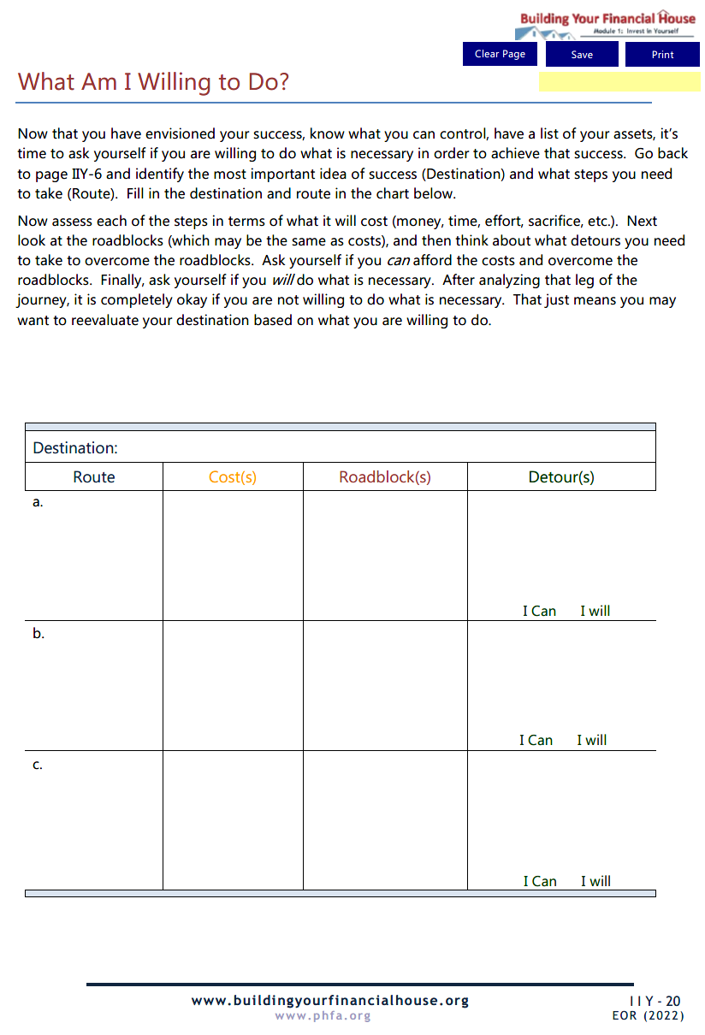
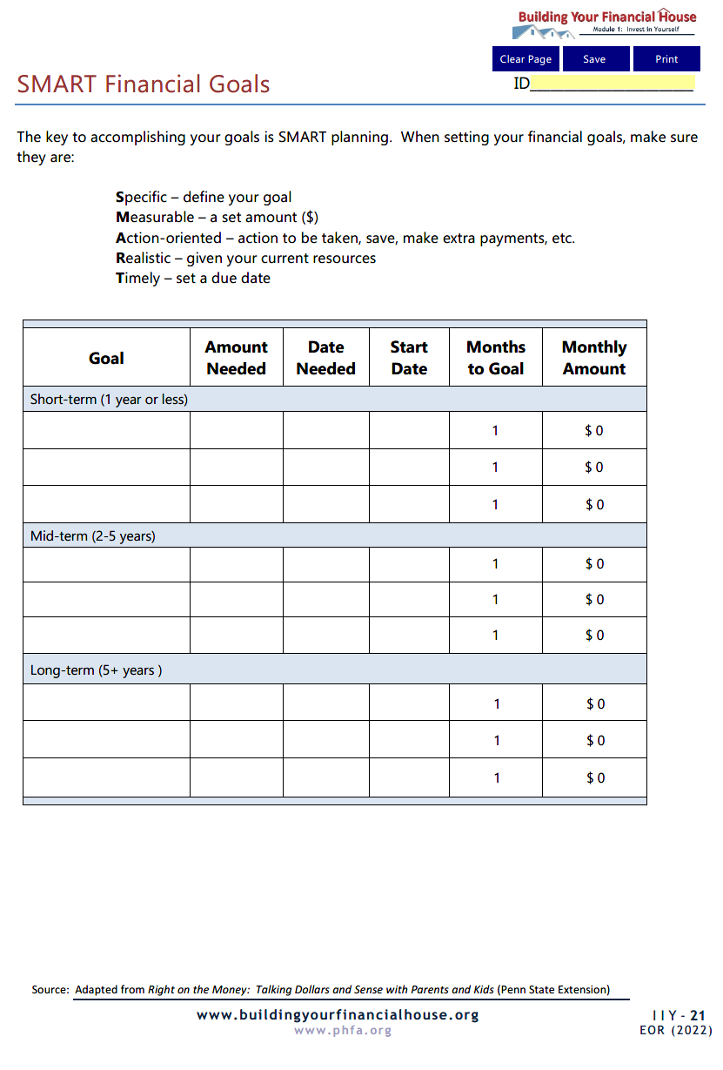

Slide 60
PRIOR TO NEXT SESSION,
email completed homework to:

Slide 61
Next Time:
Maximize Earnings

Slide 62
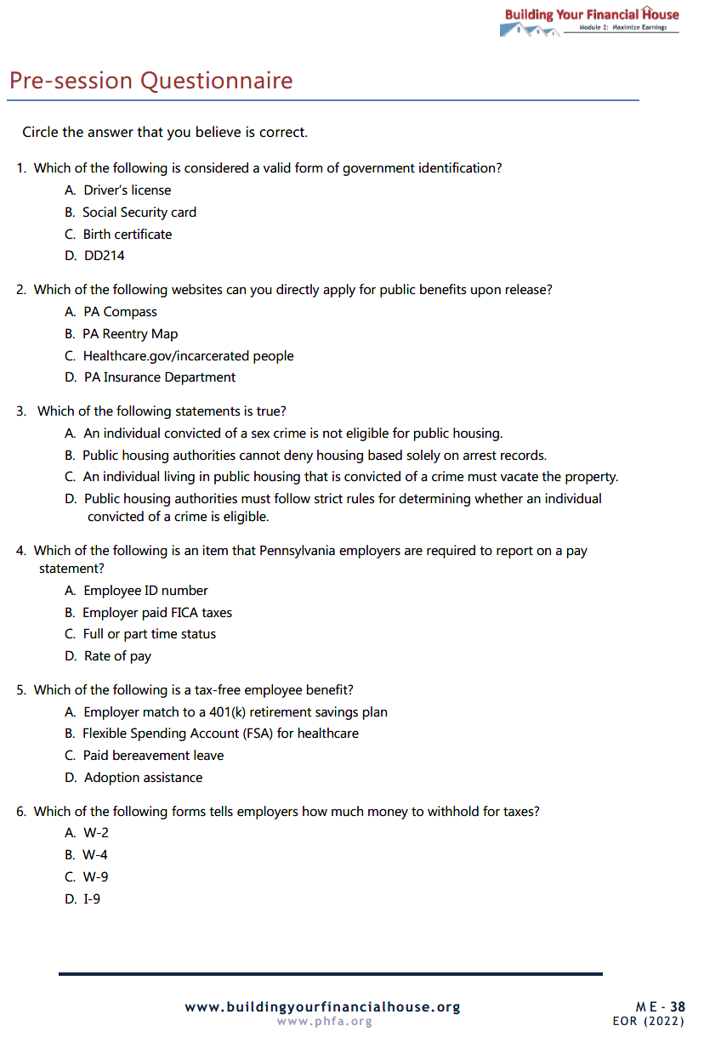
Maximize Earnings Pre-Session Questionnaire
Email Maximize Earnings Pre-Session Questionnaire to:

Slide 63
Questions?

Slide 64
Thank You!

