Slide 1
Part II

Slide 2
Did you know you shouldn’t shop for a monthly payment? How? It must fit in my money map!

Slide 3
$ 239/mo

Slide 4
Don’t Shop for a Monthly Payment
Loan Amount
Interest
Rate
Term (months)
Monthly Payment
Total Payments
Cost of Credit
Sticker
$10,000
7%
48
$239
$11,472
$1,472
Factor Change:
Down Payment $2,000
$8,000
7%
48
$192
$9,216
$1,216
Term
60 months
$10,000
7%
60
$198
$11,880
$1,880
Interest Rate 8.5%
$10,000
8.5%
48
$246
$11,808
$1,808
Fees
$340
$10,000
7%
48
$239
$11,812
$1,812

Slide 5
Four Factors of Finance
Factor
Direction
Monthly Payment
Cost of Credit
Down Payment
Term
Interest Rate
Paid Up Front
No effect
Fees
Rolled into loan

Slide 6
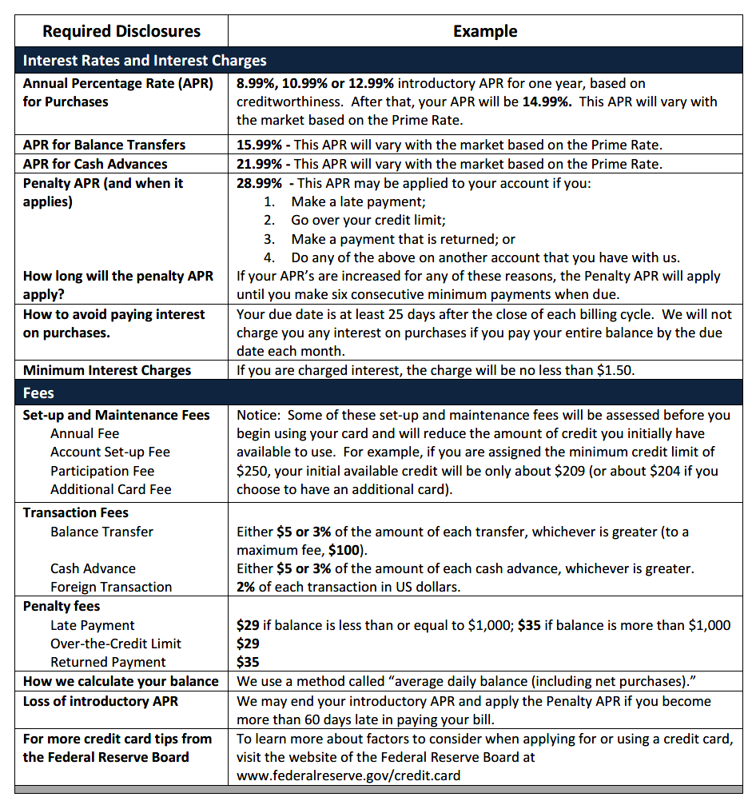
Disclosures for Good Decisions
Interest Rate and Charges
-Annual Percentage Rate (APR)
- Purchases
- Balance Transfers
- Penalty and length:
Late payment
Over credit limit
Returned payment
Related accounts
-Due date to avoid interest
-Minimum interest charges
Fees
- Set-up and maintenance
- Transaction
- Penalty
- Balance calculation method
- Conditions of introductory rate

Slide 7
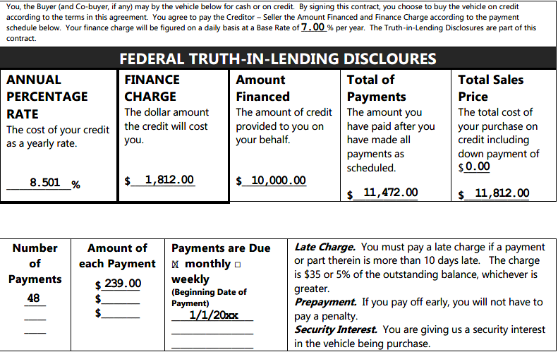
Disclosures for Good Decisions
$340

Slide 8
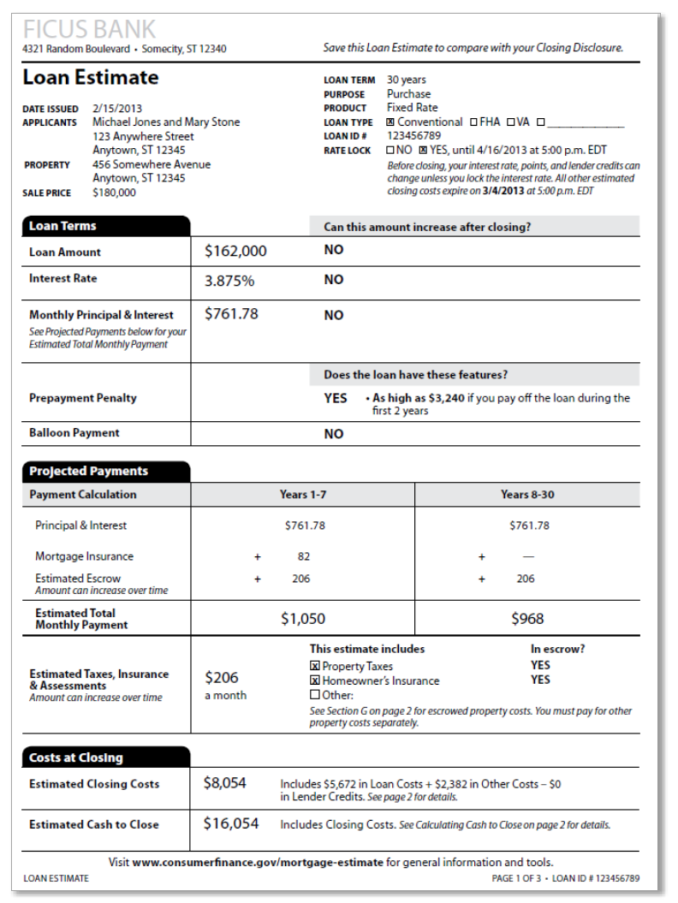
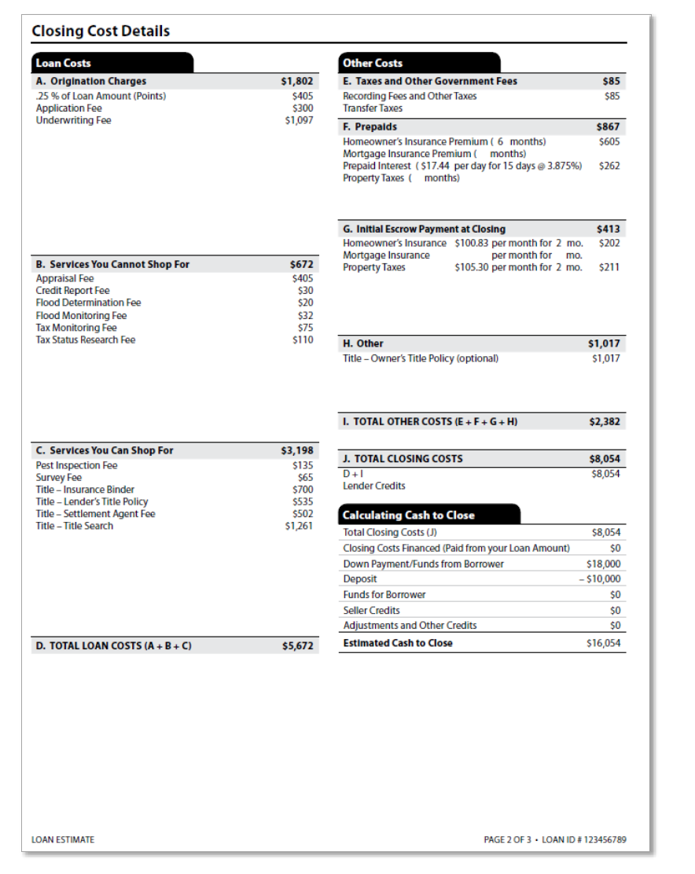
Mortgage Loan Disclosures

Slide 9
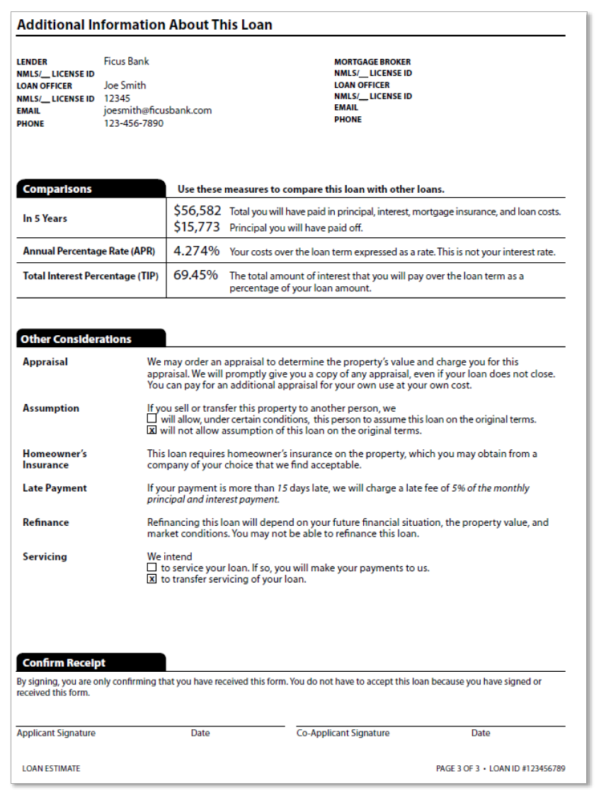
Mortgage Loan Disclosures

Slide 10
Chat Box
Credit Myth #1
True or False?
I must keep a balance on my credit card to build a credit history.

Slide 11
Chat Box
Credit Myth #2
True or False?
Credit reports are all the same.

Slide 12
Chat Box
Credit Myth #3
True or False?
My employer must have my permission to see my credit report.

Slide 13
Chat Box
Credit Myth #4
True or False?
My credit score will be lower if I view my credit reports.

Slide 14
Credit History – Credit Reports
Overall snapshot of using OPM
Who-lender, a.k.a creditor
What-revolving, installment, service
Date opened
Paid as agreed (or late)
Balance
Compiled information from creditors
Individual (not joint)
Changes based on activity-payments (made, late or missed) applications, legal action, etc., typically on a monthly cycle

Slide 15
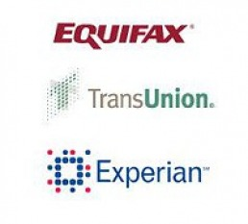
Free Credit Reports – Get Them and Check Them
Online :
www.annualcreditreport.com (the one and only free site!!!)*
Telephone:
877-322-8228
Mail:
Annual Credit Report Request Service
P.O. Box 105281
Atlanta, GA 30348-5281
*Note: Free credit reports do not contain your credit score.

Slide 16
Credit Scores – What’s Your Number?
A number which represents how likely a person is to repay a loan
It is calculated by a complicated statistical program using the information contained in your credit report
There are a variety of scoring models used for different lending purposes (auto loans, mortgages, credit cards, etc.)

Slide 17
Credit Scores – FICO Scoring Model
Inquiries
Types of Credit
10%
10%
Payment History
35%
Length of History
15%
30%
Amount of Debt

Slide 18
The Cost of Poor Credit!
Credit cost for Pennsylvania consumers borrowing $10,000 for a 48-month used auto loan*
FICO Score | APR | Monthly Payment | Total Interest Paid
720-850 | 4.428% | $228 | $ 944
690-719 | 6.598% | $233 | $ 1,184
660-689 | 7.300% | $241 | $1,568
620-659 | 11.425% | $261 | $2,528
590-619 | 19.260% | $300 | $4,400
*Source: myfico.com for rates quoted 4/21/22

Slide 19
Credit is expensive! Does my credit history matter if I decide to only use cash for purchases?

Slide 20
Why Does Credit History Matter?
Housing
Insurance
Jobs

Slide 21
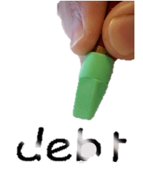
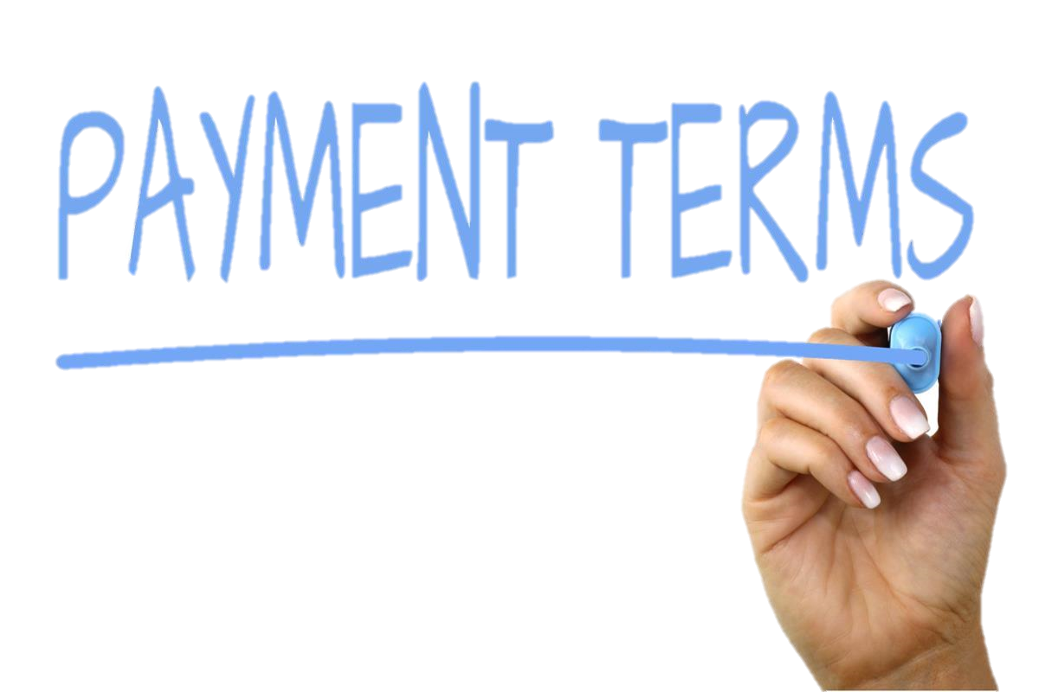
Credit – How to Use It
Only what you need
Invest in yourself
Buy assets
Pay on-time, EVERYTIME!
Don’t be fooled by a low payment
Keep debt low
This Photo by Unknown Author is licensed under CC BY-NC

Slide 22
Know When to Say “When”
Debt-to-Income Ratio
How much of your income goes towards debt?
Guidelines –
less than 10% for consumer debt (auto/student/ personal loans, credit cards, etc.)
less than 28% for housing debt (with taxes and insurance)
(Monthly debt payments ÷ Gross monthly income) x 100

Slide 23
Know When to Say “When”
Utilization Ratio
How much of your available credit are you using?
Guidelines-
Less than 30% for each revolving account
100% is not a good score!
(Debt balance ÷ Credit limit) x 100

Slide 24
Warning Signs
Ratios too high
Can’t make minimum payments
Using one credit account to pay on other credit account
Calls from creditors
Collection agencies

Slide 25
Credit: How to Fix It
On Your Own
Credit Counseling
Debt Management Program
Debt Settlement
Bankruptcy

Slide 26
Credit: How to Fix It
On Your Own
Establish manageable money map
Dissect your debt for payment strategies
Contact creditors and ask for reduced interest rates, payments, or refinance options
Make good on your promises and make payments ON TIME!
Pros
Cons
You take control
Saves money in additional late fees and/or penalties
Re-establishes good payment history
Takes time to pay off debts
May still have to manage multiple accounts and payments

Slide 27
Credit: How to Fix It
Credit Counseling
Evaluate credit report and debt
Establish a manageable money map
Suggest repayment strategies
Helps contact creditors and ask for reduced interest rate, payments or refinance options
Pros
Cons
Professional analysis of your situation
Saves money in additional late fees and/or penalties
Re-establishes good payment history
Takes time to pay off debts
May still have to manage multiple accounts and payments

Slide 28
Rebuilding Credit with Help
Debt Management Program (DMP)
Credit counseling
Contact creditors and negotiates a lower interest and manageable repayment plan
One monthly payment to provider
Monthly disbursements to creditors
Pros
Cons
Professional analysis of your situation
Saves money in additional late fees and/or penalties
Re-establishes good payment history
Write one check per month
Will take time to pay off debts (2-5 years)
May not qualify for credit until program completed
Monthly fee

Slide 29
Rebuilding Credit with Help
Debt Settlement
Credit counseling
Accounts must be in collection; if not, you will be advised to stop making payments
Make deposits into separate savings account for future settlement
Contact creditors and negotiates a settlement payment for less than owed
Disburse settlement payment to creditors
Pros
Cons
Pay less than owed
High fees
May have to claim forgiven debt as income on your taxes (1099-C)
Creditors may still try to collect on accounts
Immediate damage to credit if had been making on-time payments to creditors before

Slide 30
Rebuilding Credit with Help
Bankruptcy
Must attend pre-bankruptcy counseling before filing
File a “means” test for payment plan (Chapter 13)
Notification to creditors
Debtor education
Discharge approval or denied
Pros
Cons
Some or all of debt forgiven
Maybe faster than repayment plan
Generally, not taxable (note: there are exceptions)
Not all debt forgiven (alimony, child support, taxes, federal student loans, etc.)
Will affect qualification for new credit (usually 2+ years)
May be reported for 10 years

Slide 31
Too Good to Be True?
3 lbs ground beef
100 hamburger buns
2 cases of lettuce
a dozen tomatoes
Vegetable oil
brown food coloring
tweezers
Superglue
paintbrush
waterproof spray
glycerin and water
Predatory Lending
Source: PBSKids.org

Slide 32
Signs of Predatory Lending
High-pressure sales
We finance everyone!
No credit, no problem!
Signing documents on hood of car
No proof of income
Fudge your income
No credit? No problem!
Just a bad feeling
No Truth-in-Lending Disclosure
Sign a blank form
Changing terms at closing
Offers more than you need!
High APR’s
Don’t worry. We’ll take care of everything.

Slide 35
Types of Credit
Getting and Using Credit
Credit Reports and Scores
Dissecting Your Debt
Avoiding Predatory Lending
Today’s Recap
Notes:
Today we’re going to talk about:
Money values and setting financial goals
Creating a Money Map
Making good financial choices
Knowing how your cash flows

Slide 36
Plan and meet obligations
Limit borrowing to reasonable and manageable levels
Limit borrowing to pay for items that will improve your financial picture
Avoid high-cost borrowing; plan, understand, and shop around for best terms
Order free credit reports every 12 months from each bureau and review for errors and potential problems

Slide 37
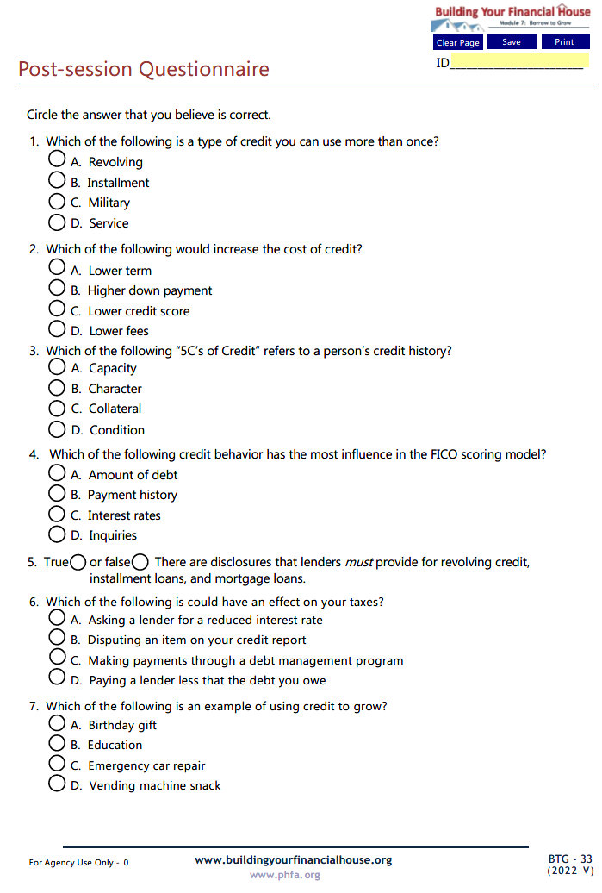
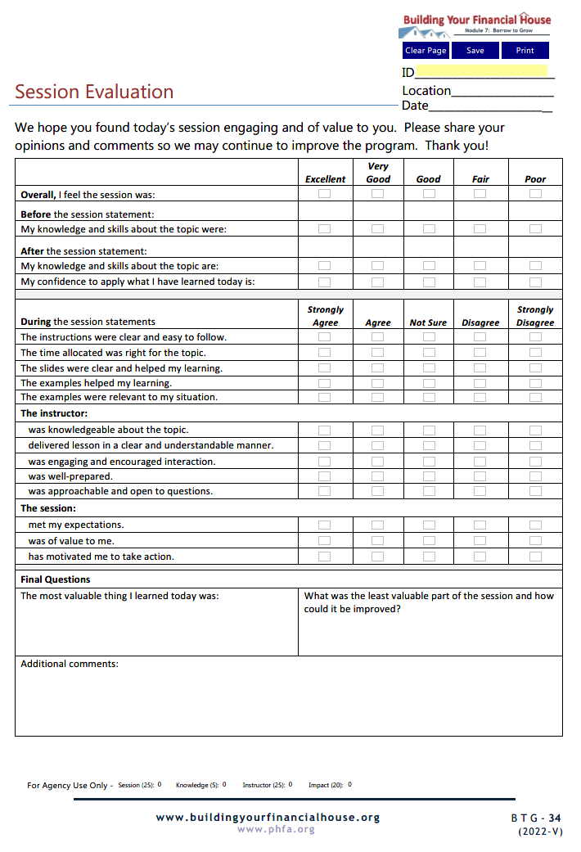
Complete Today

Slide 38
Email the Post-Session Questionnaire and the Session Evaluation to:

Slide 39
Now, it’s your turn!
Note: For best results, view in Adobe Reader DC or Nuance.

Slide 40
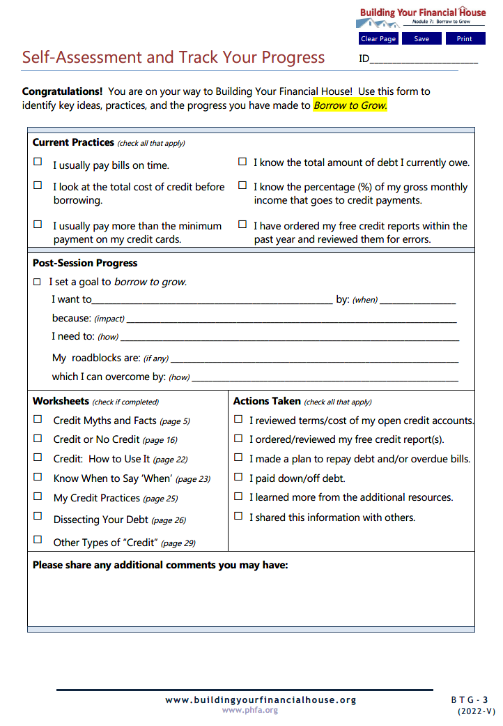
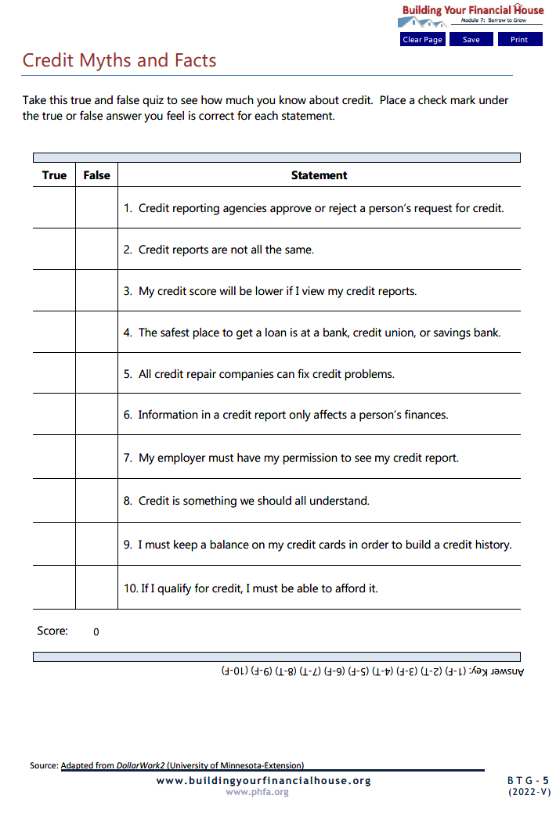
Homework

Slide 41
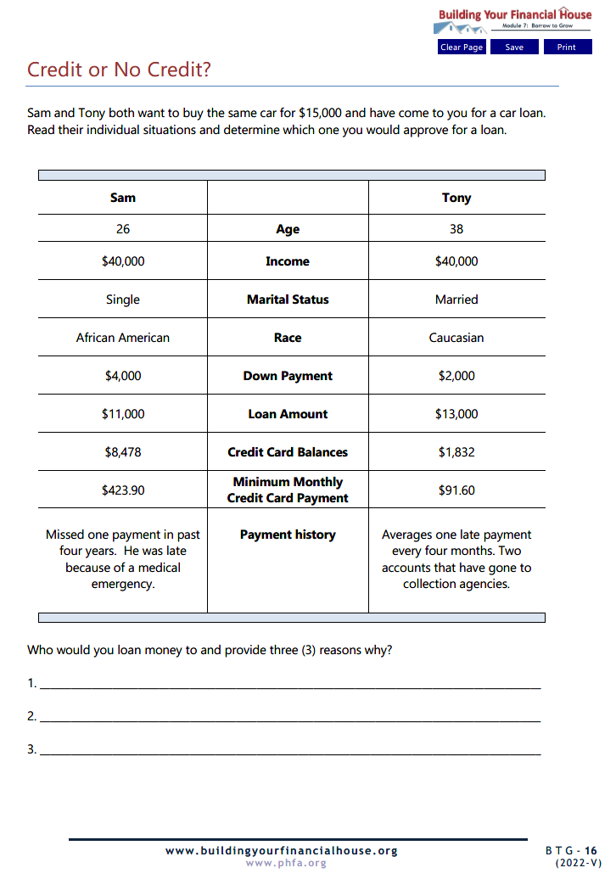
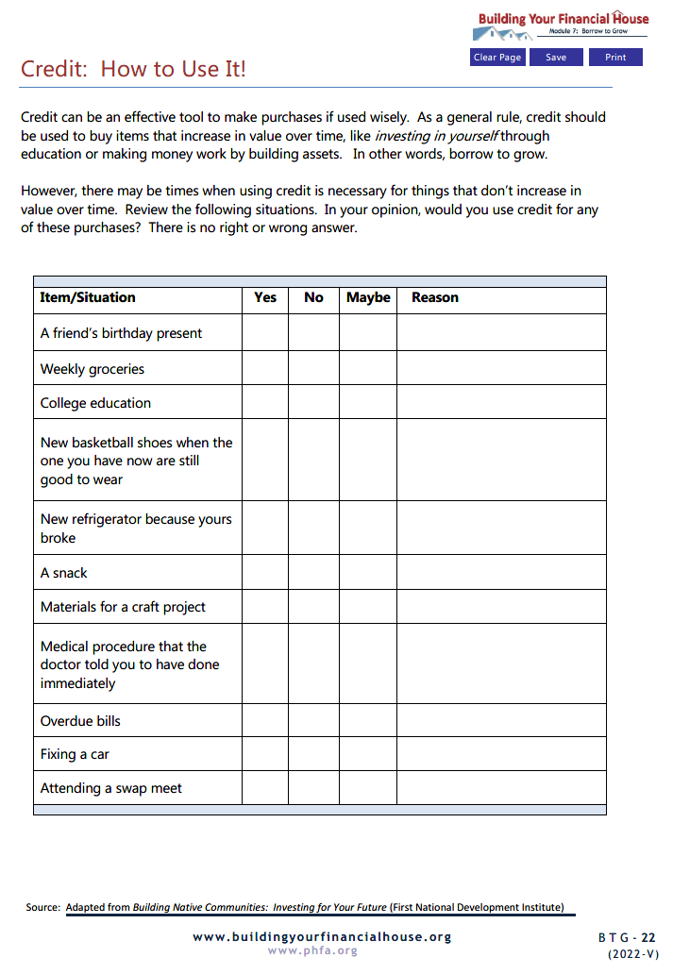

Slide 42
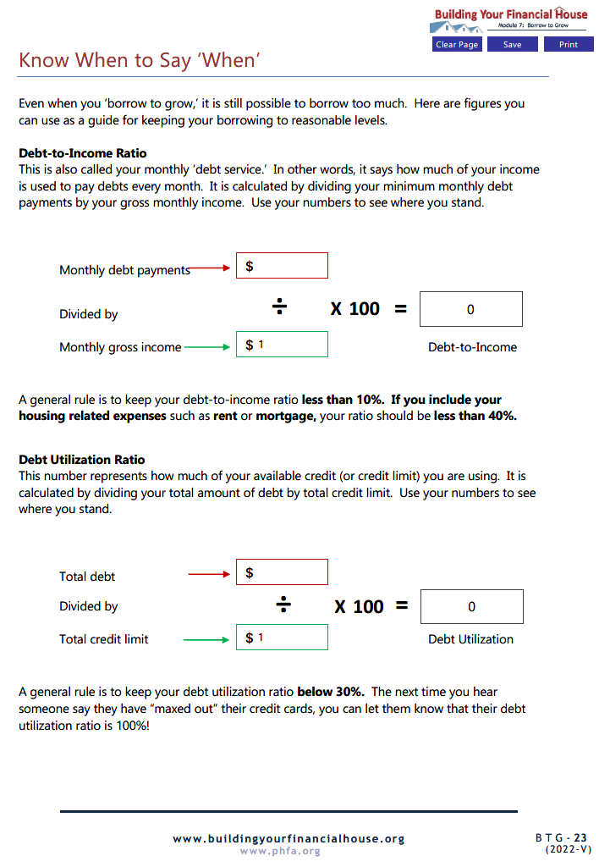
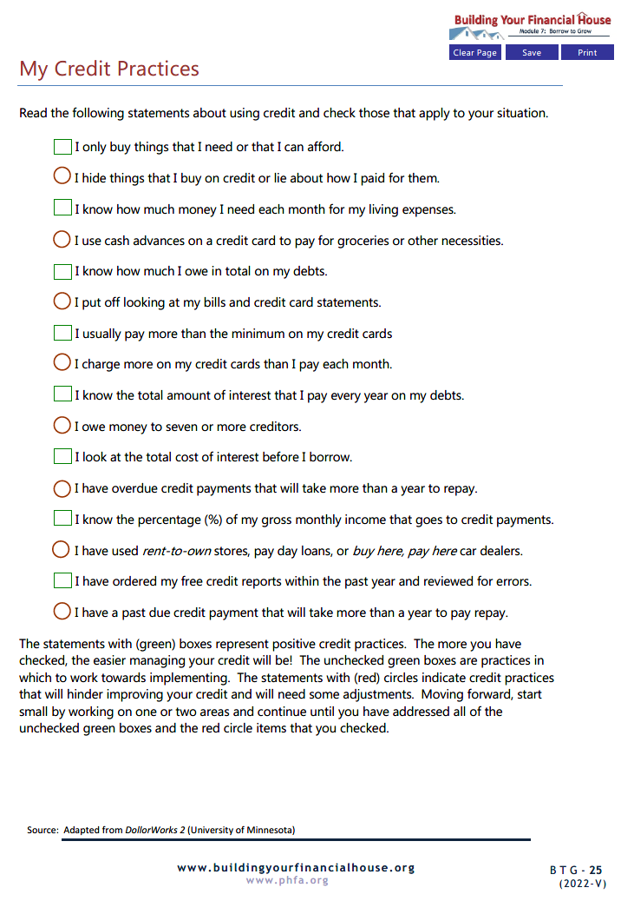

Slide 43
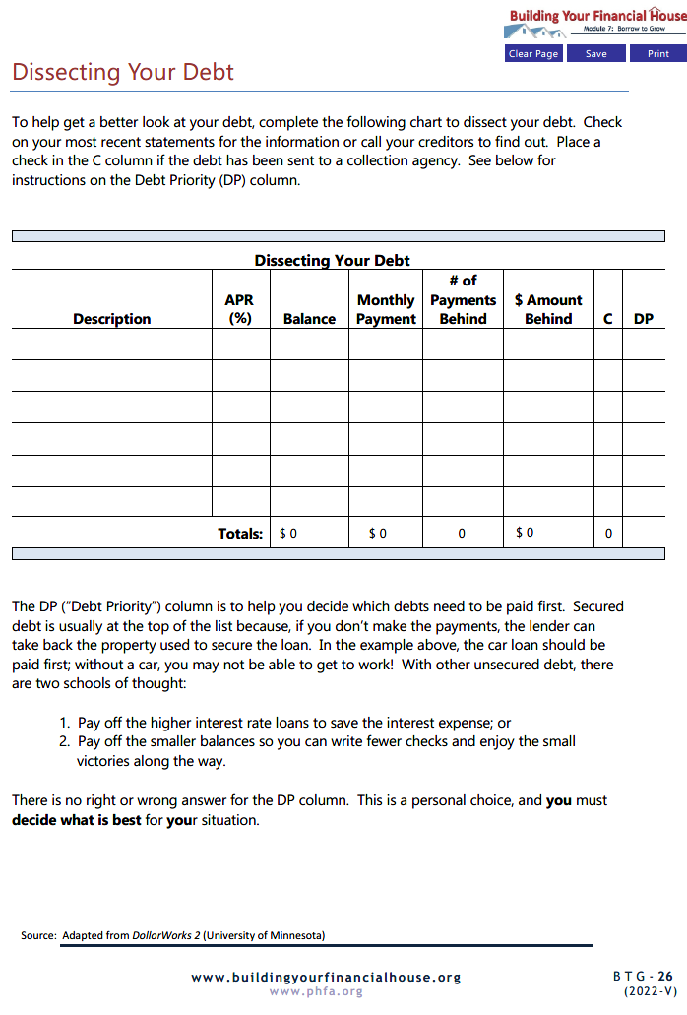
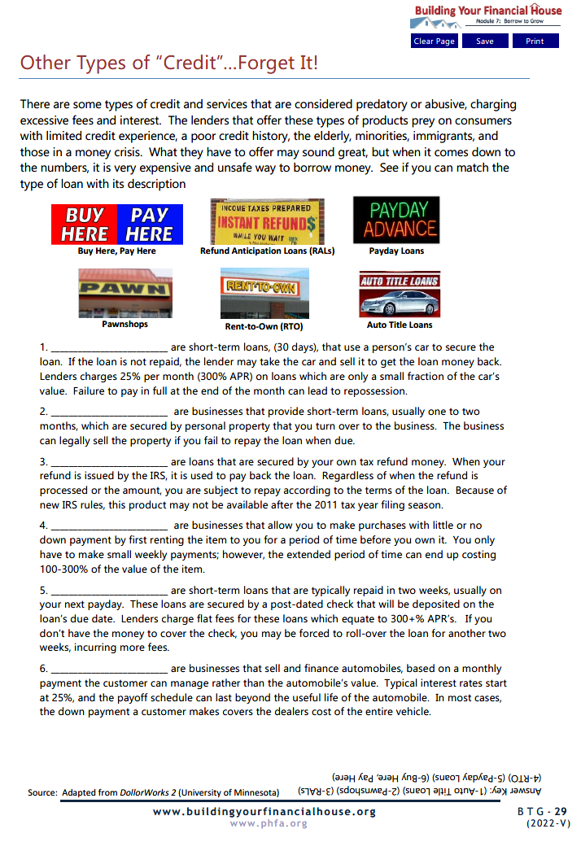

Slide 44
Email completed homework to:

Slide 45
You Did It!!
Notes:
Today we’re going to talk about:
Money values and setting financial goals
Creating a Money Map
Making good financial choices
Knowing how your cash flows

Slide 46
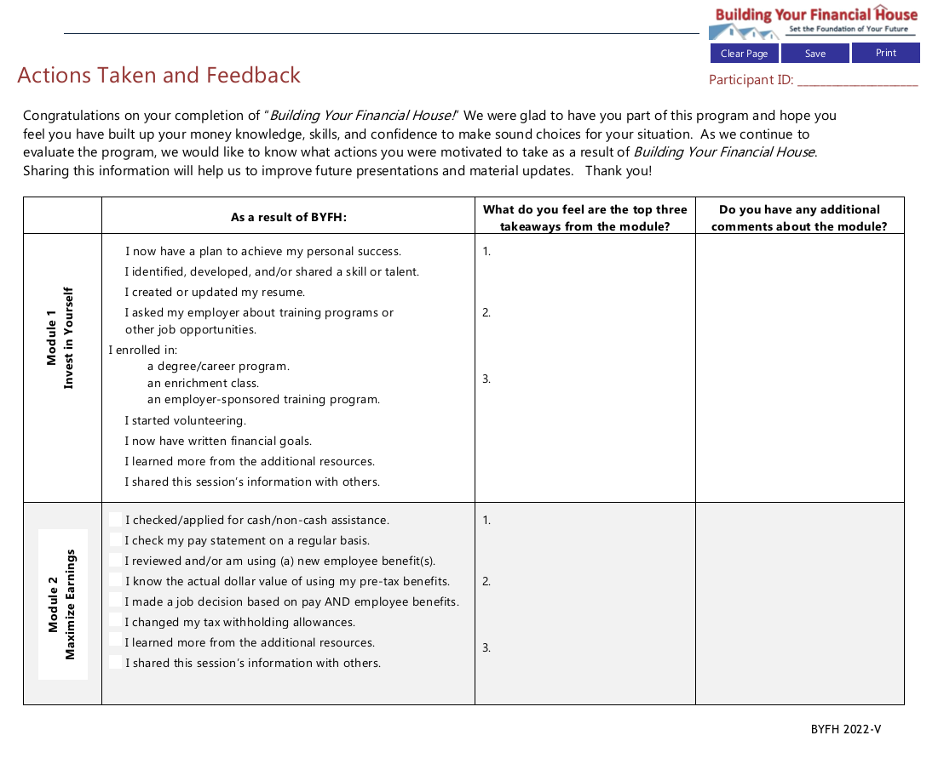
Please Share With Us!

Slide 47
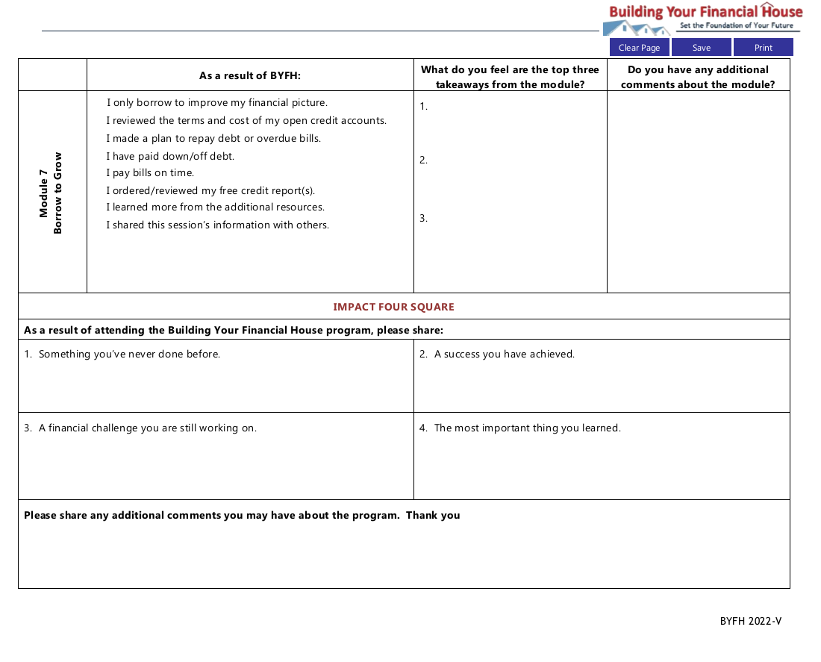
Please Share With Us!

Slide 48
Questions?

Slide 49
Thank You!

