Slide 2
Building Your Financial House
WELCOME
Notes:
Good afternoon everyone!
Thank you for joining us as we discuss Creating a Financial Resource Center on-site, at you development or agency.
We hope this presentation will help you bring vetted, unbiased financial education resources to your residents or clients that they can use right now.
So let’s get started.

Slide 3
Housekeeping
Please mute your phone or computer to eliminate background noise.
To maximize bandwidth:
(Turn camera off)
Close unused apps or webpages
Please raise hand or use chat feature for questions.
Notes:
Good afternoon everyone!
Thank you for joining us as we discuss Creating a Financial Resource Center on-site, at you development or agency.
We hope this presentation will help you bring vetted, unbiased financial education resources to your residents or clients that they can use right now.
So let’s get started.

Slide 4
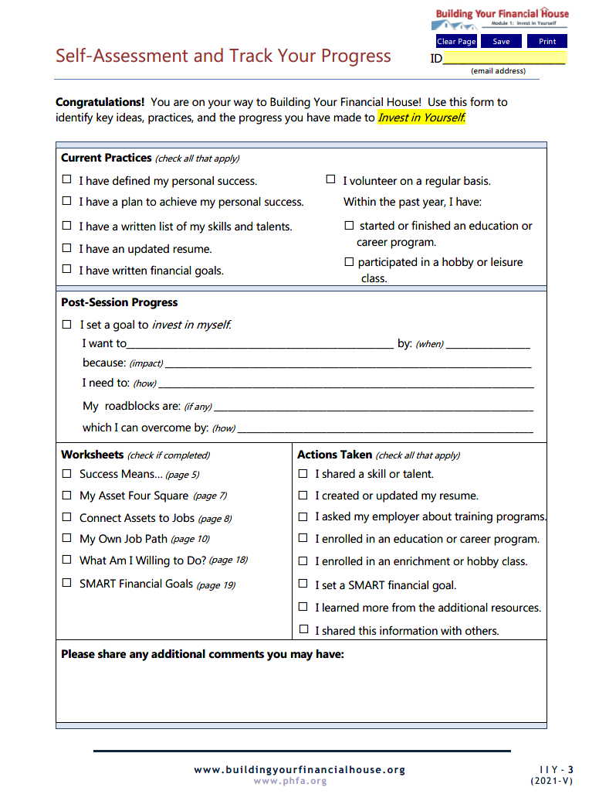
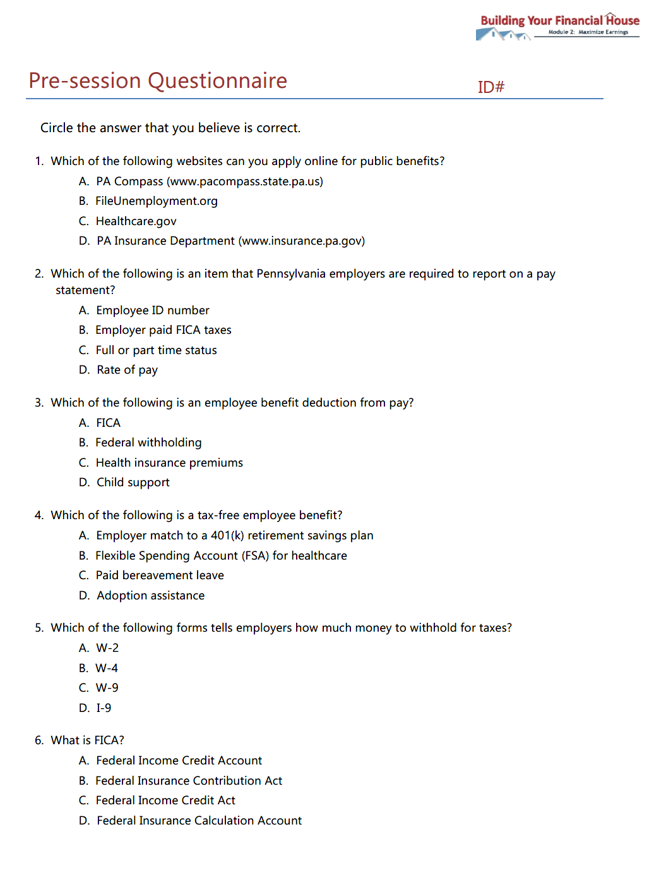
Prior to Today’s Session

Slide 5
Today’s Topics
Sources of Income
Understanding Pay Statements
Choosing Employee Benefits
The Power of Pre-tax
Completing the Form W-4
Before You Jump Ship

Slide 6
Sources of Income
Understanding Pay Statements
Choosing Employee Benefits
The Power of Pre-tax
Completing the Form W-4
Before You Jump Ship
Today’s Topics

Slide 7
6
Protect Your Potential
5
Make Money Work
4
Check Taxes
3
Spend Sensibly
7
Borrow to Grow
2
Maximize Earnings
1
Invest in Yourself

Slide 8
The walls represent earnings, built up from the foundation, and maximized by utilizing all available resources, directing payroll deductions, and choosing the right employee benefits.
2
Maximize Earnings

Slide 9
Identify your cash and non-cash sources of income
Recognize the difference between gross and net pay
Become familiar with employer provided benefits
Recognize the actual dollar value of pre-tax benefits
Identify factors which affect the net economic benefit of a job

Slide 10
Chat Share
What are some sources of income?

Slide 11
Sources of Income
Earned
Unearned

Slide 12
Short-term Resources

Slide 13
Who is FICA?

Slide 14
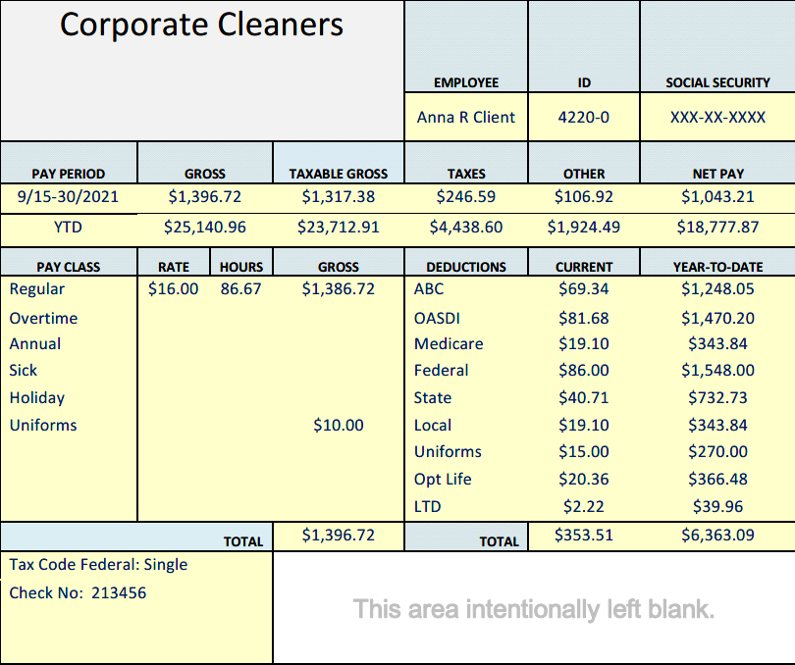
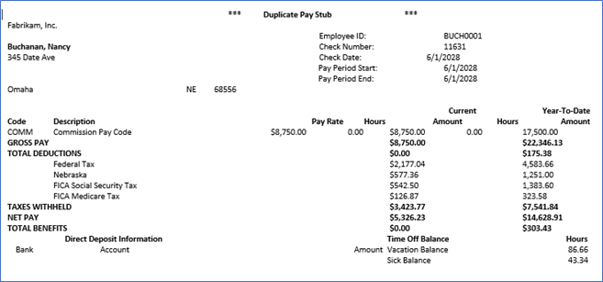
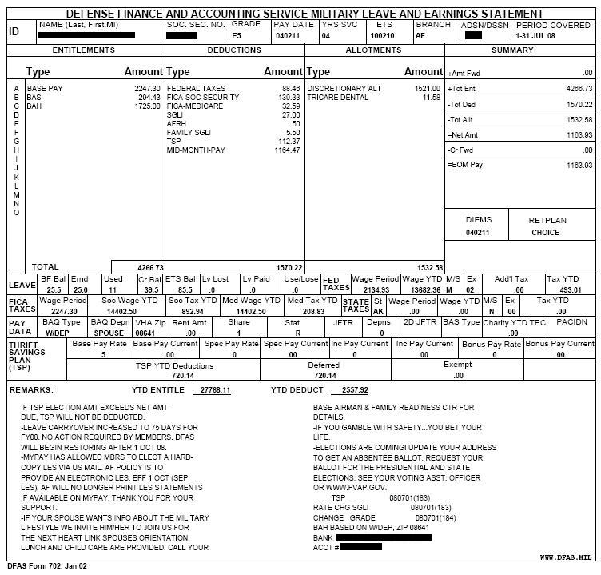
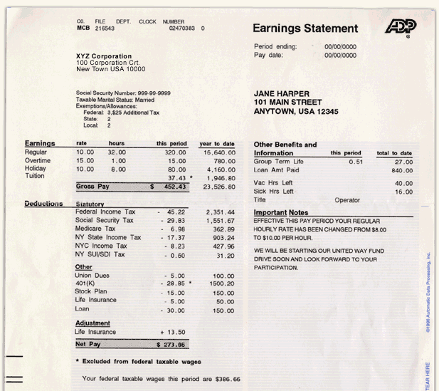
Did you know?

Slide 15
Anna’s Pay Statement

Slide 16
Reading a Pay Statement
Identification
Pay period
Gross
Taxable
Taxes
Other
Net Pay
Year-to-date
Health Insurance
Hours worked/rate
Social Security/Medicare
Federal/State/Local Withholding
Other compensation
Uniforms
Life/Disability Insurance
Filing Status
Flexible Spending Arrangements (FSA)
Garnishments
Health Savings Accounts (HSA)
Purchases
Retirement Savings Plans
Other Savings

Slide 17
What is FICA?
OASDI (old age, survivor, and disability insurance), a.k.a. Social Security
Employee and employer
6.2%
$147,000 (2022)
FICA is the Federal Insurance Contribution Act
(1935)
Medicare – healthcare for ages 65 and older
Employee and employer
1.45% on all earned wages
0.9% HI (high income) surcharge
Note: If you are self-employed you get to pay both employer and employee portions!
Notes:
Surcharge is 250k for MFJ (125 if filing separately), 200K for single, HOH, and Qual Widow(er)

Slide 18
Poll
How often do you review your pay statement?

Slide 19
Why is this important?

Slide 20
In the Chat Box
Other than a paycheck, what are some benefits to working for a company/organization?

Slide 21
More Than a Paycheck
We want YOU
to WANT
to WORK HERE!

Slide 22
Employee Benefits
Stay healthy
Learn more
Advancement
Secure future
What should we look for?

Slide 23
Employee Benefits
Free stuff!
Discounts!
Lower taxes!
Also:

Slide 24
Types of Benefits
Health
Medical plans (HMO/PPO)
Prescription drugs
Dental/Vision
Hearing
Long-term care
Health Savings (HSA’s)
Flexible Spending (FSA’s)
Insurance
Retirement
Paid Time Off
Other

Slide 25
Types of Benefits
Health
Life
Dependent life
Short-term disability
Long-term disability
Critical illness
Property
Insurance

Slide 26
Types of Benefits
Health
Pension (a.k.a. defined benefit)
Savings Plans: (defined contribution)
401(k)/403(b)/457
Profit Sharing
Employee Stock Ownership
(ESOP’s)
Retiree Health
Memberships
Insurance
Retirement

Slide 27
Types of Benefits
Health
Annual/Vacation
Personal Days
Holidays
Sick Time
Family Medical Leave Act (FMLA)
Bereavement
Comp Time
Insurance
Retirement
Paid Time Off

Slide 28
Types of Benefits
Health
Employee Assistance
Dependent Care
Adoption
Tuition Reimbursement
529/ABLE Savings Plans
Fitness Center
Free Coffee(!!)
Insurance
Retirement
Paid Time Off
Other

Slide 29
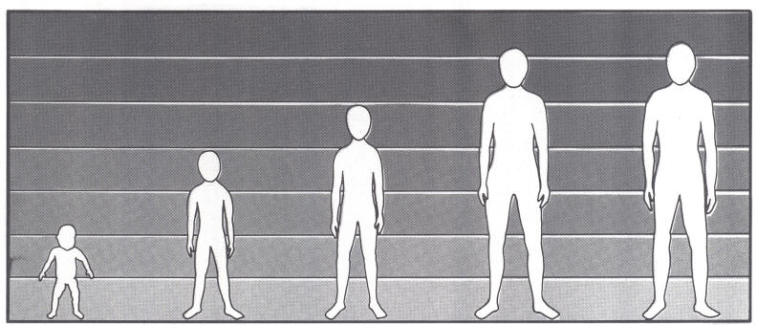
Choosing the Right Benefits
Age
Family Status
Health
Cost/Benefit

Slide 30
What does pre-tax really mean, and how can I benefit?

Slide 31
Let’s look at how Anna benefits from pre-tax.

Slide 32
The Power of Pre-Tax
Paying for, or contributing to, certain employee benefits that reduce the income on which your federal, state, local, and FICA taxes are calculated.
Different benefits have different tax treatment.
Pre-tax is:

Slide 33
Tax Treatment
Tax-Free
Paying no:
Federal
State
Local
FICA
Semi Tax-Fee
1. Paying one or more:
State/local
Social Security
Medicare tax
2. Maximum thresholds
Tax-Deferred
Paying taxes at a later date.

Slide 34
Tax Treatment
Tax-Free
Paying no:
Federal
State
Local
FICA
Premiums paid:
Health insurance plan
Long-term care
Contributions:
Health Savings Account (HSA)
Flexible Spending Arrangement (FSA) for healthcare expenses

Slide 35
HSA’s vs. FSA’s
Health Savings Accounts (HSA’s)
Employee-owned savings account to pay for out-of-pocket medical expenses
Employer must offer high-deductible health plan (HDHP)
Maximum contribution-$3,650 individual/$7,300 family*
Flexible Spending Arrangements (FSA’s)
Contribute to employer-controlled plan to pay for out-of-pocket medical expenses
Maximum contribution
$2,850*
Use it or lose it**
*Limits for 2022. HSA’s have a $1,000 catch-up provision for ages 55 and older.
**Special roll-over provisions were in place for 2020 and 2021.

Slide 36
Health insurance premiums $1,644
Out-of-pocket medical expenses $ 600
Total Tax-free Benefits: $2,264
Federal (0%) $ 0
FICA and Medicare (7.65%) $ 173
State (3.07%) $ 69
Local(1.45%) $ 33
Taxes Saved: $ 275

Slide 37
Tax Treatment
Semi Tax-Fee
1. Paying one or more:
State/local
Social Security
Medicare
2. Maximum thresholds
Contributions:
Flexible Spending Arrangement (FSA) for dependent care ($5,000)*
Benefits:
Adoption ($14,890)*
Education ($5,250)*
*Individual Limits for 2022.

Slide 38
Semi Tax-Free Example
FSA (dependent care) - Quick Calculation
Maximum contribution: $5,000
Tax rates: 12% Federal*
7% FICA
19% Total
*Federal marginal rate for illustration only. Your marginal rate may be different.
$950 SAVINGS!!

Slide 39
Tax Treatment
Tax-Deferred
Taxes are paid in the future.
Contributions:
Pension
Saving Plans:
401(k)/403(b)
Deferred comp (457)
$20,500/27,000*
*Limits for 2022/catch-up provision for 50 and older.

Slide 40
Total Tax-free Benefits: $2,264
401(k) 2% deferral $ 666
Tax-free and deferred Benefits: $2,864
Federal (0%) $ 0
Taxes Saved: $ 0
401(k) Company match $ 666
Total Retirement Savings $1,332

Slide 41
Additional Tax Benefits
Lower federal taxable wages
may increase :*
Earned Income Tax Credit
Additional Child Tax Credit
Retirement “Saver’s Credit”
*This is not meant as tax advice or guarantee. Your individual situation may be different.
TAX
CREDITS!

Slide 42
Anna’s Gross Income $33,280
Health insurance premiums ($ 1,664)
Out-of-pocket medical expenses ($ 600)
401(k) 2% deferral ($ 666)
Federal Taxable Wages $30,350
Increase in Earned Income Tax Credit $ 611

Slide 43
Feels Like Real Benefit
Taxes Saved $275 $ 275
Increase in EITC $611 $ 611
401(k) Contribution ($666) $ 666
401(k) Match $ 0 $ 666
Net Result $220 $2,217
More in Ahead of
her pocket the game

Slide 44
Anna’s Choice

Slide 45
ABC Inc. | Comparison | DEF Company
 | Annual Pay Transportation Allowance
 | Gross Compensation
 | State/Local Income Taxes FICA Taxes Health Insurance (5%) FSA Contribution 401(k) Contribution (2%)
 | Net Take Home
 | Transportation Cost Professional Dress 401(k) Match Tuition Out-of-pocket medical
 | Net Economic Comparison
$42,900
$ 0
$41,600
$ 1,200
$42,900
$42,800
($ 1,931)
($ 3,118)
($ 2,145)
$ 0
($ 858)
($ 1,872)
($ 2,977)
($ 2,080)
($ 600)
($ 832)
$34,849
$34,439
($ 3,900)
$ 0
$ 858
$ 0
($ 600)
($ 1,560)
($ 900)
$ 0
$ 3,000
$ 0
$31,207
$34,979

Slide 46
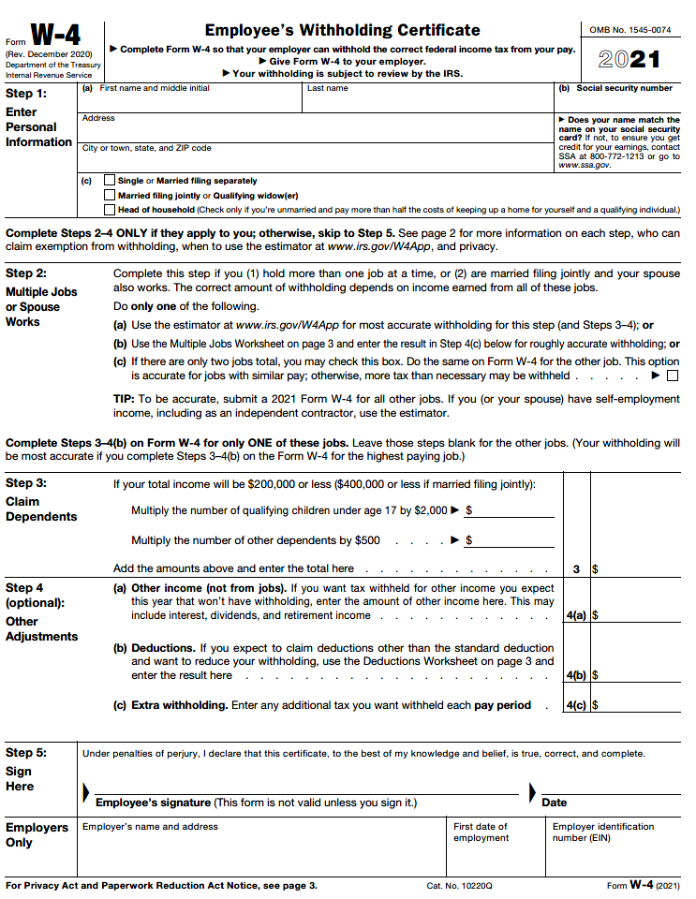
Completing the IRS Form W-4

Slide 48
Sources of Income
Understanding Pay Statements
Choosing Employee Benefits
The Power of Pre-tax
Completing the Form W-4
Before You Jump Ship
Session Recap

Slide 49
Review your pay statement
Calculate gross and net monthly income
Ask questions, compare options, and select the employee benefits that are right for you
Review your W-4 withholding allowances and adjust if necessary
Evaluate net economic benefit before accepting a new job offer

Slide 50
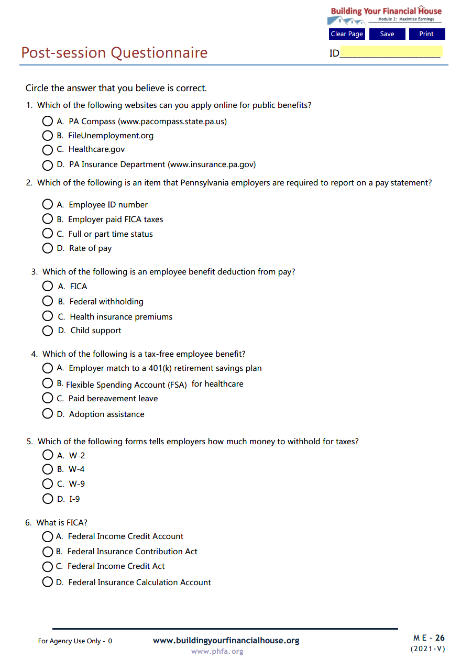
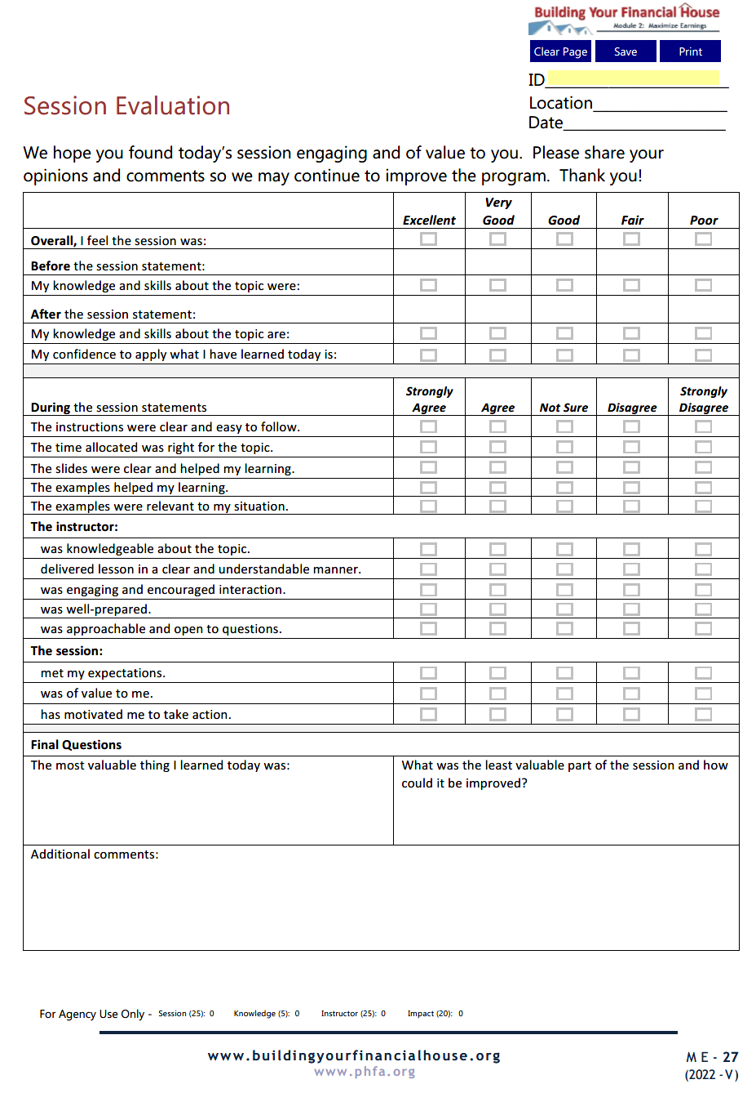
Complete Today

Slide 51
Email the Post-Session Questionnaire and the Session Evaluation to:

Slide 52
Now, it’s your turn!
Note: For best results, view in Adobe Reader DC or Nuance.

Slide 53
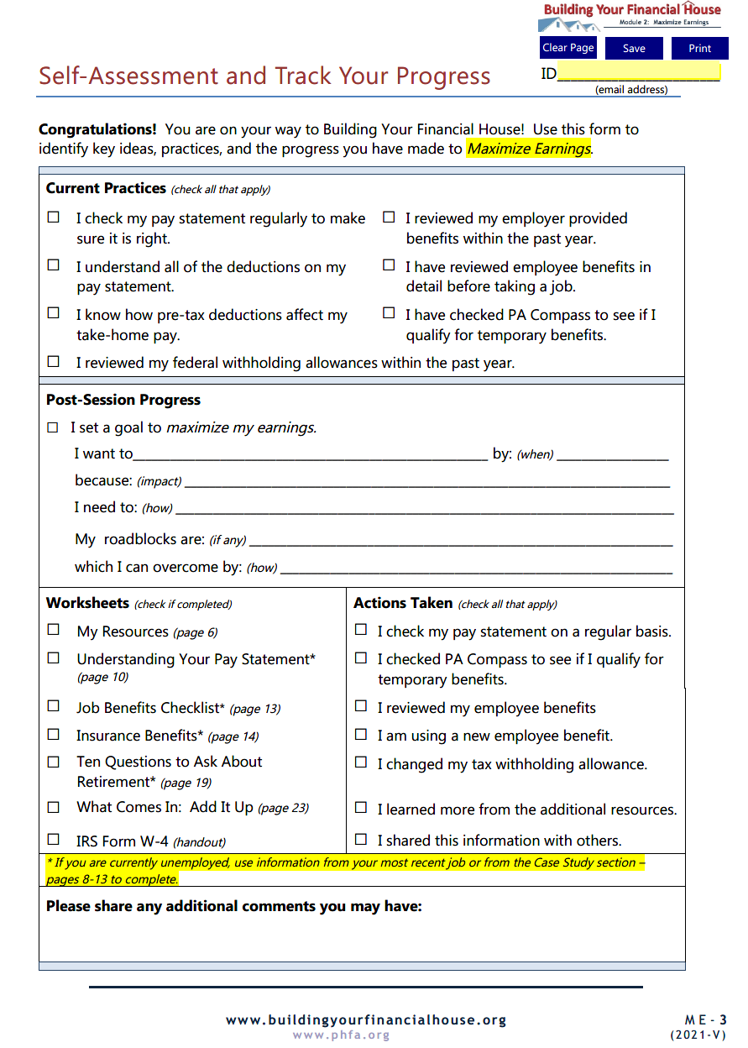
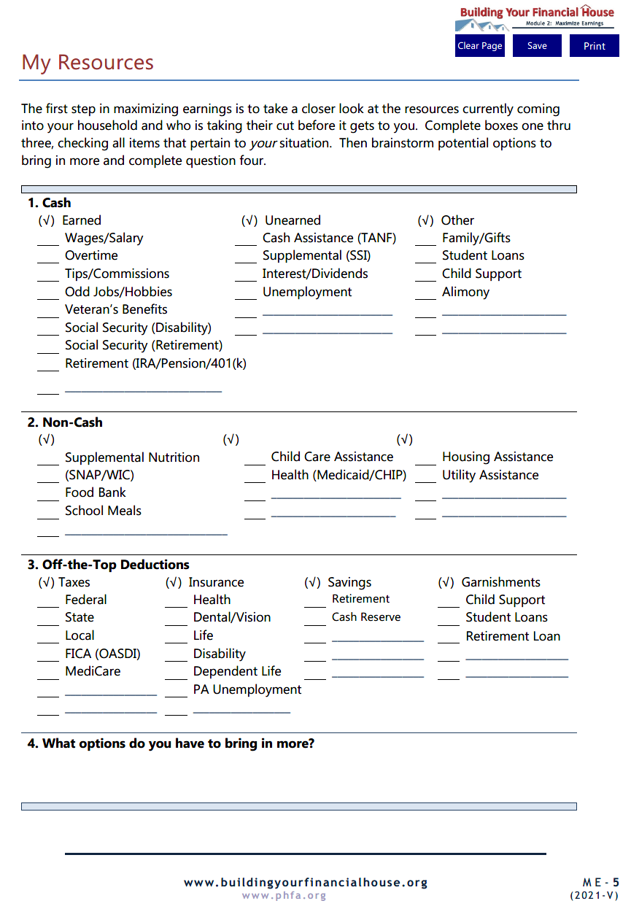
Homework

Slide 54
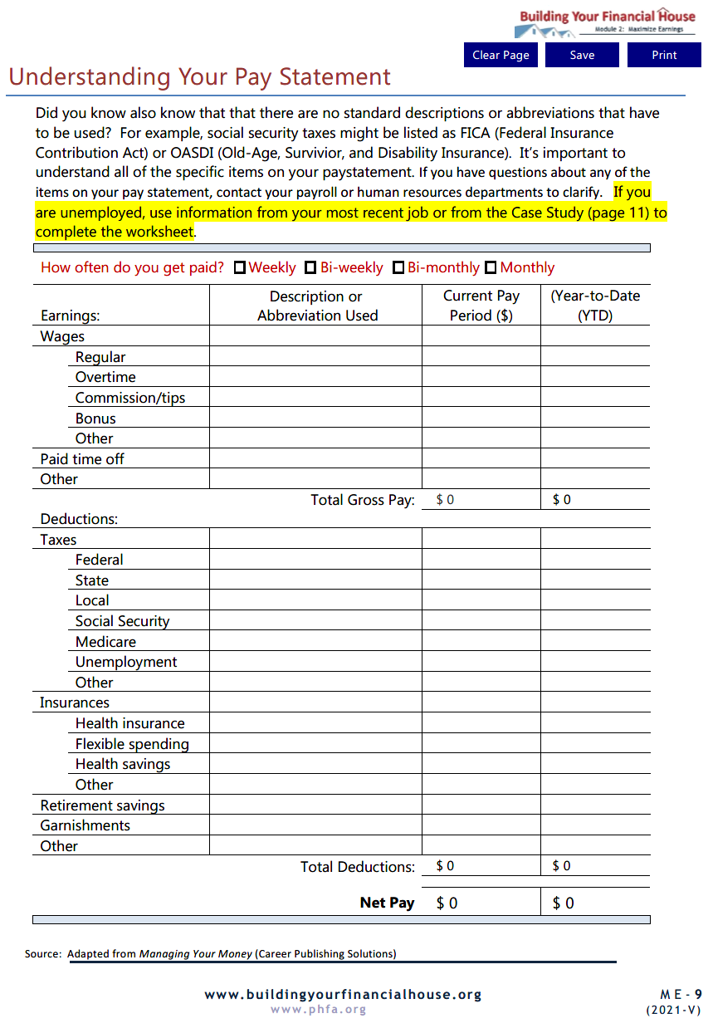
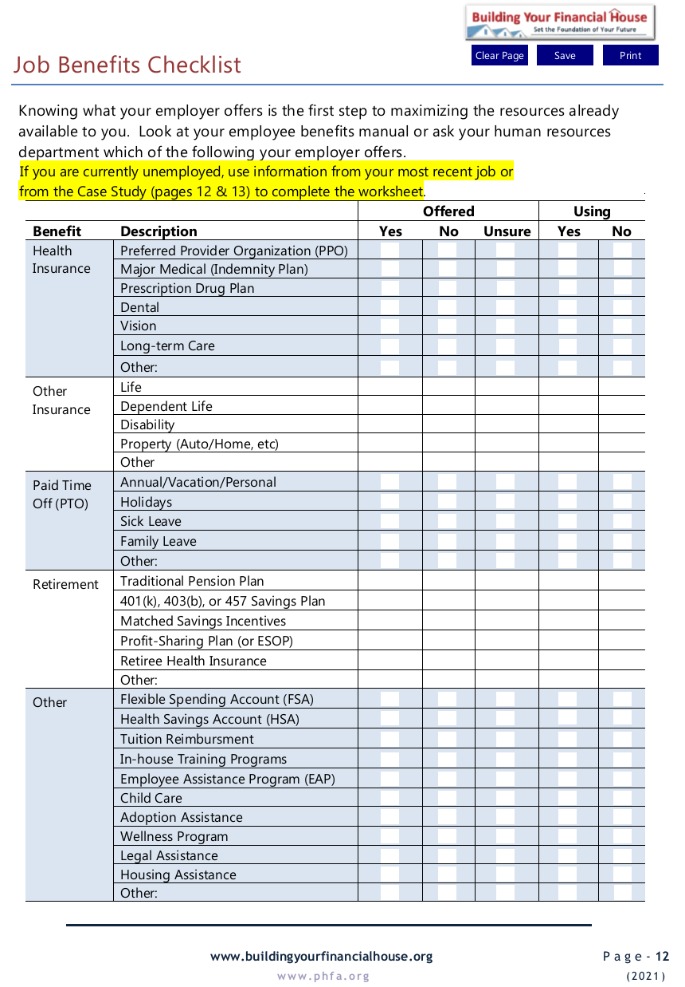

Slide 55
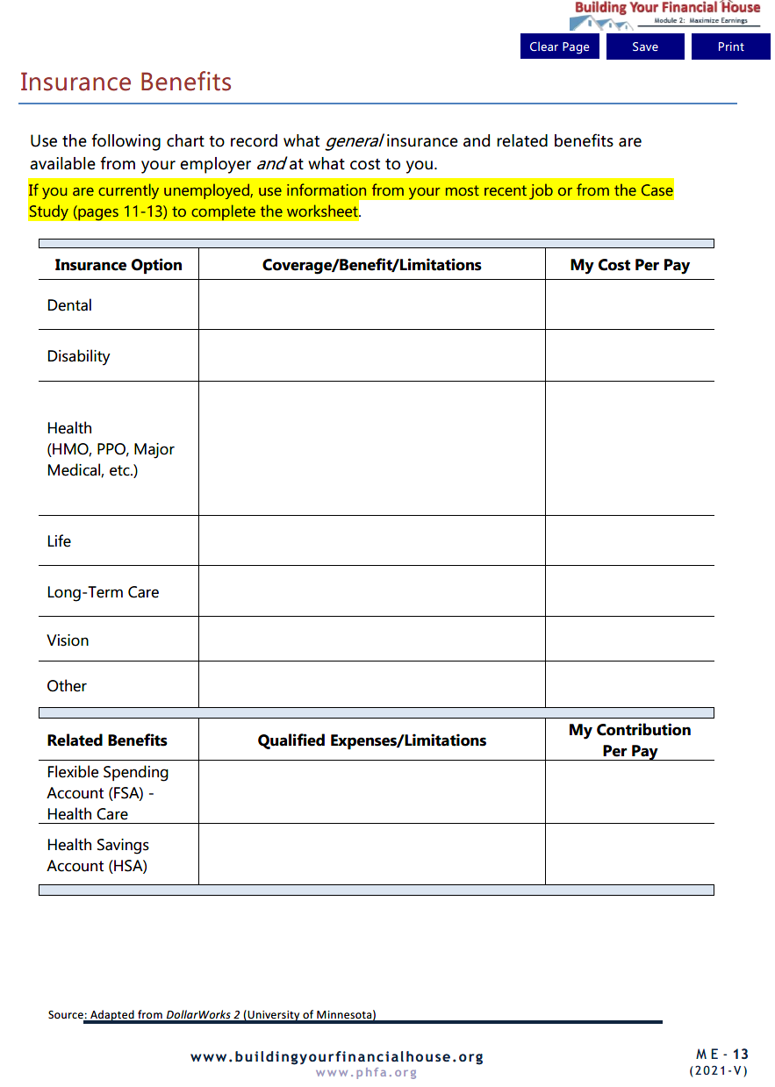
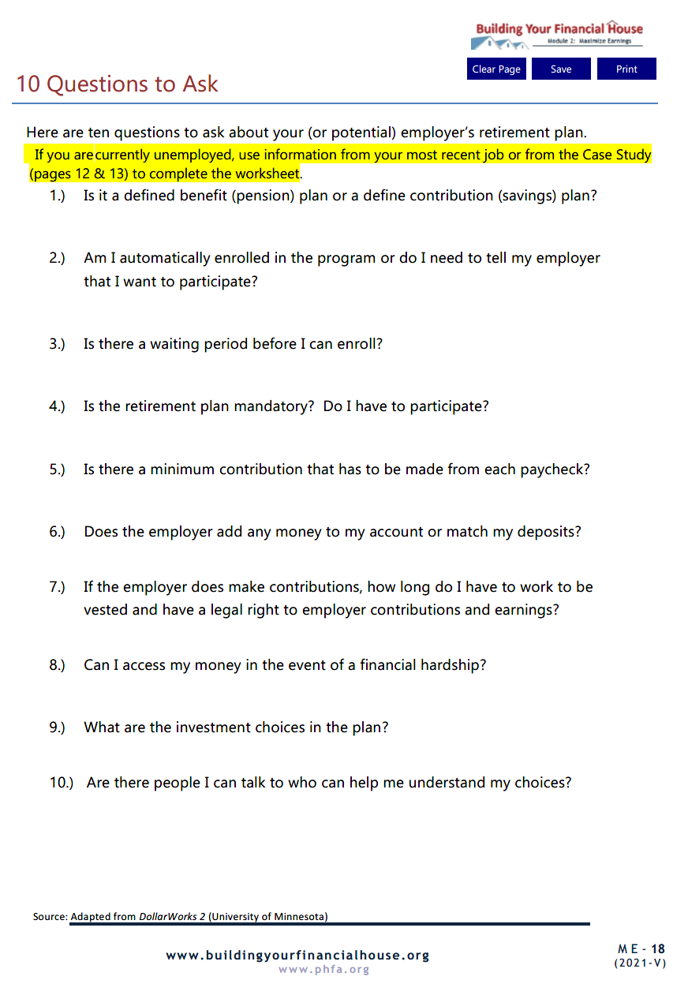

Slide 56
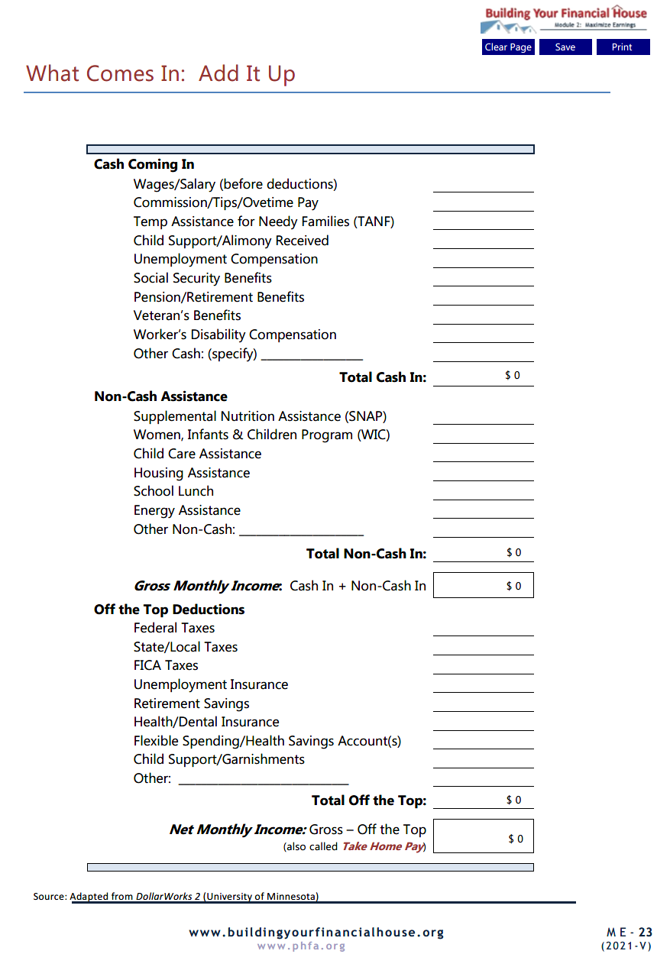
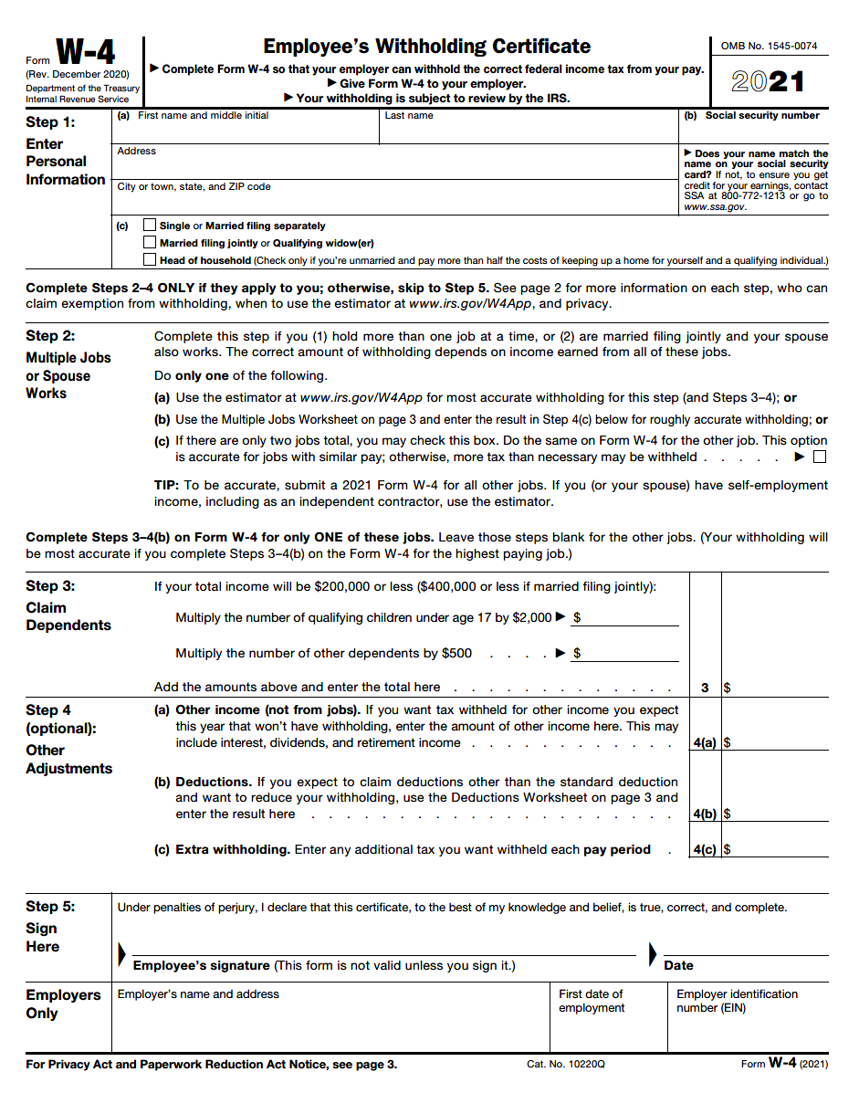

Slide 57
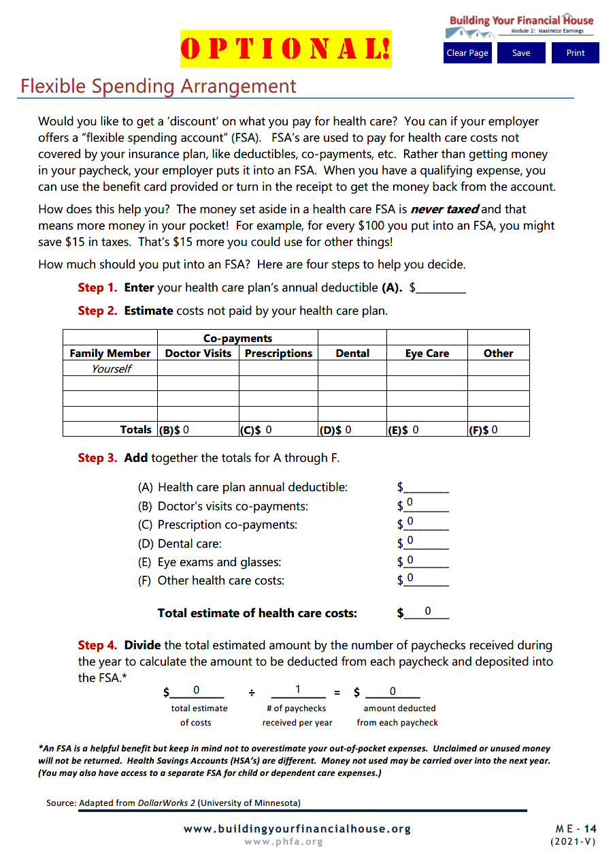
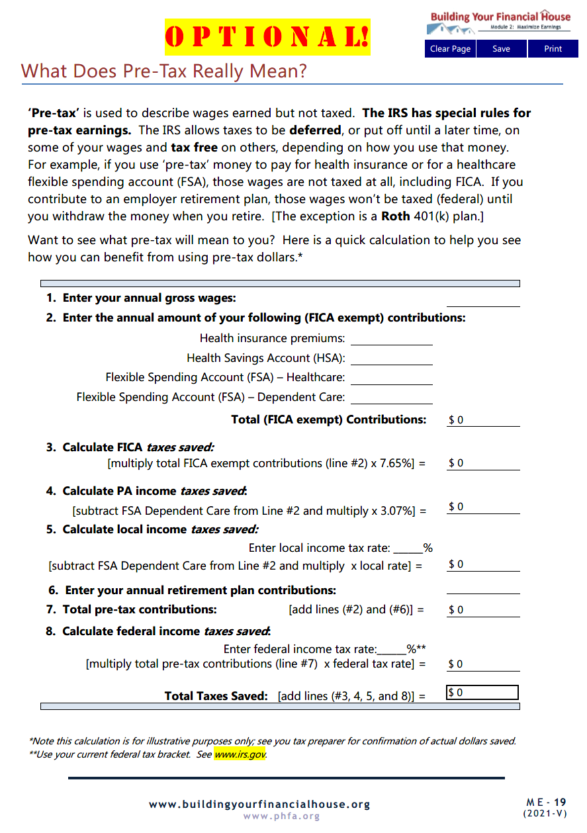
Optional!!

Slide 58
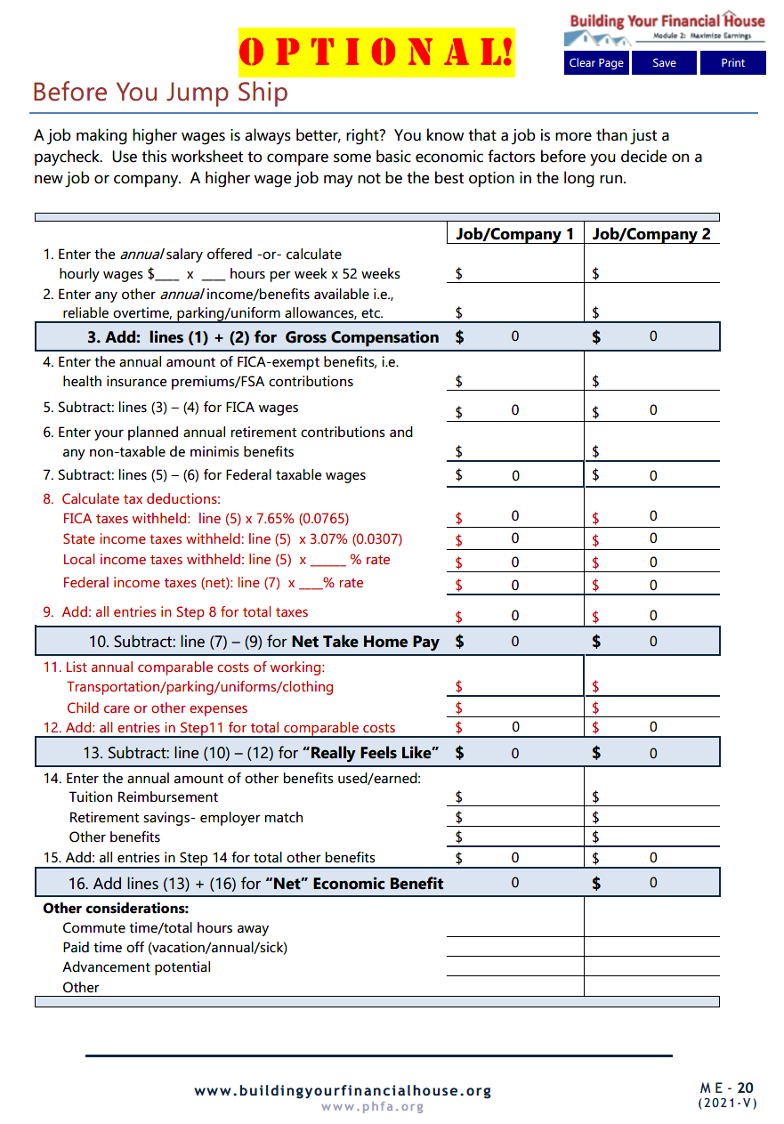
Optional!!

Slide 59
PRIOR TO NEXT SESSION,
email completed homework to:

Slide 60
Next Time:
Spend Sensibly

Slide 61
Spend Sensibly Pre-Session Questionnaire
Email Spend Sensibly Pre-Session Questionnaire to:

Slide 62
Questions?

Slide 63
Thank You!

