Slide 2
Building Your Financial House
WELCOME
Notes:
Good afternoon everyone!
Thank you for joining us as we discuss Creating a Financial Resource Center on-site, at you development or agency.
We hope this presentation will help you bring vetted, unbiased financial education resources to your residents or clients that they can use right now.
So let’s get started.

Slide 3
Housekeeping
Please mute your phone or computer to eliminate background noise.
To maximize bandwidth:
(Turn camera off)
Close unused apps or webpages
Please raise hand or use chat feature for questions.
Notes:
Good afternoon everyone!
Thank you for joining us as we discuss Creating a Financial Resource Center on-site, at you development or agency.
We hope this presentation will help you bring vetted, unbiased financial education resources to your residents or clients that they can use right now.
So let’s get started.

Slide 4
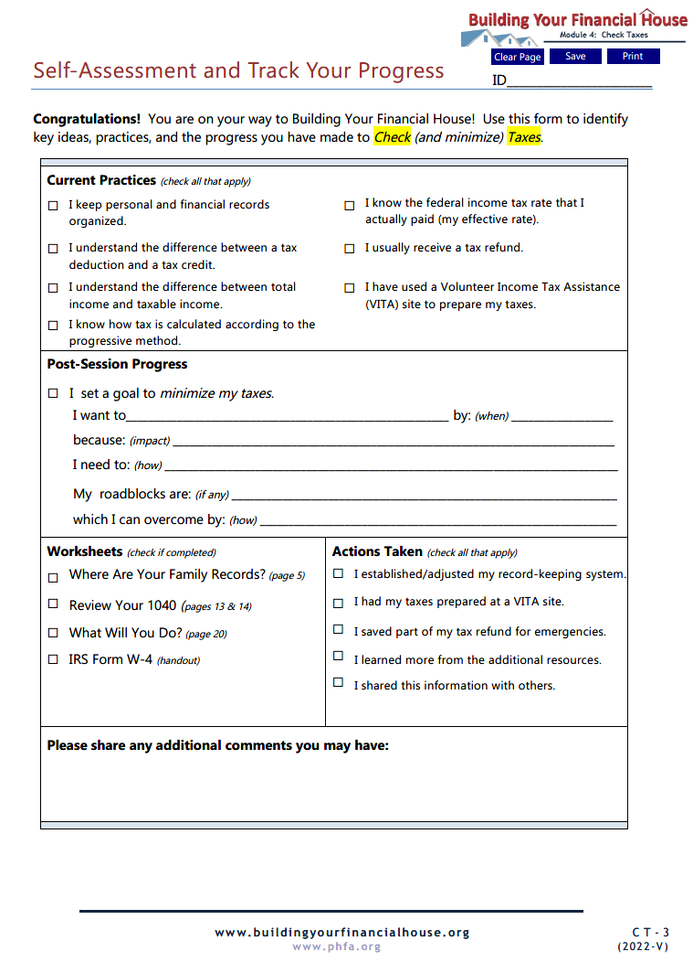
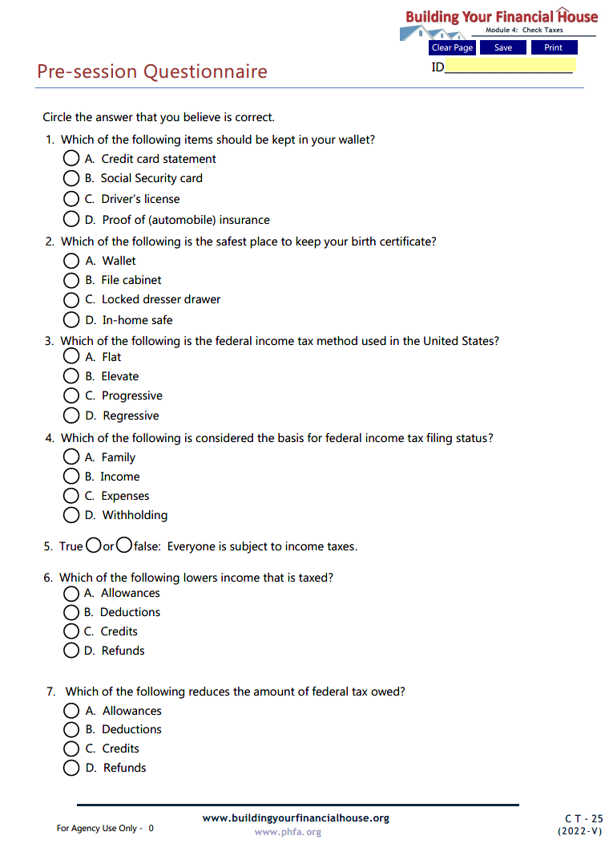
Prior to Today’s Session

Slide 5
Today’s Topics
Who, What and When of Taxes
The Progressive Tax System
Reviewing Your 1040
Refunds and Withholding
Tax Preparers
Notes:
Today we’re going to talk about:
Money values and setting financial goals
Creating a Money Map
Making good financial choices
Knowing how your cash flows

Slide 6
6
Protect Your Potential
5
Make Money Work
4
Check Taxes
3
Spend Sensibly
7
Borrow to Grow
2
Maximize Earnings
1
Invest in Yourself

Slide 7
4
Check Taxes
Checking the insulation can minimize a house’s hidden heat loss, just as checking taxes can minimize dollars lost to overlooked deductions and credits

Slide 8
Recognize the value in record keeping
Identify the key components of a tax return
Recognize the difference between total income and taxable income
Recognize the difference between total tax and withholding
Identify the various tax preparation methods and providers

Slide 9
How is your record keeping?

Slide 10
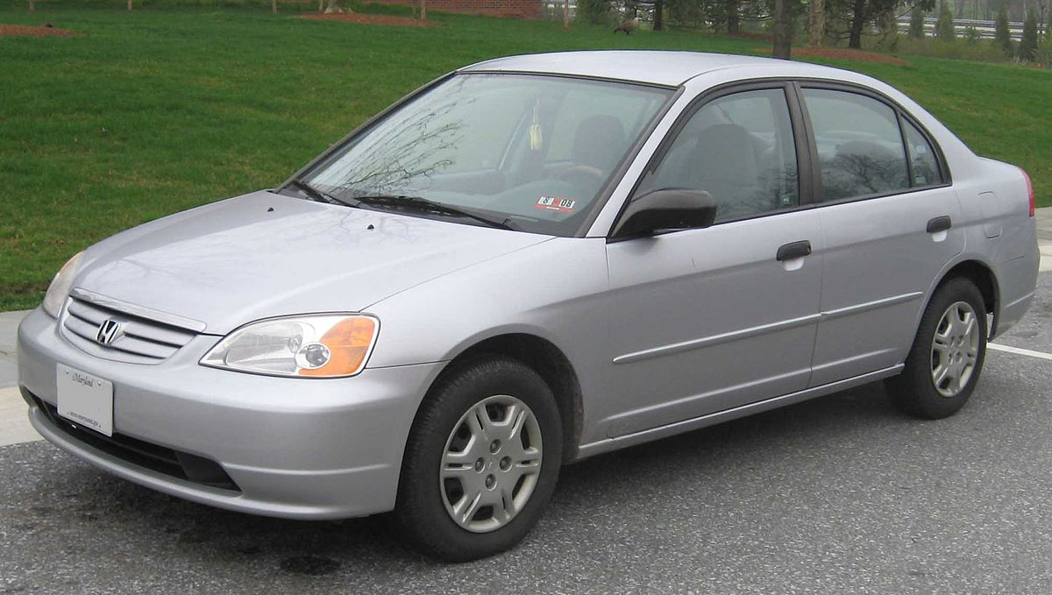
Record Keeping
You’re buying a new car and want to trade in your old car.
Can you locate the title?

Slide 11
Record Keeping
The big-screen TV you bought last month isn’t working.
Do you have the receipt and warrantee?

Slide 12
Record Keeping
Someone broke into your apartment while you were at work.
Do you have a list and pictures of the household items that were stolen?

Slide 13
What to Keep
FINANCIAL
LEGAL
VITAL
PROPERTY
PERSONAL

Slide 14
Where to Keep
ON OUR PERSON
FILE CABINET
HOME SAFE
SAFE DEPOSIT BOX

Slide 15
Why
ALL INCLUSIVE
PROVIDES PROOF
SAVES MONEY
LESS STRESS

Slide 16
Final Record Keeping Thought
Add a discard date!

Slide 17
Chat Box
What comes to mind when you hear the word taxes?

Slide 19
Who, What and When
EVERYONE
WHO
INCOME
PAY-AS-YOU-GO
WHAT
WHEN

Slide 20
To Tax or Not to Tax?
Wages
Cash gifts
Stolen property
Debt forgiven
Child support
Life insurance
Cash assistance
Hobbies
Non-cash gifts
SSI
Unemployment
Bribes
Social Security
Cash prizes
Medical assistance
Military pension

Slide 21
To Tax or Not to Tax?
Wages
Hobbies
Military pension
Unemployment
Debt forgiven
Bribes
Stolen property
Cash prizes
Social Security

Slide 22
To Tax or Not to Tax?
Child support
Cash assistance
Medical assistance
SSI
Life insurance
Cash gifts
Non-cash gifts

Slide 23
What does progressive tax mean?

Slide 24
The more you earn, the higher the rate.
There are income tax “brackets” with increasingly higher rates.
Progressive
tax is:

Slide 25
Progressive Tax
$50,000
$100,000
$150,000
$0 - $25,000
10%
$25,001 - $50,000
15%
$7,500
$50,001 - $100,000
25%
$25,000
$100,001 - $150,000
30%
$45,000
These tiers are for illustrative purposes only. Go to: IRS.gov for the current tiers.

Slide 26
Progressive Tax - Example
$50,000
$100,000
$150,000
$0 - $25,000
10%
$2,500
$2,500
$2,500
$25,001 - $50,000
15%
$3,750
$3,750
$3,750
$50,001 - $100,000
25%
$12,500
$12,500
$100,001 - $150,000
30%
$15,000
Actual:
$6,250
$18,750
$33,750
Effective rate:
12.5%
18.8%
22.5%
Estimated:
$7,500
$25,000
$45,000
These tiers are for illustrative purposes only. Go to: IRS.gov for the current tiers.

Slide 27
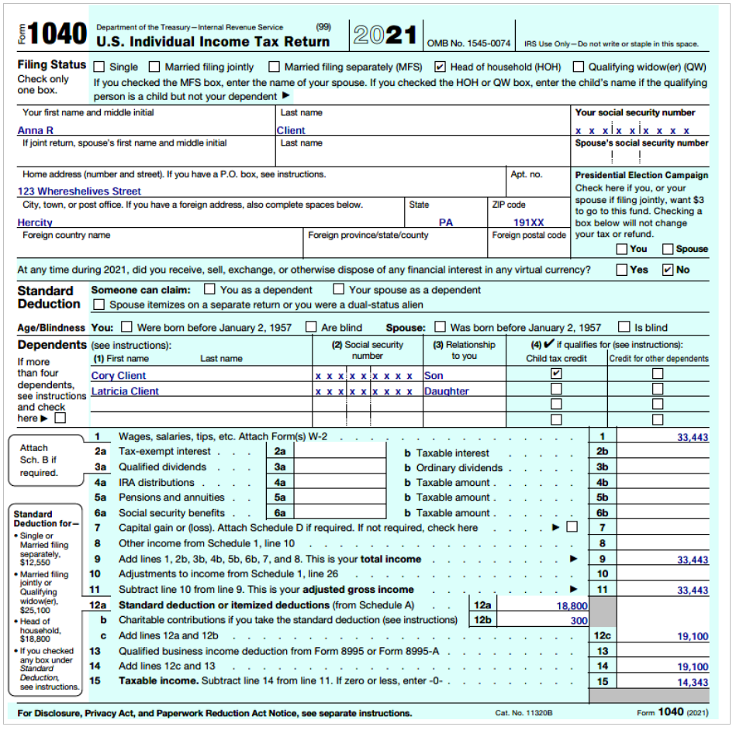
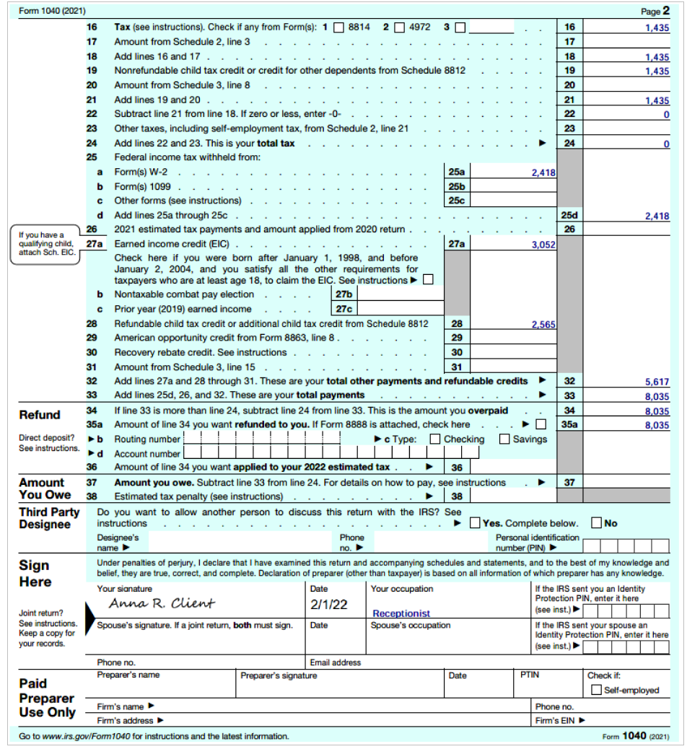
IRS Form 1040 – The Year End Resolution

Slide 28
Anna’s Taxes

Slide 29
Anna’s Taxes

Slide 30
The Process
Filing Status
Filing status – is essentially family status that affects deductions, credits, tax brackets, etc.
Single
Married (filing jointly or separately)
Qualified widow (dependent child)
Income
Adjustments
Deductions
Dependents - everyone that is being supported by the reported income.
Children (minor/adult)
Parents
Other relatives
Others
Credits
Total Payments
Net Result

Slide 31
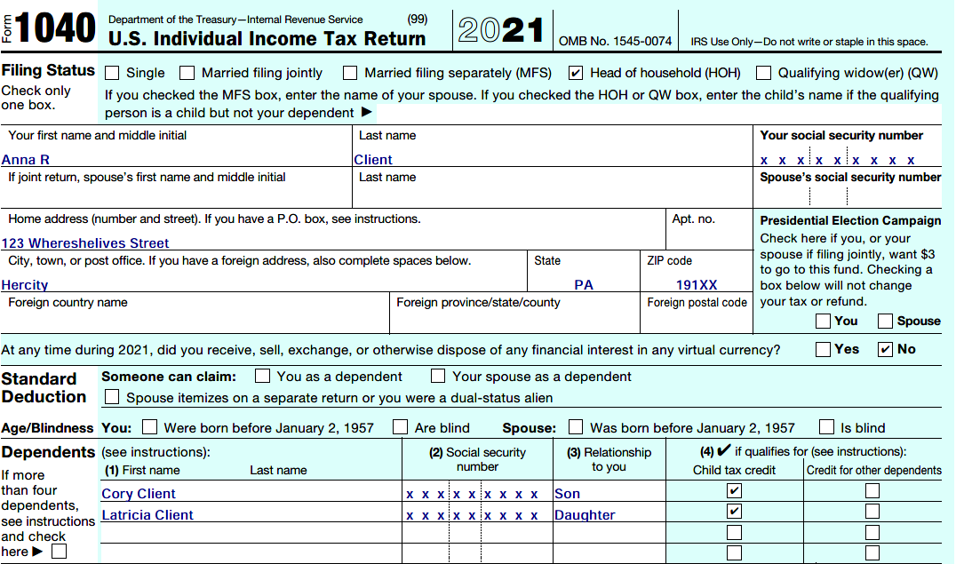
Anna’s Filing Status

Slide 32
Income
Filing Status
W-2’s
Wages
Tips
Bonuses
Income
1099’s
Interest/dividends
Capital gains
Retirement/Social Security
Unemployment
Debt forgiven
Schedule 1
Self-employment
Capital gains
Rental property

Slide 33
Raise Hand
Income

Slide 34
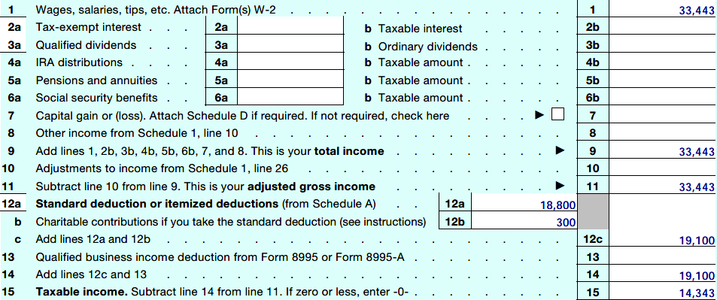
Anna’s Income

Slide 35
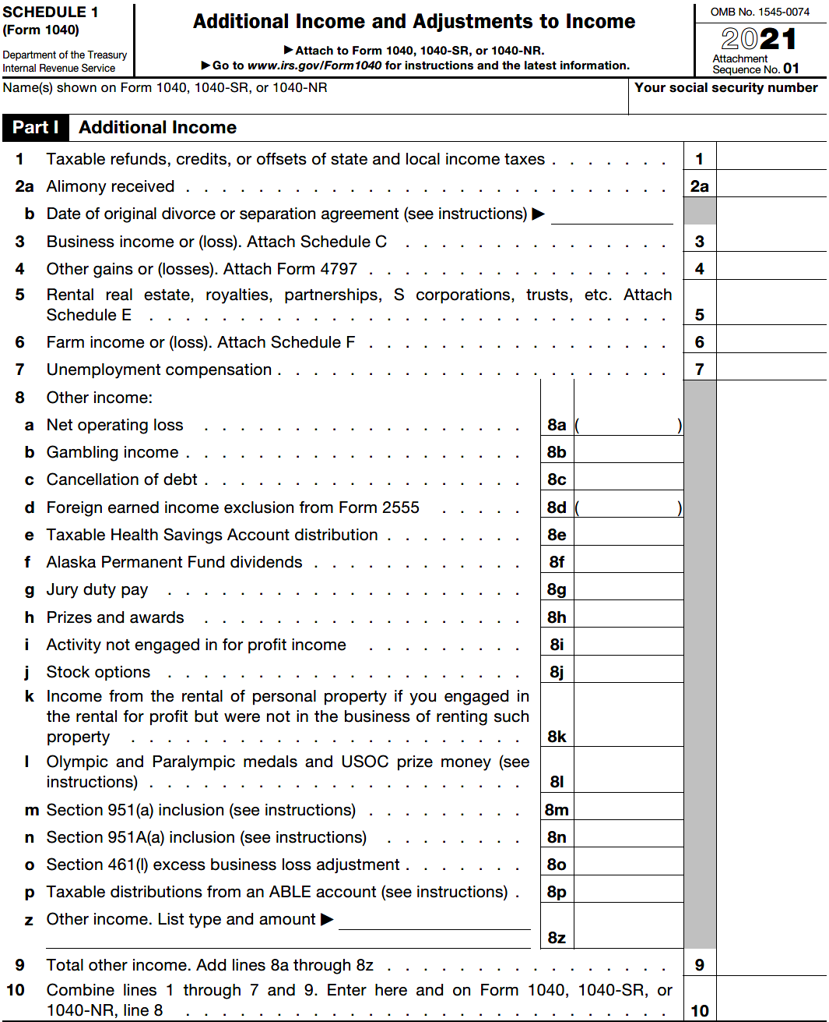
Side Bar: Schedule 1 – Additional Income

Slide 36
Adjustments
Filing Status
Adjustments – are certain expenses that are encouraged and allowed to reduce income.
Income
Adjustments
IRA contributions (traditional)
Tuition and student loan interest
Teacher’s out-of-pocket expenses
Certain self-employment expenses
Alimony paid

Slide 37
Raise Hand
Adjustments

Slide 38
Anna’s Adjusted Gross Income

Slide 39
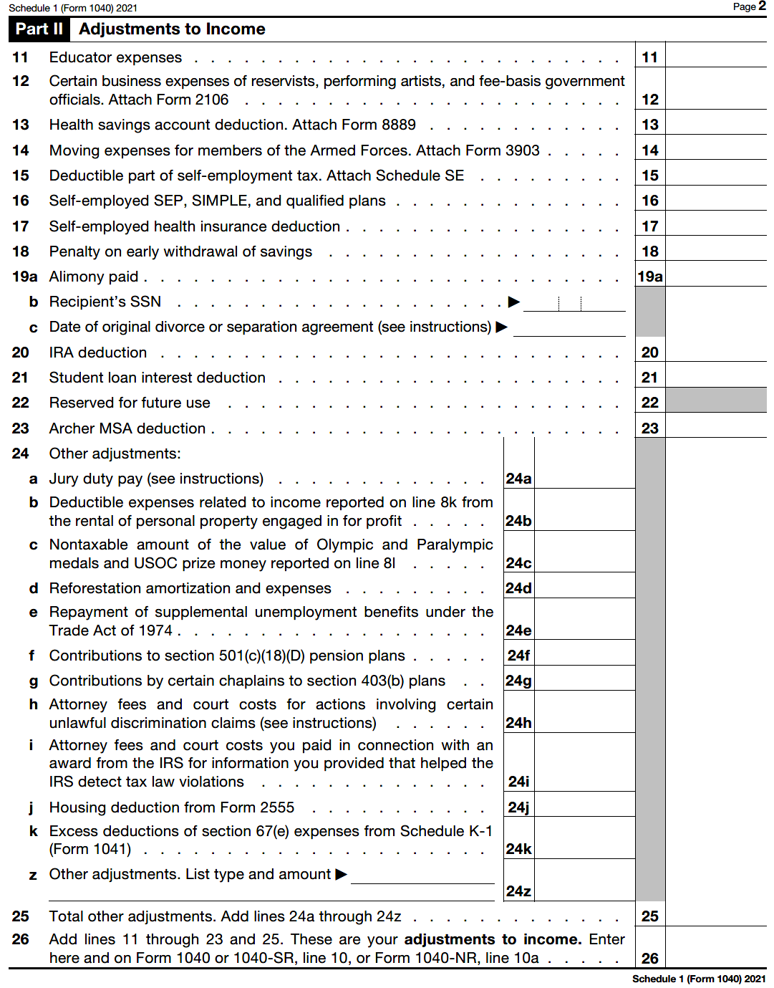
Side Bar: Schedule 1 – Adjustments to Income

Slide 40
Adjusted Gross Income
Filing Status
Adjusted Gross Income (AGI)- is used for certain tax calculations including deduction and credit limitations.
Income
Adjustments
AGI
Total Income – Adjustments

Slide 41
Deductions
Filing Status
Deductions – are more expenses allowed to reduce income. You may itemize (list and add) or use a standard amount if you don’t have (or have enough) of these expenses.
Income
Adjustments
For 2021, you may use the greater of:
Deductions
Itemized
Medical expenses (over 7.5% of AGI)
Taxes paid (state/local income, real estate, etc. to a maximum of $10,000
Interest paid (mortgage or investment loan)
Gifts to charity (up to 60% of AGI)
Casualty losses (only if from a federally declared disaster area)
Standard
$12,550 for Single or Married, filing separately
$25,100 for Married, filing jointly or Qualifying Widow(er)
$18,800 for Head of Household
Charitable deductions ($300 maximum with standard deduction)

Slide 42
Raise Hand
Deductions

Slide 43
Anna’s Deductions

Slide 44
Taxable Income
Filing Status
Income
Total Income
Less: Adjustments (AGI)
Less: Deductions
Taxable Income
Adjustments
Deductions

Slide 45
Anna’s Taxable Income

Slide 46
Compare
Taxable Income ÷ Total Income x 100 =
% of income actually subject to federal income tax!!
For Anna:
$14,343 ÷ $33,443 x 100 = 43%

Slide 47
Tax by Filing Status (2021)
Single, and
Married, filing separately
Married, filing jointly and Qualifying Widow(er)
Head of Household
Rate
10% 0 to $ 9,995 0 to $ 19,900 0 to $ 14,200
12% to $ 40,525 to $ 81,050 to $ 54,200
22% to $ 86,375 to $172,750 to $ 86,350
24% to $164,925 to $329,850 to $164,900
32% to $209,425 to $418,850 to $209,400
There are two more tiers: 35% and 37%

Slide 48
Raise Hand
Taxes

Slide 49
Anna’s Tax

Slide 50
Anna’s Tax

Slide 51
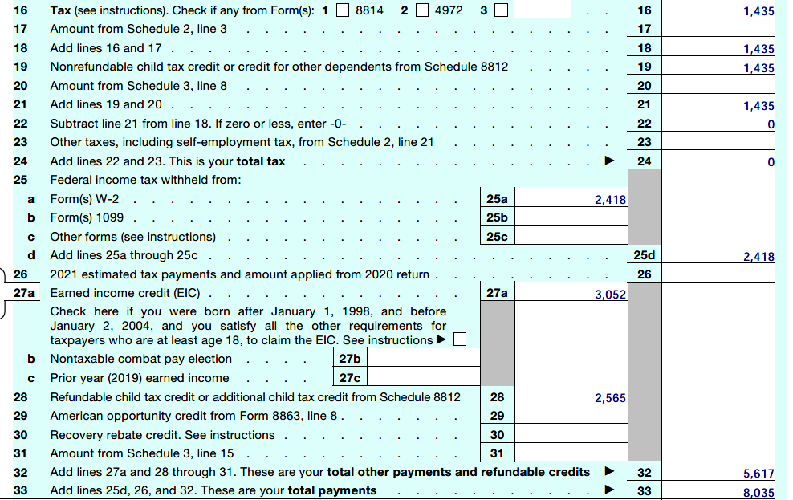
Anna’s Tax

Slide 52
Credits
Filing Status
Credits – are dollar for dollar reduction in calculated tax owed from certain expenses paid, savings and dependents.
Income
Adjustments
Child(ren) under 17
Child and dependent care expenses
Retirement savings
Education expenses
Energy efficiency repairs
Foreign taxes paid
Deductions
Credits

Slide 53
Raise Hand
Credits

Slide 54
Anna’s Credits

Slide 55
Wait, One More Chance to Tax!
Filing Status
Other Taxes:
Income
Self-employment (note: gig economy)
Credit repayments
Penalties for early withdrawal of retirement savings (10%) or not taking the required minimum distribution (50%)
Alternative minimum tax
Adjustments
Deductions
Credits
Tax – Credits + Other Taxes =
Total Tax
or
Net Tax Liability

Slide 56
Anna’s Total Tax or Net Tax Liability

Slide 57
Total Payments
Filing Status
During the Year – pay as you go towards total tax liability.
Withholding from wages
Estimated quarterly payments
Prior year refund applied to current year
Income
Adjustments
Deductions
Refundable Credits – that “act” like payments made during the year.
Earned income tax credit
Additional child tax credit
American Opportunity (Hope) education credit
Credits
Total Payments

Slide 58
Raise Hand
RefundableCredits

Slide 59
Anna’s Total Payments

Slide 60
Net Result
Filing Status
Net result – is the final resolution between tax liability and payments.
Total Tax – Total Payments
Income
Adjustments
Deductions
If a negative number, meaning more was paid than owed, a refund is due.
If a positive number, meaning less was paid than owed, a payment is due.
Credits
Total Payments
Net Result

Slide 61
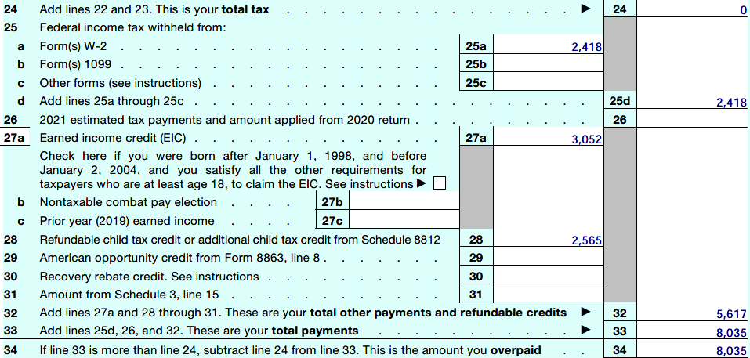
Anna’s Net Result

Slide 62
Total Tax vs. Withholding
Refund
Payment Due
Net withholding* ÷ Pay periods
$$’s that could be back in each paycheck instead of waiting for filing at year end!
Payment due ÷ Pay periods
$$’s that could be withheld from each paycheck instead of writing a check at filing!
*Net withholding = Withholding – Total Tax

Slide 63
Anna’s Over Withholding
Refund
Refund
Net withholding* ÷ Pay periods
$$’s that could be back in each paycheck instead of waiting for filing at year end!
$2,418 - 0 ÷ 24 =
$101 extra in her paycheck
*Net withholding = Withholding – Total Tax

Slide 64
How can I change this for next year?

Slide 65
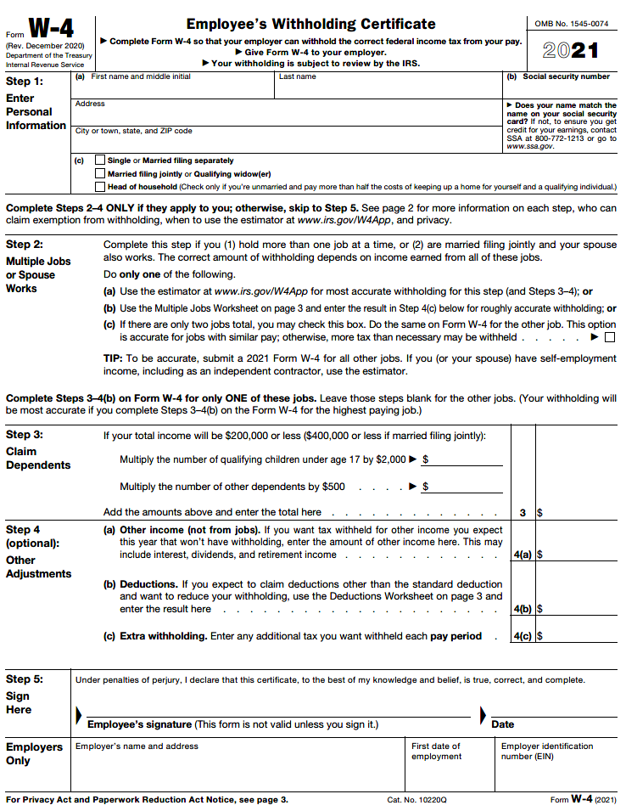
https://www.irs.gov/individuals/tax-withholding-estimator

Slide 66
Refund Recipe
Any Way You Want!
10%
Later
Now
30%
60%

Slide 67
Anna’s Refund
Any Way – 29%
How much? $2,905
For what?
New computer: $1,100
New TV $ 885
New cell $ 520
Kids to spend $ 400
10%
Later – 31%
Now – 40%
30%
60%
How much? $3,070
For what?
Rent reserve $1,000
Car insurance $ 870
Savings bonds $ 500
Back-to-school $ 400
Holiday set-aside$ 300
How much? $4,025
For what?
Credit card: $1,100
Tithe: $1,020
Bank fees: $ 165
Cable/internet: $ 240
Clothes (Anna) $ 600
Clothes (kids) $ 400
Noodles!! $ 500

Slide 68
Tax Preparers
www.irs.gov/freefile
Free, online fillable forms and filing (federal only) for everyone
Free for those making less than $72,000 through IRS-sponsored software programs
For purchase
Commercial software,
Step-by-step
Inexpensive
Yourself!

Slide 69
Tax Preparers
Volunteer Income Tax Assistance (VITA) – free for:
People making $57,000 or less
People with disabilities
Limited English-speaking taxpayers
Tax Counseling for the Elderly (TCE) – free for those 60 and older
https://irs.treasury.gov/freetaxprep/
Free assistance!*
*VITA and TCE tax prepares are IRS trained volunteers.

Slide 70
Tax Preparers
Enrolled Agents
www.naea.org
Federally licensed tax professionals
Can represent clients before IRS
Cost vary with services
Certified Public Accountants:
www.picpa.org
Licensed by the state board of accountancy
Can represent clients before IRS
Expensive/varies with services
Uncredentialled:
Must have PTIN#
Continuing education for tax year
Buyer beware
Paid preparer$

Slide 71
Tax Preparers
Franchises/chains
Independently owned-operated
Preparers trained through franchise tax courses
Convenient locations, targeting struggling consumers
Expensive cost/benefit
Refund anticipation products
Chains

Slide 73
Who, What and When of Taxes
The Progressive Tax System
Reviewing Your 1040
Refunds and Withholding
Tax Preparers
Recap
Notes:
Today we’re going to talk about:
Money values and setting financial goals
Creating a Money Map
Making good financial choices
Knowing how your cash flows

Slide 74
Establish a manageable record keeping system
Identify credits and deductions overlooked or that may now apply to your situation
Weigh the pros and cons of tax refunds and make adjustments to withholding if appropriate
Select the appropriate tax preparer for your situation and avoid unnecessary fees

Slide 75
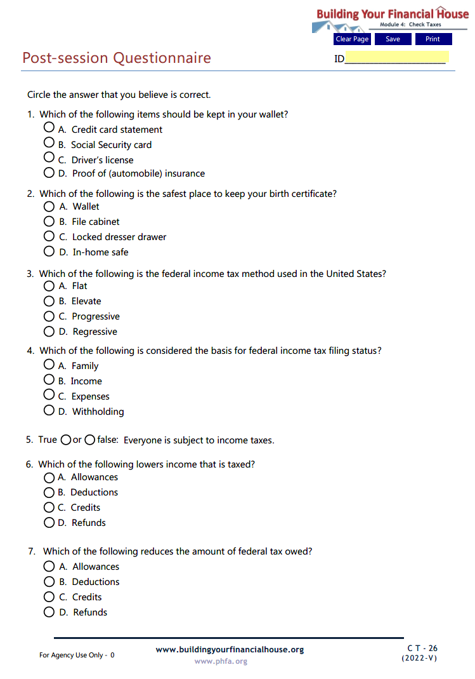
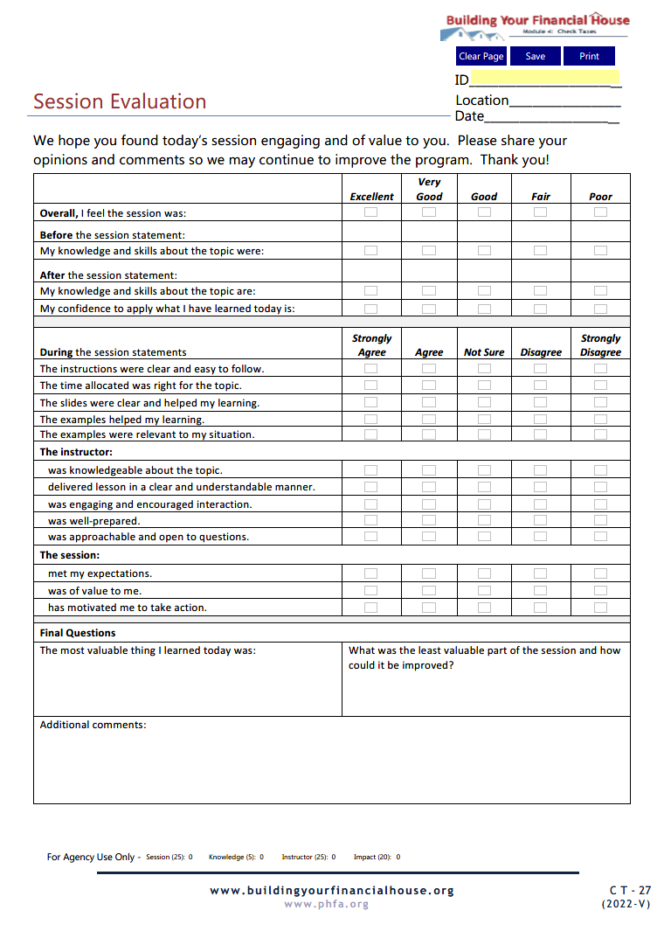
Complete Today

Slide 76
Email the Post-Session Questionnaire and the Session Evaluation to:

Slide 77
Now, it’s your turn!
Note: For best results, view in Adobe Reader DC or Nuance.

Slide 78
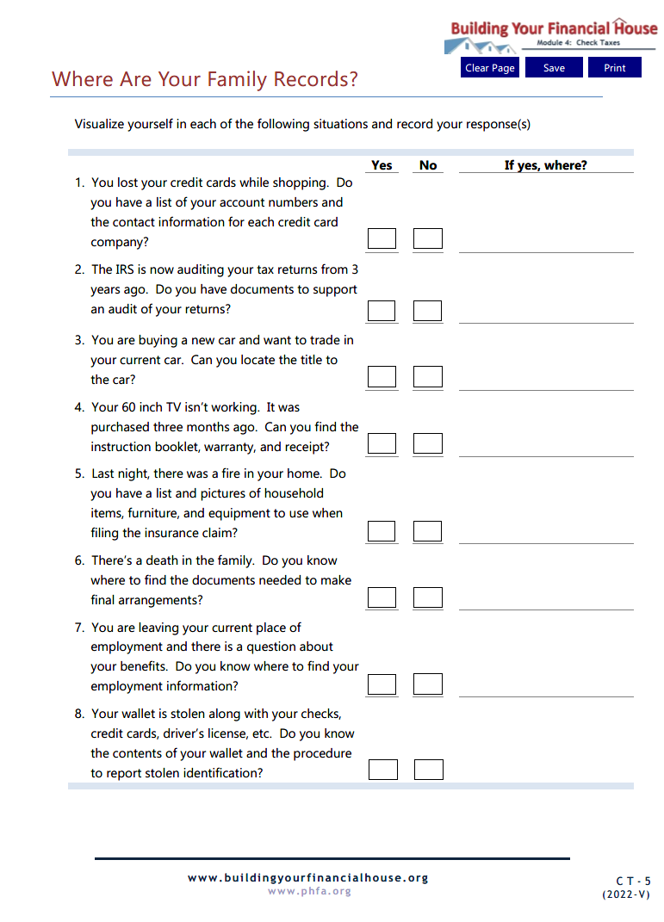
Homework

Slide 79
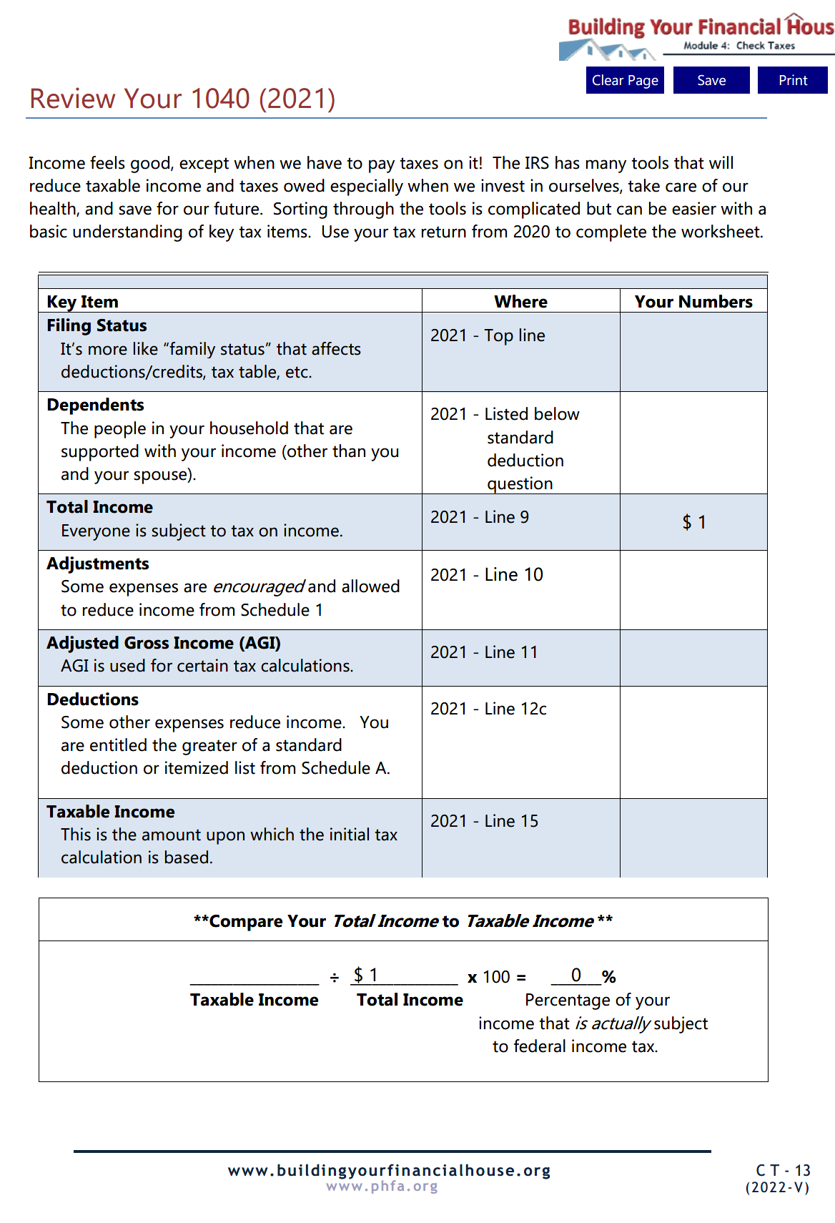
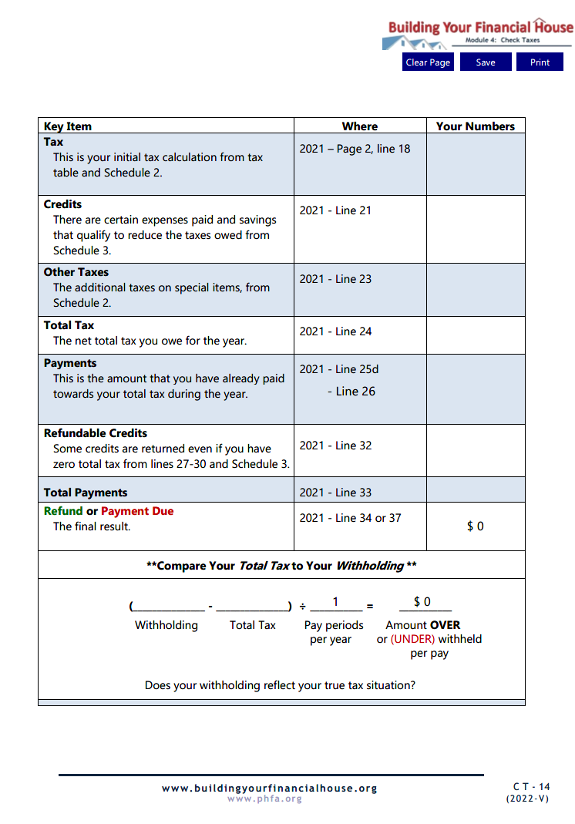

Slide 80
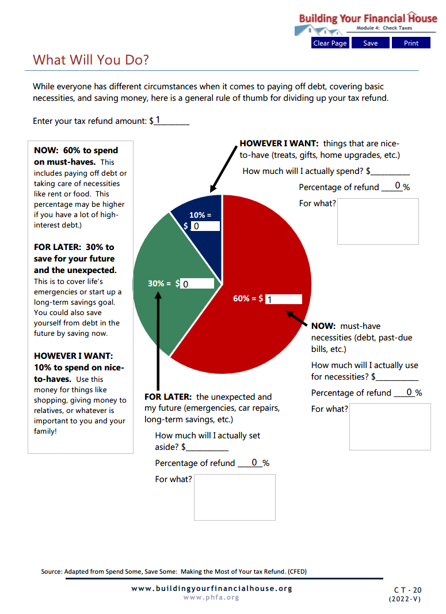

Slide 81
PRIOR TO NEXT SESSION,
email completed homework to:

Slide 82
Next Time:
Make Money Work

Slide 83
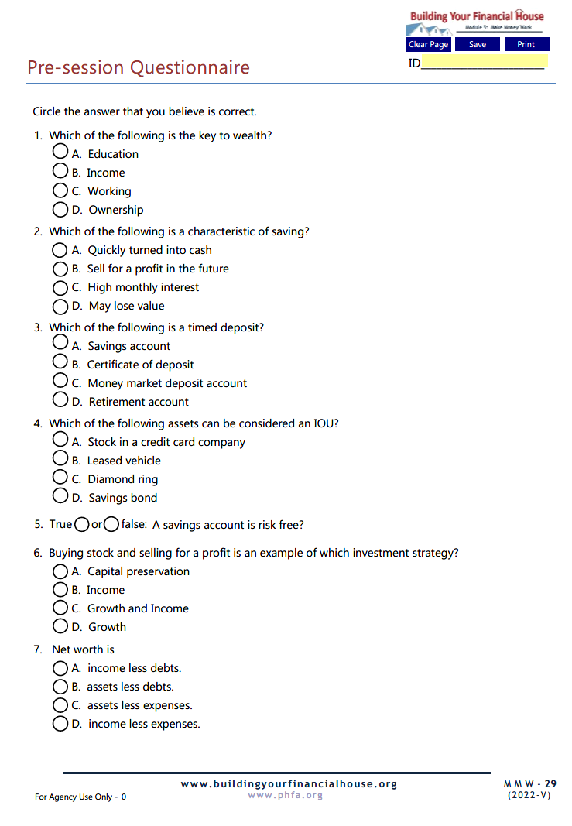
Make Money Work Pre-Session Questionnaire
Email Spend Sensibly Pre-Session Questionnaire to:

Slide 84
Questions?

Slide 85
Thank You!

